Slide 1
Summit Cooling and Environmental Control
Jeff Barr
Project Architect
Oscar Nuñez
Facility Technical Coordinator
German Schumacher
Software Engineering Lead
LSST 2017 Project & Community Workshop
August 15, 2017

Slide 2
Cooling Ventilation Air Conditioning (CVAC)
CVAC provides the cooling capacity to condition enclosure temperature during daytime cycle, to extract heat from mirrors cells and other heat sources, and to condition/ventilate the enclosed areas of the Service Building
Installation schedule included in Summit Construction Contract Program (Gantt Chart):
  Process includes purchasing, fabrication & integration of all equipment.
  Masterclima – subcontractor to Besalco – will complete work in October
Verification and Acceptance Process,
  According to Specifications in the Contract and Document 17368
  Masterclima is reportedly developing a plan for appropriate testing which they will submit to us for review
  We need to proactively provide them with input on the critical testing and verification we will require for CVAC equipment and its control

Slide 3
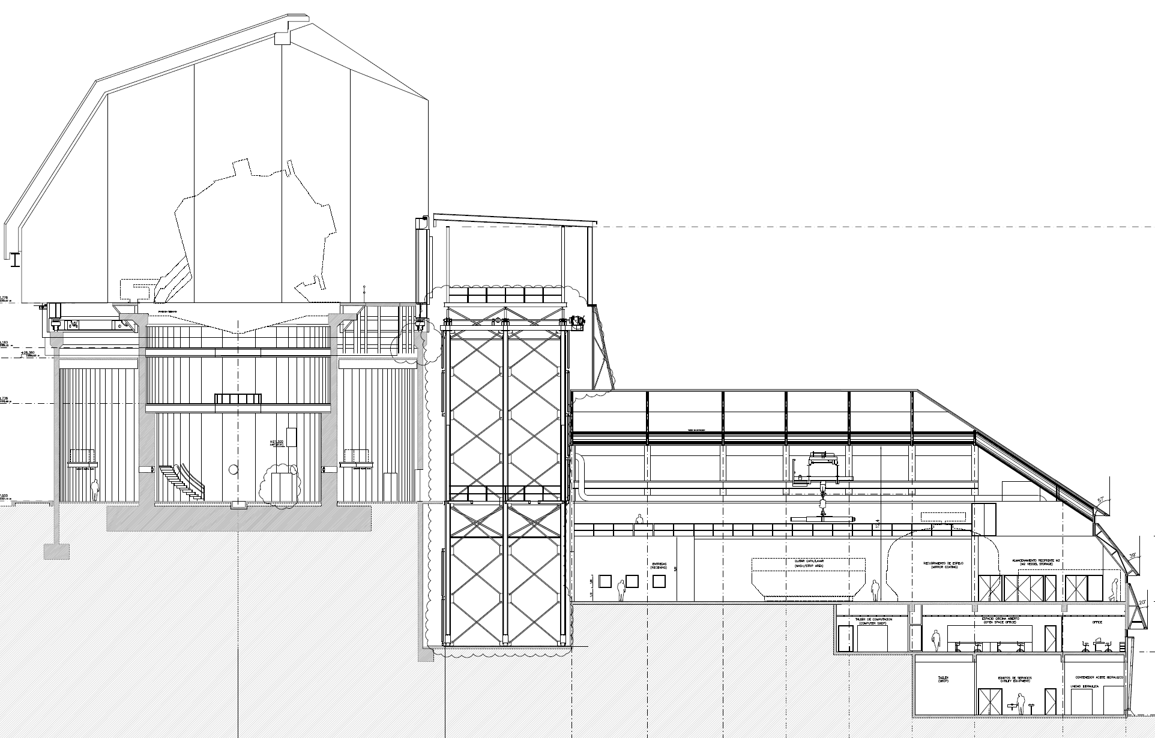

Summit Facility Environmental Control Zoning
30 m diameter
Inside Telescope Enclosure:
Daytime – Active Air Conditioning
(to nighttime startup temp.)
Nighttime – Natural Ventilation
(w/ supplemental active downdraft)
37.8 m
Lift Shaft – Ambient Ventilation
56 m length (x 24m width)
Service Building – Particulate Controlled Ambient Temperature (w/ minimal conditioning)
platform lift shaft
telescope pier
air
exhaust
camera shop
mirror coating
25 m
Camera Clean and White Rooms (beyond) – particulate, temperature and humidity control
receiving
Control Room, Computing, Offices – Air Conditioned
Utility Equipment –
Natural & Active Ventilation
Thermal Management Plan: Doc. LTS-106

Slide 4
Thermal Management of the Enclosure
The Summit Facility will be under thermal management, with the implementation of an Enclosure Environment Conditioning system (EEC), that will condition the different sections of the Summit Facility, according to its functionality.
To minimize dome seeing at the beginning of observing (daytime cycle), the interior temperature of the enclosure and the telescope, will be maintained while the dome is closed at a temperature appropriate when opening for observing.
When observing (nighttime cycle), the temperature of the telescope and enclosure are controlled by wind flushing through the enclosure vents and enclosure slits, along with a down draft system.

Slide 5
Current Progress with Summit Environmental Control System
Avance del SISTEMA de Control de Clima en la Montaña

Slide 6
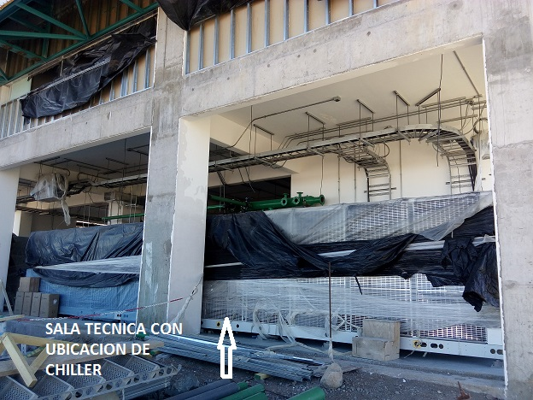
Current Progress – Mechanical Room & Chillers
3 Main Chillers - view from outside south end of building

Slide 7
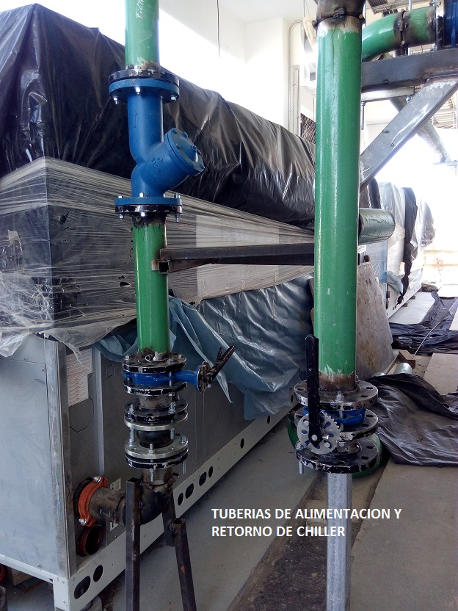
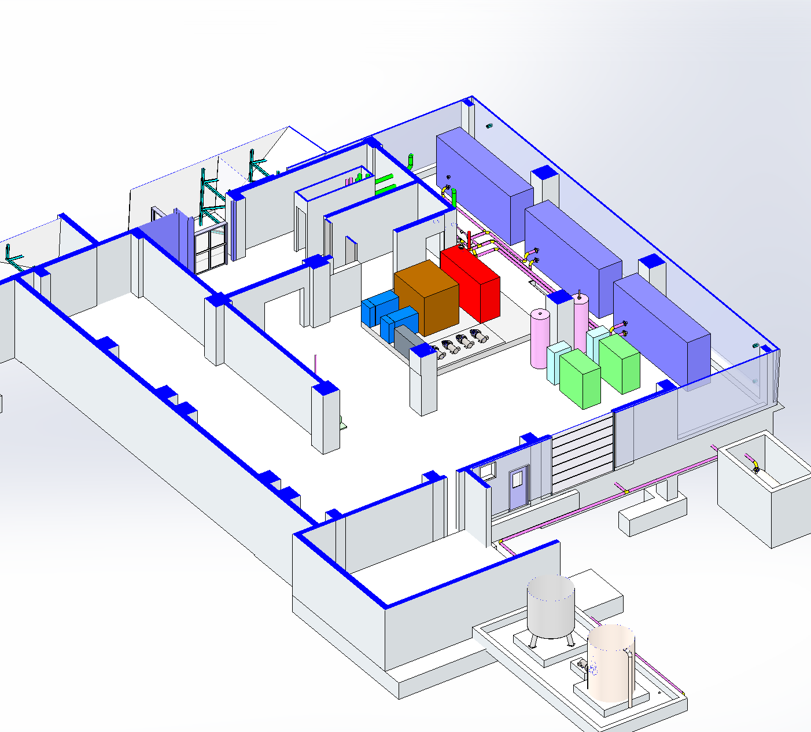
Se aprecia la conexion de las tuberias de alimentacion y retorno hacia los chiller que se encuentra incompleta
Current Progress – Manifolds & Piping

Slide 8
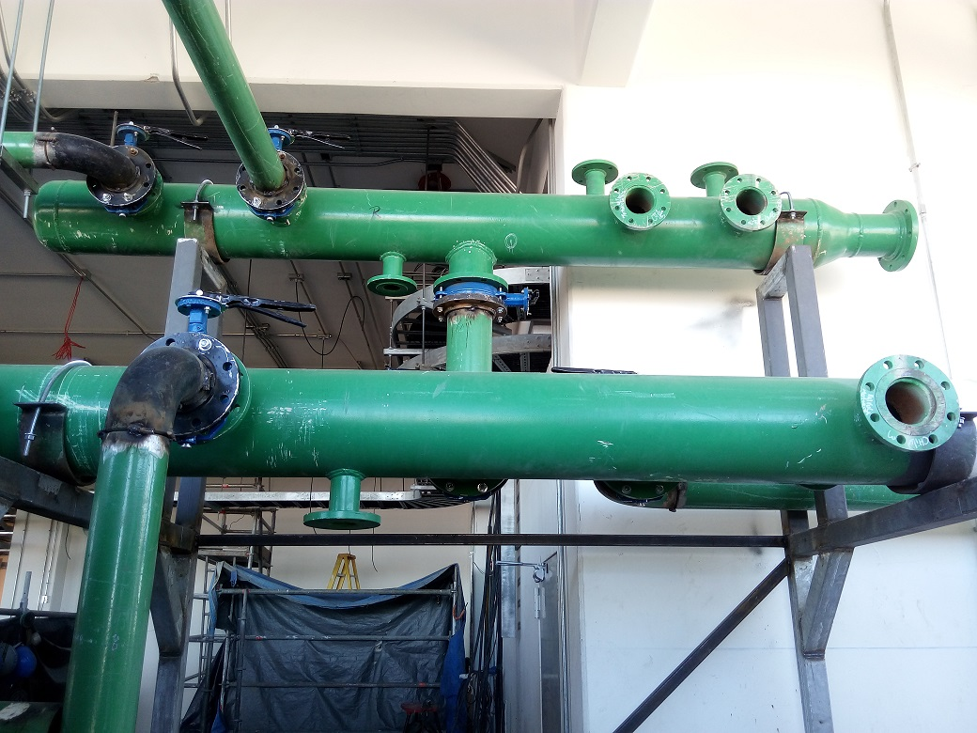
Current Progress – Glycol Supply and Return
MANIFOLD DE ALIMENTACION Y RETORNO A LA SALIDA DE LOS CHILLER
Provide for interchangeability of low-temp. and standard building chillers.

Slide 9
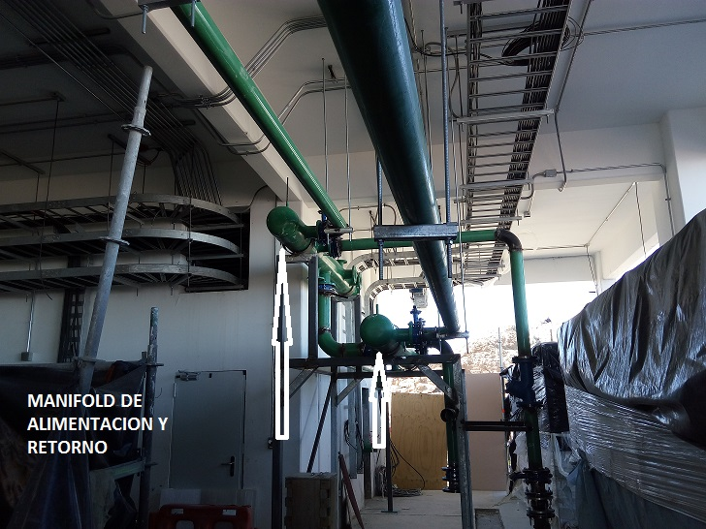
Se puede apreciar la instalacion de los manifold y la union entre dos de ellos que son los que alimentan a clima telescopio
Current Progress – Chillers and Manifolds

Slide 10
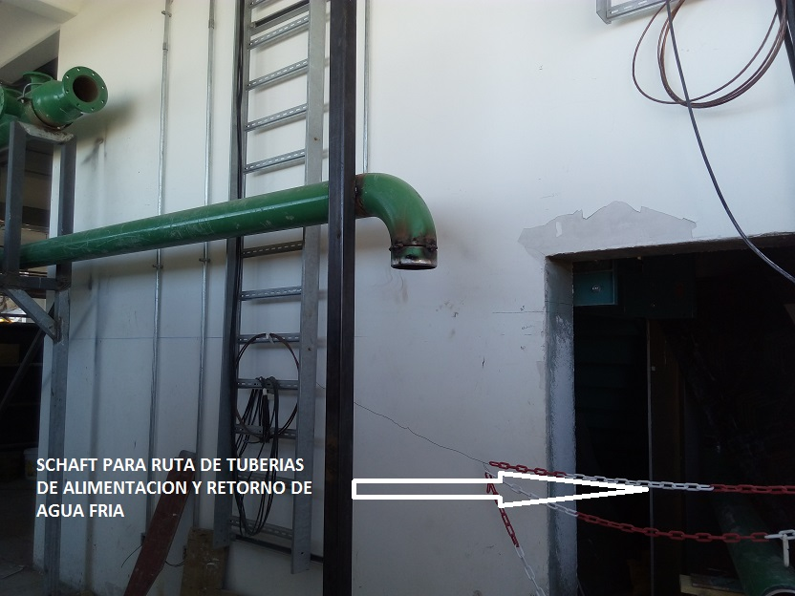
La ruta de las tuberias para clima esta definida por el schaft que se aprecia y que corresponde a la caja escala
Current Progress – Piping & Shaft

Slide 11
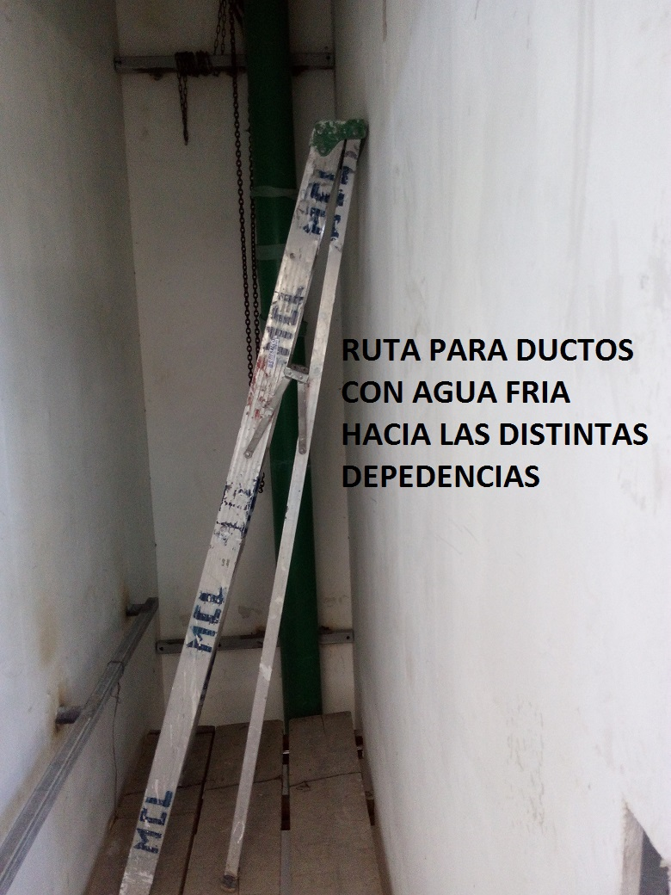
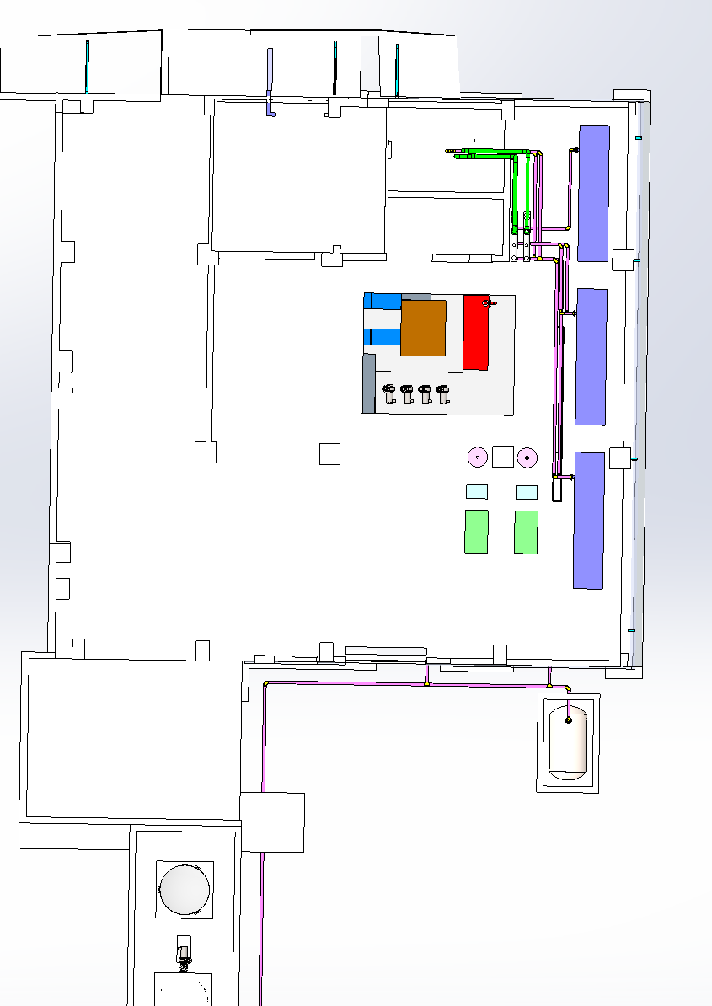
Current Progress – Piping & Shaft

Slide 12
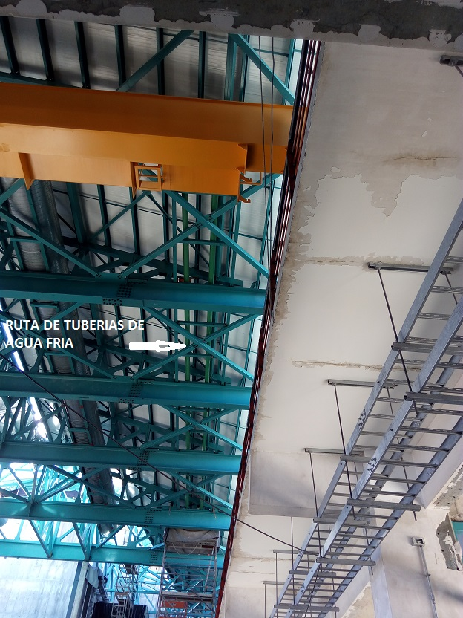
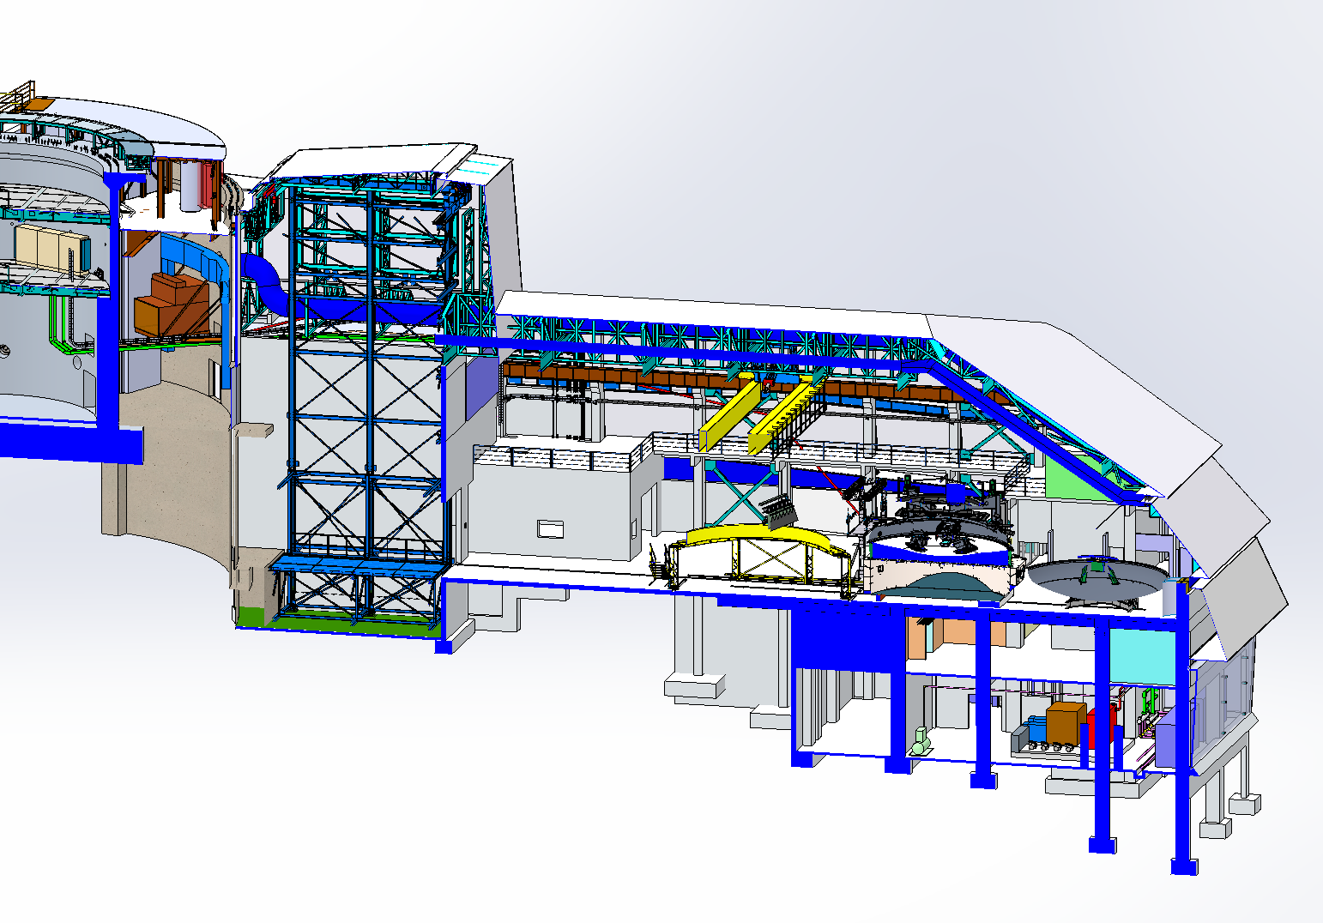
Current Progress – Horizontal Piping Run
RUTA CON LAS TUBERIAS DE ALIMETACION HACIA LOS UMAS (INCONCLUSAS)

Slide 13
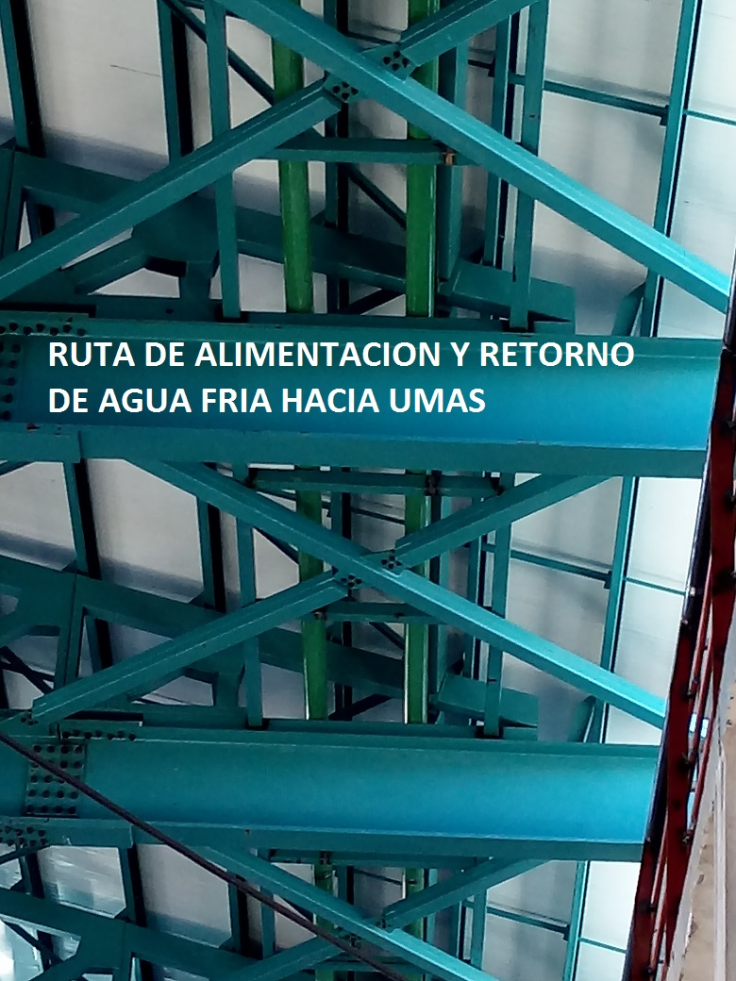
Current Progress – Horizontal Piping Run

Slide 14
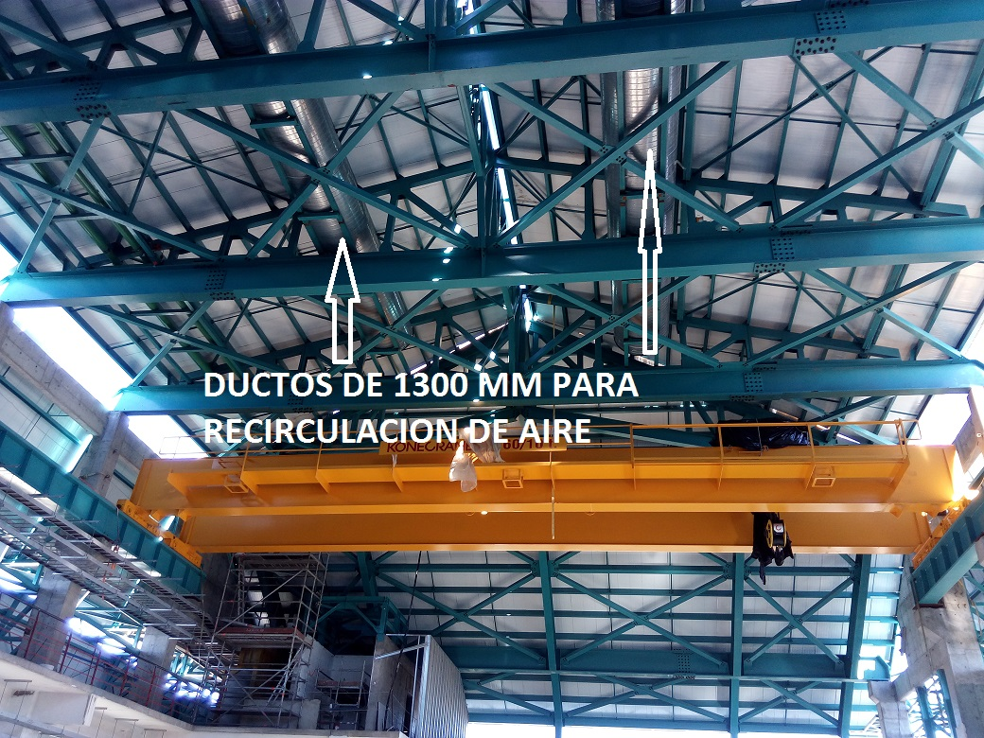
Current Progress – Main Ventilation Ducts

Slide 15
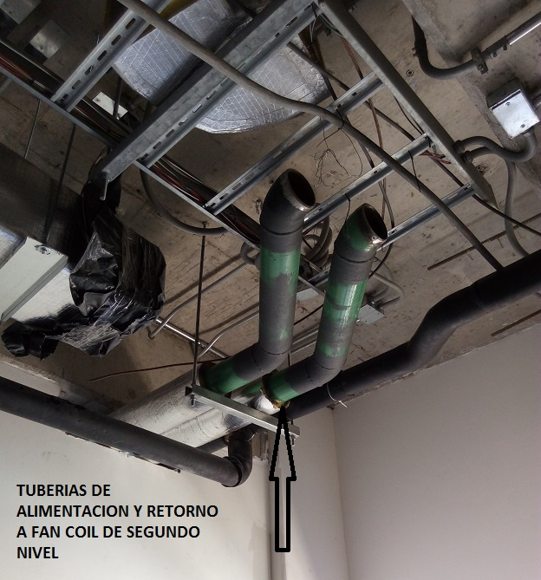
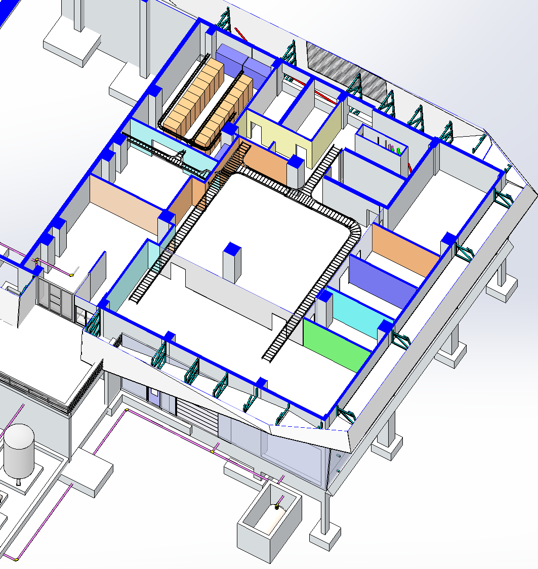
Current Progress – Piping to Fan Coils at 2nd Level

Slide 16
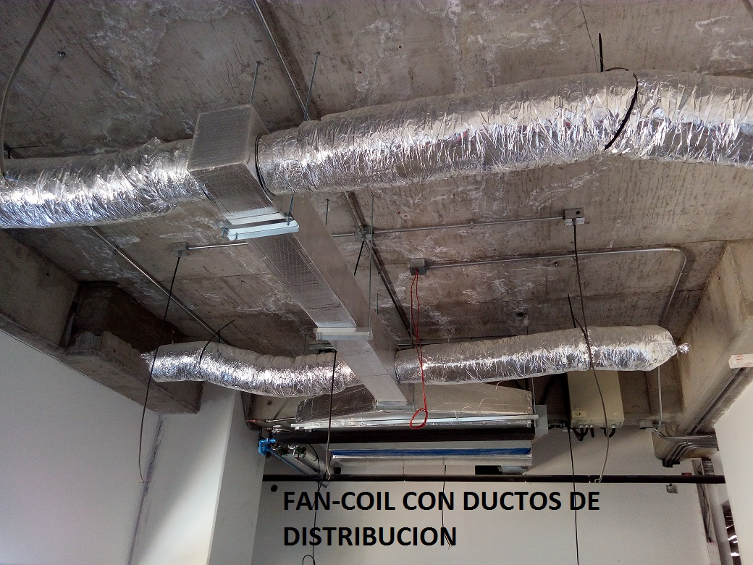
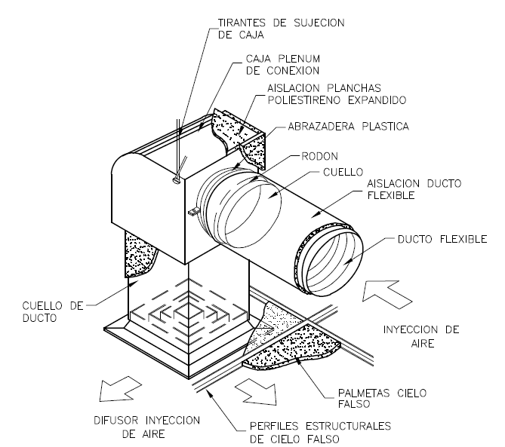
Current Progress – Fan Coil at Office Area
SISTEMA DE INYECCION A OFICINAS QUE SE UNE CON LAS MANGAS DEL LOS FAN-COIL

Slide 17
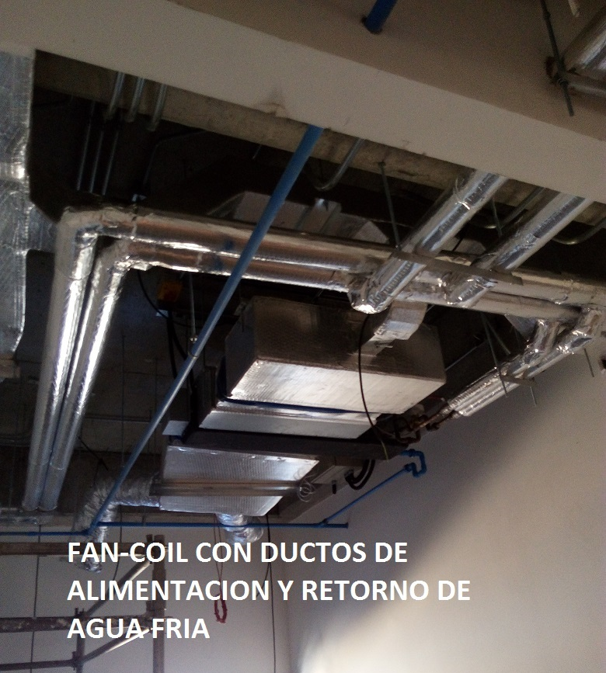
Current Progress – Glycol S&R to Fan Coil

Slide 18
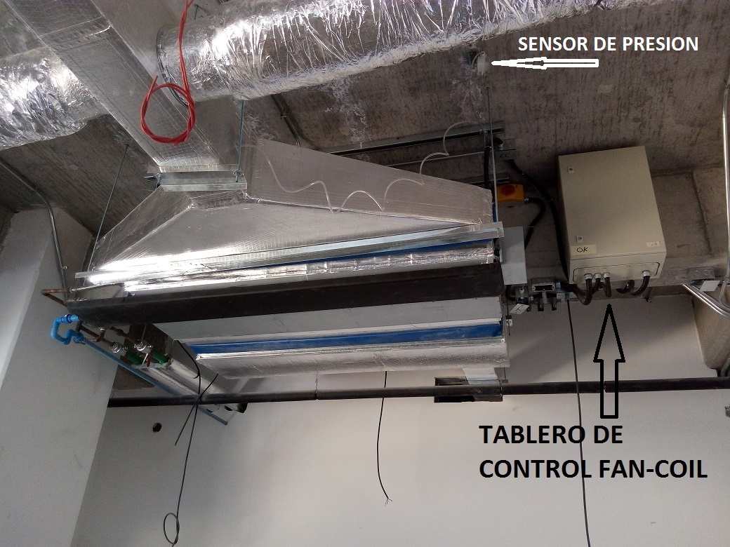
Current Progress – Control Unit at Fan Coil
TABLERO DE CONTROL INDIVIDUAL DE CADA SISTEMA DE FAN-COIL Y SENSOR DE PRESION INSTALADO EN DUCTO

Slide 19
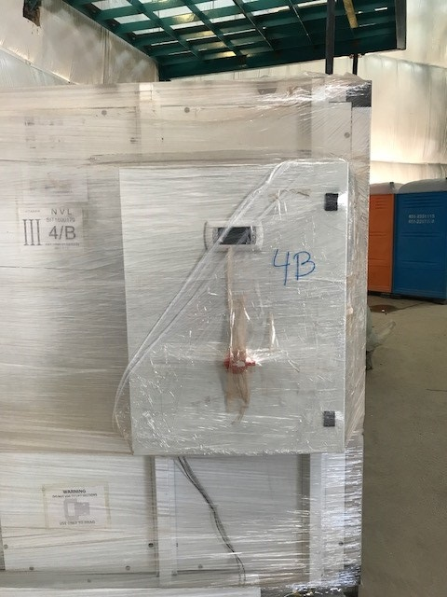
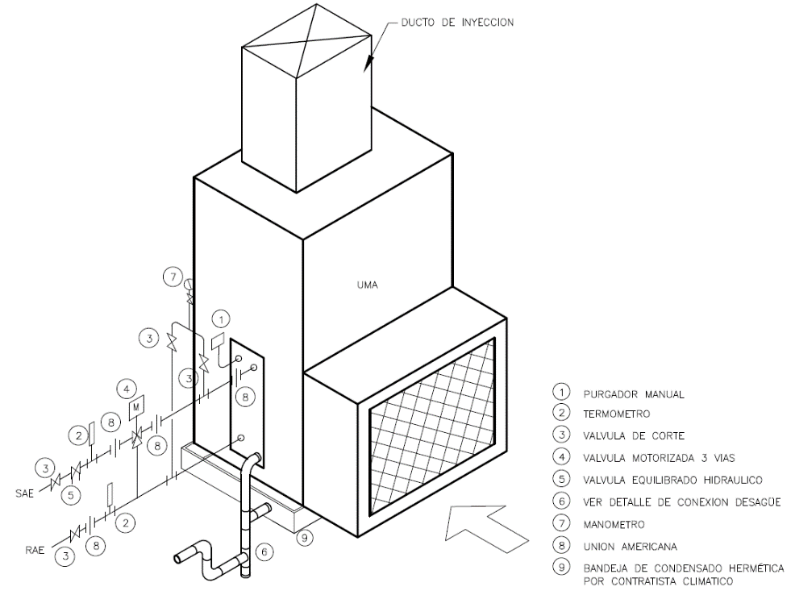
Current Progress – Air Handling Unit for Dome
EQUIPO UMAS A INSTALAR SOBRE SOPORTES

Slide 20
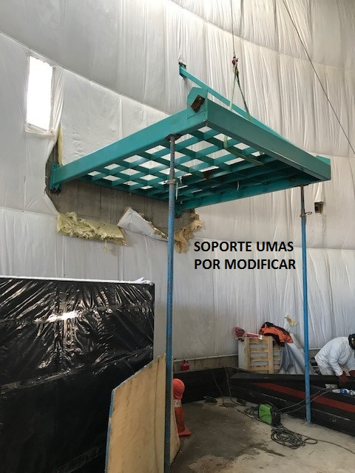
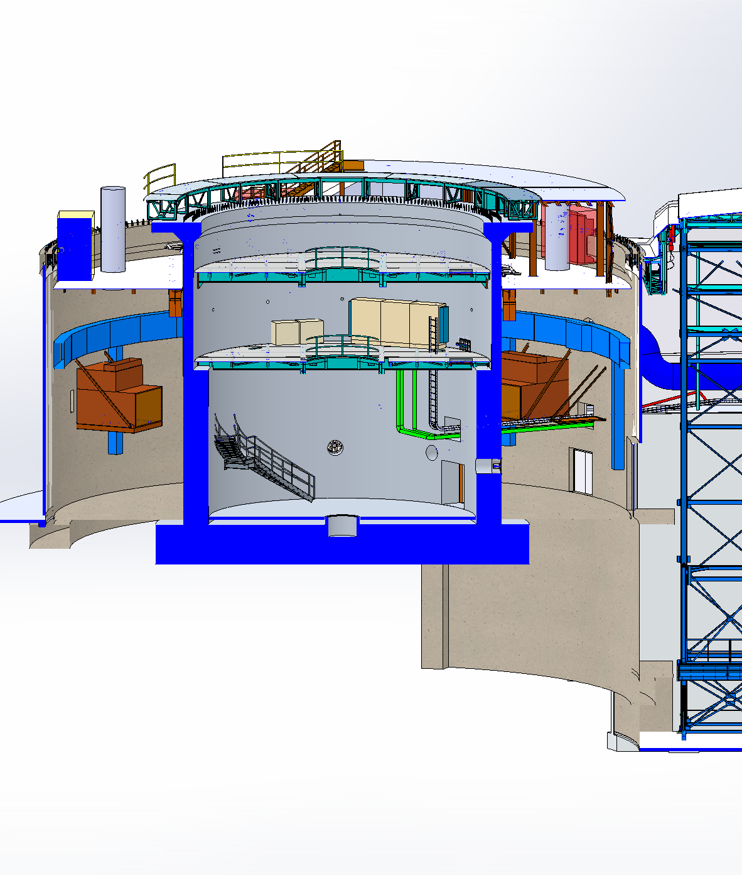
Current Progress – Dome AHU Support Platform

Slide 21
CVAC Control System Specifications and Status

Slide 22
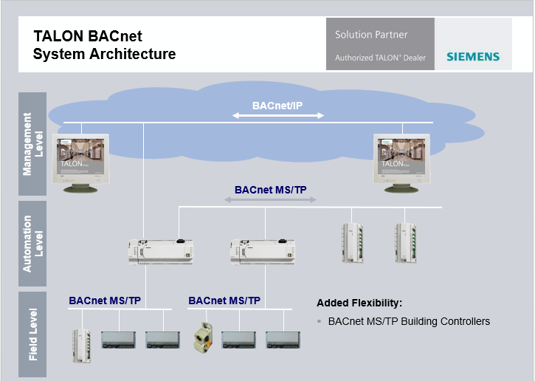
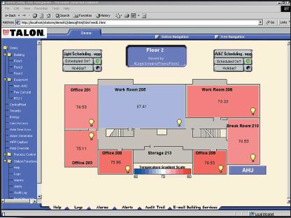
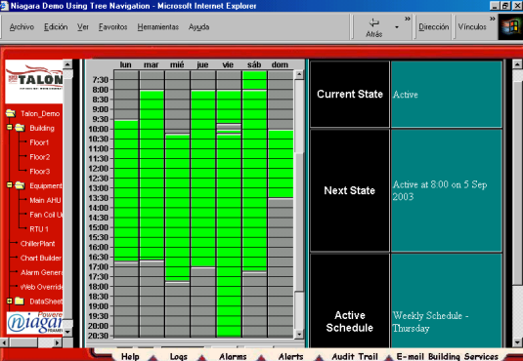
Proposed Centralized Control For CVAC
- Siemens hardware based on industry standard open protocol.
- Connection to LSST communications for telemetry capture and supervision.
- Training on operations and customization of system.

Slide 24
EEC Control Architecture
TCS
Optics
Controller
Mirrors
Thermal
Control
Camera
Camera
Thermal
Control
Facility
Database
DDS Communications Middleware
DOME
Enclosure
Environment
Control
Sensors
Readout
LOUVERS
Fans
CVAC
Enclosure
Sensors
External
Sensors
CC
Air
Handling
Units
CVAC
Sensors
Flow
Valves
Chiller(s)
Fans

Slide 25
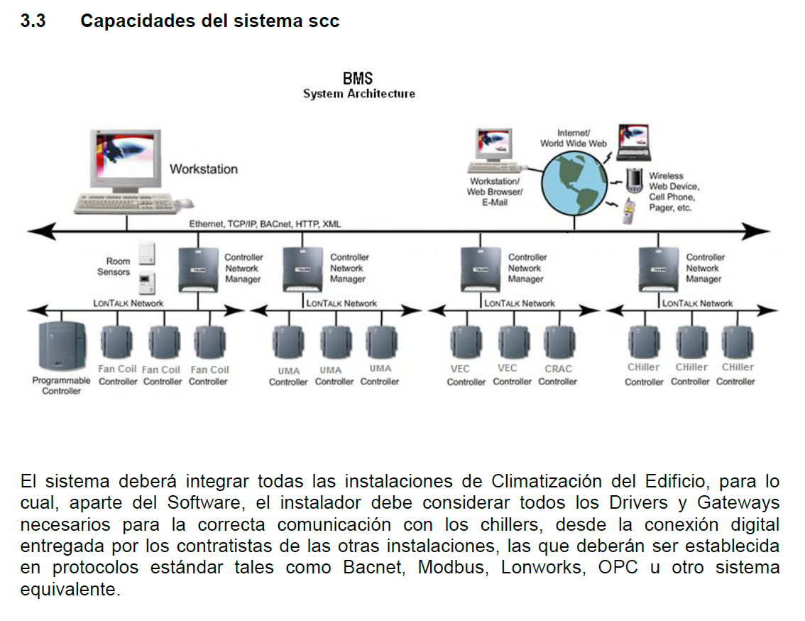
Control Architecture from Technical Specifications

Slide 26
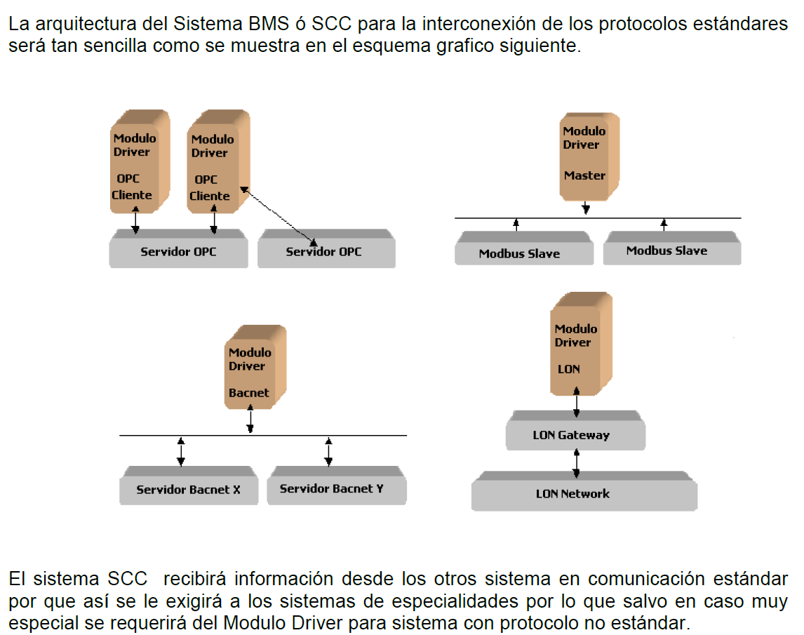
Control Diagram from Technical Specifications

Slide 27
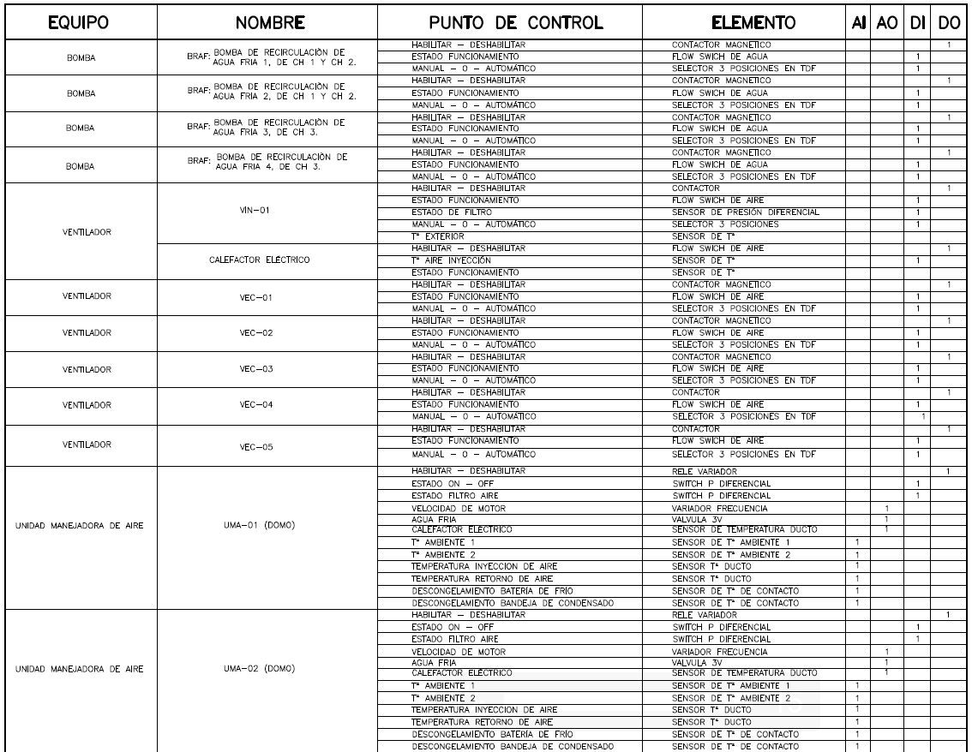
CVAC Equipment under Centralized Control

Slide 28
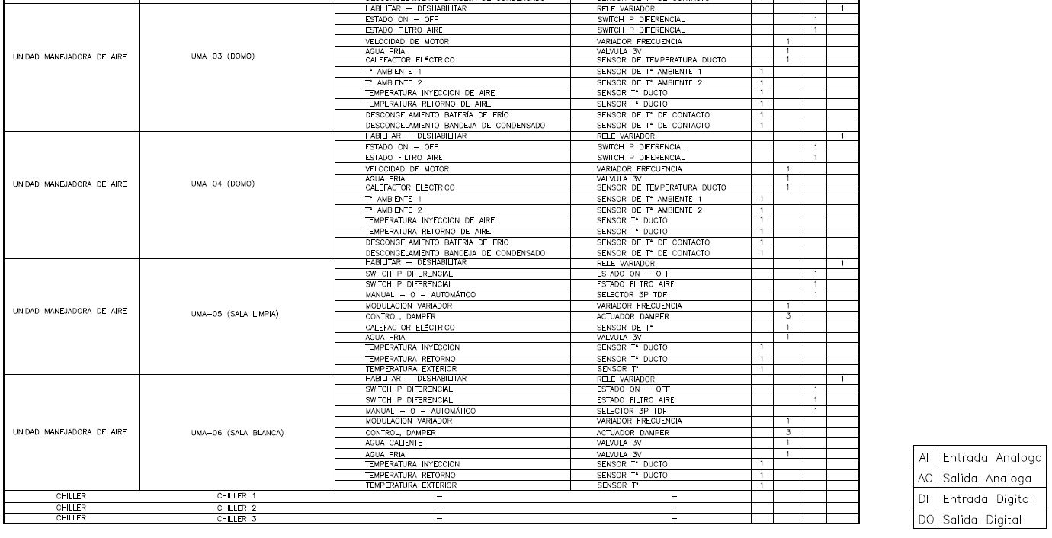
CVAC Equipment under Centralized Control
(cont.)

Slide 29
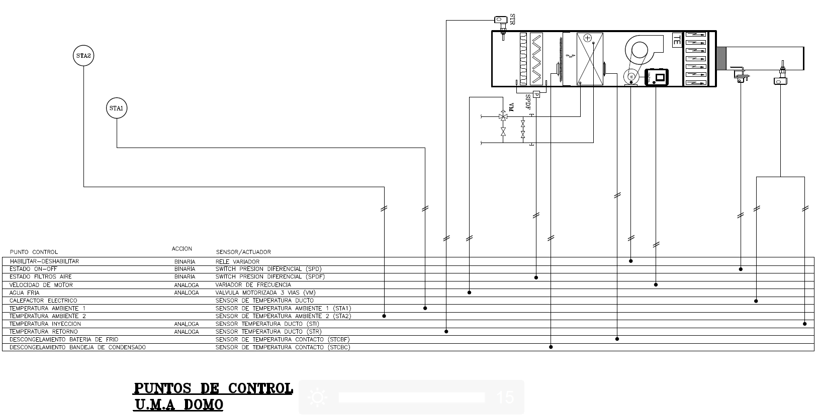
Example of Equipment Control Diagram

Slide 30
Imminent Completion of Besalco/Masterclima Contract

Slide 31
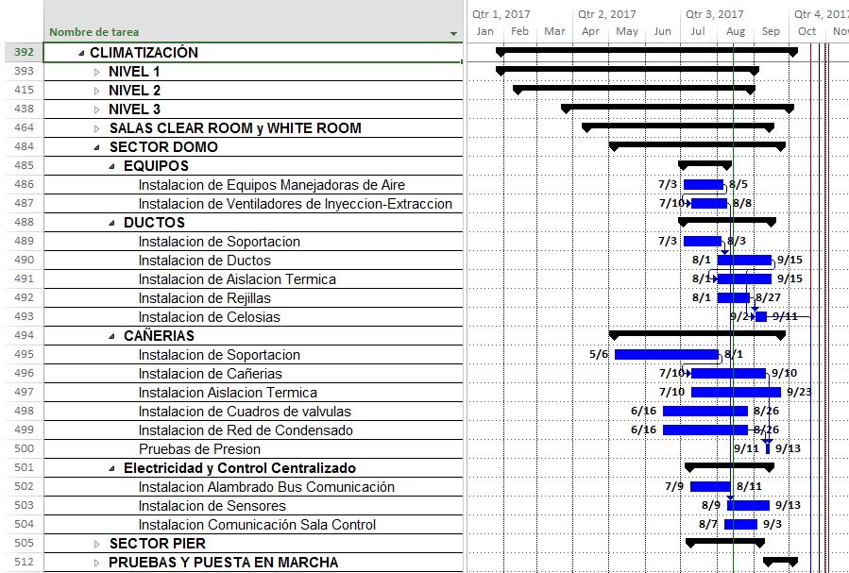
Besalco Current Gantt Chart for Climatización

Slide 32
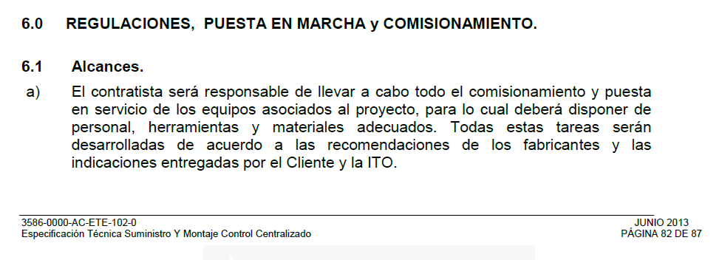
Adjustment, Start-up, Commissioning excerpt from Technical Specifications

Slide 33
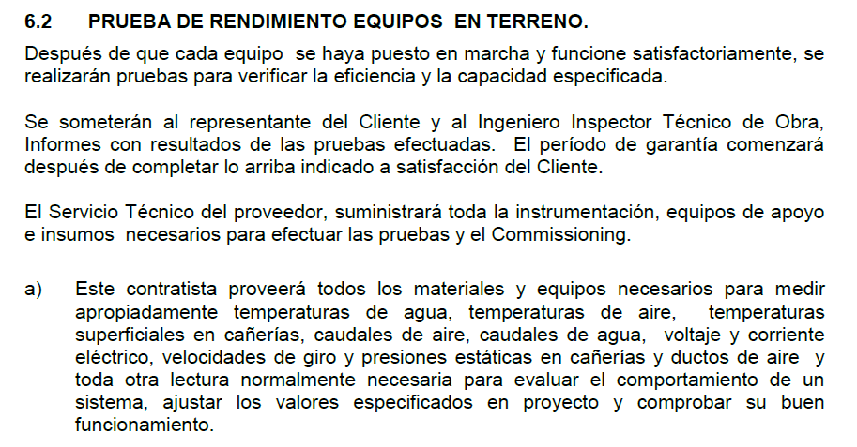
Field Performance Testing of Equipment excerpt from Technical Specifications

Slide 34
Questions to Be Addressed – Today or Soon
What, if any, non-standard mechanical testing do we expect Masterclima to do for the cooling and ventilation equipment?
Can “simulate” the presence of the dome in some way to ensure adequate capacity and proper functioning of AHUs, bi-pass valves, ventilator fans under static pressure, etc?
Do we need to simulate any other load conditions (e.g. mirror cooling, computer room heat load.
What control input/output protocols should we require for testing for all equipment?
What monitoring capability do we expect to have demonstrated prior to acceptance?
We will test the response of the system to the mechanical failure of one of the low temperature chillers, and back-up by the general purpose chiller. Are there any other similar special test conditions we should consider?

