Slide 1
Multi Subsystem Software Pathfinders
August 16, 2017

Slide 2
Agenda
Review existing draft schedule and logic
Discuss details and logistics for upcoming fall activities
Plan forward
next meetings
LCR to baseline activities

Slide 3
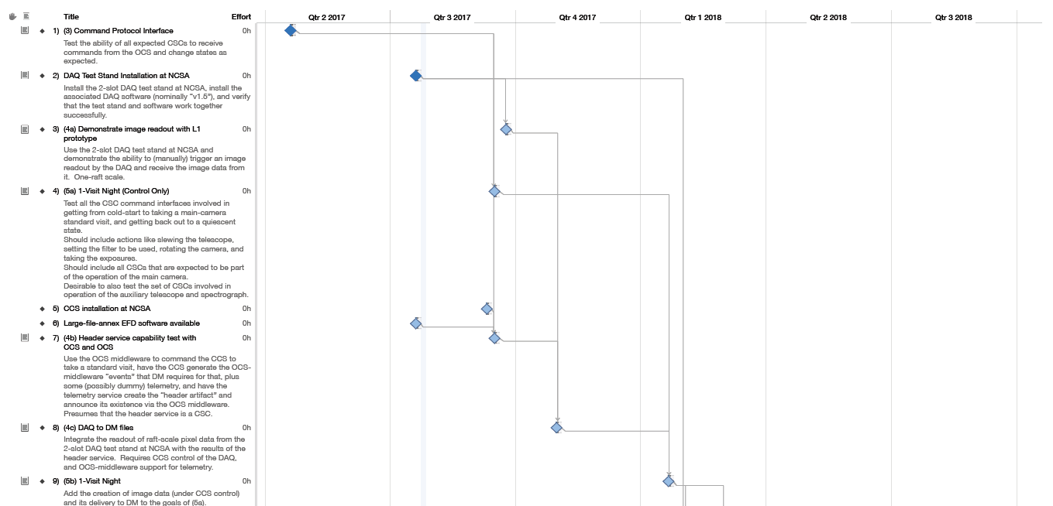
Draft Schedule
See PDFs on meeting page

Slide 4
Details being developed on Confluence
https://confluence.lsstcorp.org/display/SYSENG/Early+Integration+Activities
In Work

