Slide 1
Desired Outcomes
Clarify existing opportunities for the Community to provide input to the Project
Help the Project and subsystems prioritize resources for community engagement
Identify follow-up activities that can strengthen communication framework, e.g. Science Collaborations as a proxy for the community
Get input that will inform the Project-level communications plan strategy and policy

Slide 2
Desired Outcomes
Clarify existing opportunities for the Community to provide input to the Project
Help the Project and subsystems prioritize resources for community engagement
Identify follow-up activities that can strengthen communication framework, e.g. Science Collaborations as a proxy for the community
Get input that will inform the Project-level communications plan strategy and policy
… We recognize that even among the “insiders” community in this room that there is a wide range of perspectives and needs.

Slide 3
Getting started ….
Identify a scribe and person to report back at Friday’s plenary
Begin with mini-discussions –
Turn to 1-2 other people near you
Discuss what you are hoping to get out of this breakout
Discuss communications opportunities and concerns that interest you
Add a suggested discussion topic or question to the flip charts

Slide 4
Suggested Discussion questions
Key topics that the Project is actively soliciting feedback from the community – Data Management as a use case (Observing Strategy)
Science Collaborations as a proxy for the overall community
What is work now being done in the community that would benefit the Project? How can this work be ingested?
Approaches to connect with a more diverse cross section of the scientific community
Strengths and weaknesses of the current instantiation of communication tools
On what topics would the community like more engagement

Slide 5
2. Science Collaborations as a Proxy for the Community
Using science collaborations and chairs as an interface between the Project and the science community can be an efficient way to interface with the community e.g. presentations at collaboration meetings, Project Science Team engagement with the chairs, etc.
If this is a primary way to connect with the Project – This opportunity should be made clear to the community

Slide 6
3. Relevant work being done in the community
Analysis of pre-cursor data sets with (version of) the Stack – for example Hyper Suprime Cam data
Analysis and generation of simulated datasets – for example DESC Data Challenges
Running OpSim and generated new simulations
… What are other examples?
… What process/communication channel should be used for the Project to benefit from this work?

Slide 7
4. Approaches for reaching a broader community
We aren’t reaching a diverse community, by about any definition of the word “diverse”.
LSST can be more proactive in utilizing e.g. AAS and NOAO email exploders.
What other approaches should we implement to improve engagement with a broader community?

Slide 8
5. Two Way Comm. tools – Strengths and Weaknesses?
Email to team member
At professional meetings
Through science collaboration
Community.lsst.org
Through the Science Advisory Committee
Slack
Observing Strategy white paper
Data Management Github site

Slide 9
5. Sources of information – Strengths and Weaknesses?
Science collaboration emails
Professional meetings
Community.lsst.org
LSST Digest emails
Project website
Blog posts
Social media (e.g. Facebook and Twitter)
Slack
Github

Slide 10
6. Topics for Project-Community engagement
General Project information
Survey Observing Strategy
Science Pipelines and Algorithms
Data Rights and Data Access
Commissioning Strategy
Alert Stream
EPO
Alert Event Brokers
Others…?

Slide 11
DM/Community Interaction Strategy
Mario Juric <mjuric@astro.washington.edu>
August 14th, 2017.

Slide 12
Organization of DM-Comm’ty Interactions
In Data Management, the System Science Team serves as the interface between the stakeholders (the community) and the Engineering team.
LSST Science Collaborations are our proxy for the overall community.
Community
DM System Science Team
DM Engineering Team

Slide 13
DM System Science Team
Juric
Graham
Slater
Bellm
Bosch
Dubois-Felsmann
Gruendl
Krughoff
Wood-Vasey
Lupton
Average effort ~0.5 FTE
From http://ls.st/sst o, http://ls.st/LDM-294)

Slide 14
Typical Communication Modes
“Consult”: Resolve remaining design and requirements questions
Example: Current baseline for DIAObject catalogs calls for the computation of features to enable training of ML classifiers; need to understand which features to use. Will use the TVS SC as a vehicle to understand the options.
“Inform”: Keep the community apprised of LSST DM Status and Plans
Example: Presented the LSST Science Platform to the SC Chairs
Example: Presentation to the Solar System SC on the status and plans for MOPS (August 9th 2017)
“Teach”: Communicate what LSST will deliver (and receive feedback)
Example: Held a 2-day workshop with the UK SWG in April 2016.

Slide 15
Points of Contact
Community: We use the LSST Science Collaborations as a proxy for the overall community. Advantages:
Leverages SC organization; communicate/organize through the Chair, rather than individually with members
Note: some special considerations for int’l contributors’ communities (e.g., Chile, UK, France)
DM: Designated Points of Contact (liaisons)
Every SC has (or will have) a member of the DM SST who designated as their liaison.
These PoCs work with SC chairs satisfy both DM and SC needs.
They’re meant to be generally “plugged in” to collaboration work and plans, so they can identify and advise both the Project and the SCs on potential issues.

Slide 16
Primary Communication Channels
Meetings, Conferences, Workshops
Opportunity to reach large audiences at once. Reaches broad communities. Example: Chilean LSST Science workshop, December 2016. French LSST Science Workshop, June 1027. DPS Town-Hall meetings.
Collaboration Telecons (incl. SWG telecons)
Opportunity to keep the SC appraised of DM progress & understand SC plans.
Example: Attending DESC leadership telecons.
Mailing lists and community.lsst.org
General discussion venue.
Example: Discussions on (various) DESC mailing lists on LSST plans for photometric redshifts.
PoC
SST
PoC (or DMSS)
+ a well organized and maintained website

Slide 17
Issues and Work in Progress
DM is still implementing all aspects. Not all liaisons have been named, or they haven’t started attending collaboration telecons. Delayed by the DM replan work, but hope to finish this fall.
Some aspects still missing, a website being a key one (next slide).
Need to better differentiate between different communities, and appropriately use communication tools we have available (see following slides)
Resources remain an issue; it’s (too) easy to neglect communication.

Slide 18
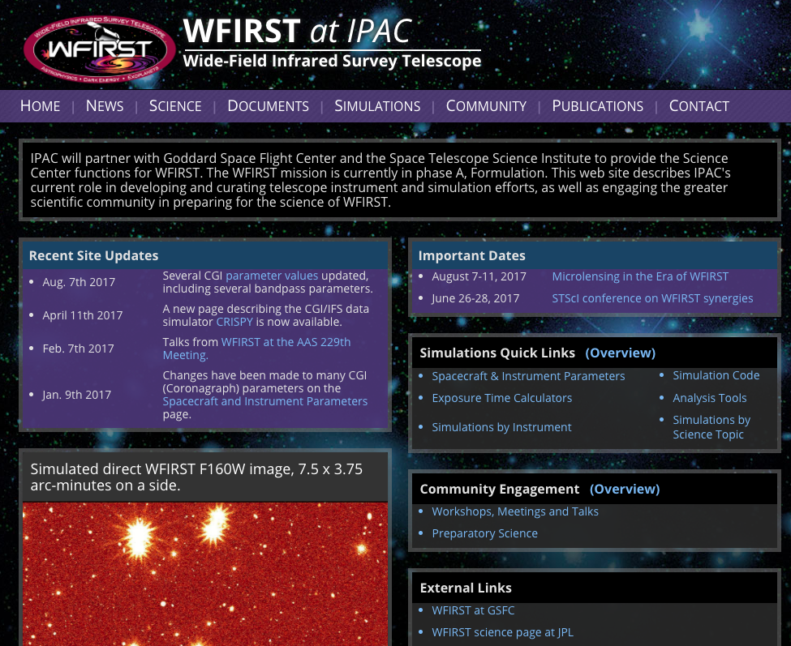
Thinking Ahead: LSST Data Website
Our lsst.org website is largely aimed towards the general science-oriented public
To complete the DM communication structure, we’d benefit from a science products-oriented one
http://dm.lsst.org (though currently too software oriented; see next slide)
Place to learn about the planned data products and services
Links to existing simulated products, prototype services
Place to learn about DM development plans and progress
Place to learn about Community interaction mechanisms and tools (points of contact, tools, etc.)
Data-related publications, presentations
Analogous to what other missions have deployed by their “data processing” arms (e.g., WFIRST). Natural path towards the LSST Archive website in operations.
Not clear we have the resources to maintain it; should try.
IPAC WFIRST website: a possible model for making project information better discoverable by the community.

Slide 19
Thinking Ahead: LSST Community vs. LSST Stack Community
We’re beginning to distinguish between the “LSST Community” and the ”LSST Stack Community”.
1. LSST Community: the community of scientists interested in using LSST data and services for research.
2. LSST Stack Community: the community of people interested in running or modifying the LSST processing software.
The two overlap, but have (sometimes significantly) different expectations or needs.
The former is likely to be significantly larger.
E.g., compare the number of people who have used SDSS data, vs. who have run Photo.
We’ve so far put the emphasis on supporting community #2. This had the effect of sometimes confusing or giving the wrong impression to community #1.
E.g., a typical LSST user will not be expected to use the LSST stack or reduce the data themselves. Most users shouldn’t be trying to build it.
We haven’t yet offered LSST-like simulated datasets, emphasized data model documentation, broadly offered LSST-reprocessed data, and similar products. These may be more interesting to community #1.
We need to support both communities, with appropriate mechanisms.

Slide 20
Summary
DM is putting into place an organized community interaction effort, in order to fulfill the Construction mandate to deliver data products and services the community needs, within budget and schedule constraints.
The effort is led by the DM System Science Team, centered around designated liaisons, with Science Collaborations serving as an organized proxy for the overall community.
Not all aspects have been established yet (e.g., website) as resources remain an issue, but progress is being made.

Slide 21
Backups

Slide 22
How should this work in practice
The collaboration chairs have monthly meetings with the PST; a chance to discuss high-level issues (this is broader than just DM)
The Chairs pass this information to the collaborations
DM Liaisons will attend regular collaboration telecons. A chance to connect on a weekly or fortnightly basis.
This will not be a one-size-fits all arrangement; all collaborations are subtly different (some require more than one liaison, depending on DM needs)
We are looking into establishing (at least) a quarterly “DM status update” calls with each science collaboration. The Solar System SC meeting last week may be a good model.
A chance for any collaboration member to be kept appraised of DM progress

Slide 23
Supporting Contributions to DM Software
Most LSST DM software is open source and available on github
For those interested in trying the LSST codes (as well as our own developers), we’ve made extensive documentation available on how to install and run it. For example:
http://developer.lsst.io
http://pipelines.lsst.io
We’re open to community interaction and contributions to the LSST software, with a number of mechanisms to enable these:
Bug reports and contributions: Github Issues
StackOverflow-like message board: http://community.lsst.org
Real-time chat: Slack

