Slide 1
LSST Camera Environment, Safety, and Health Joe Kenny Camera Safety Manager LSST Safety Council Review 18 August 2015

Slide 2
Outline
LSST Camera System Safety Program Plan (LCA-31)
LSST Camera Hazard Analysis Report (LCA-14)
LSST Camera Hazard List (LCA-15), mitigations and verifications
Summary
LSST Safety Council Camera Review • Bremerton, WA • 2015

Slide 3
LSST Camera System Safety Program Plan (LCA-31)
Describes tasks and activities of the Camera System Safety Program (SSP) in identifying Camera hazards imposing design requirements and management controls to prevent mishaps and/or mitigate their impact
Covers all phases of the program including design, development, fabrication, assembly, handling, transportation, storage, integration, test, and operation
Assures that
Safety is optimized in the design, construction, and operation of the Camera, consistent with performance, schedule and budget
Hazards associated with the system are identified and evaluated for all phases of the program.
The risks associated with all identified hazards are controlled to acceptable levels.
New hazards are not introduced into the system through design changes.
Requirements for retrofit actions necessary to eliminate or control hazards are minimized.
LSST Safety Council Camera Review • Bremerton, WA • 2015

Slide 4
LSST Camera System Safety Program Plan (LCA-31)
Defines the role of the Camera System Safety Engineer, viz.:
Participates in formal design reviews
Prepares the SSP deliverable documents
Supports the LSST SSP implementation and providing the primary interface to the Camera
Develops and applies safety design criteria and requirements
Reviews and approves selected drawings, specifications, and procedures
Evaluates design changes for their impact on safety
LSST Safety Council Camera Review • Bremerton, WA • 2015

Slide 5
LSST Camera System Safety Program Plan (LCA-31)
…describes the system safety process
LSST Safety Council Camera Review • Bremerton, WA • 2015

Slide 6
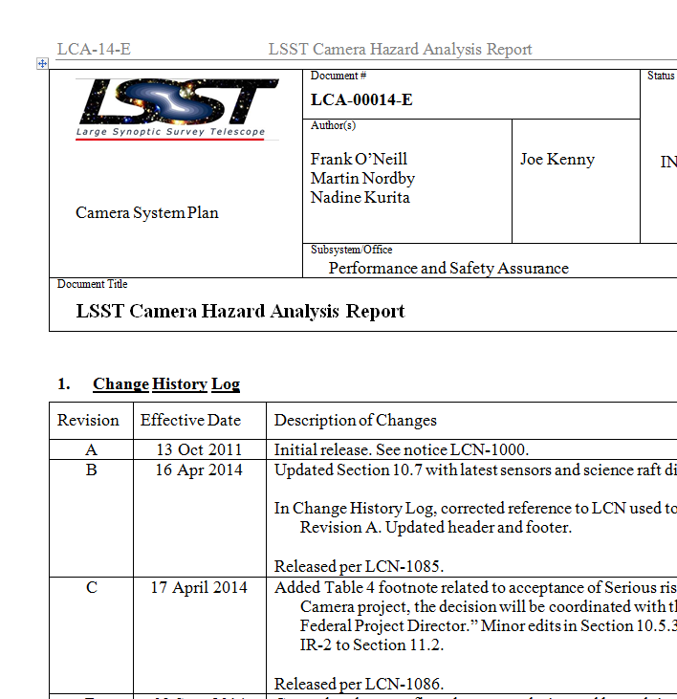
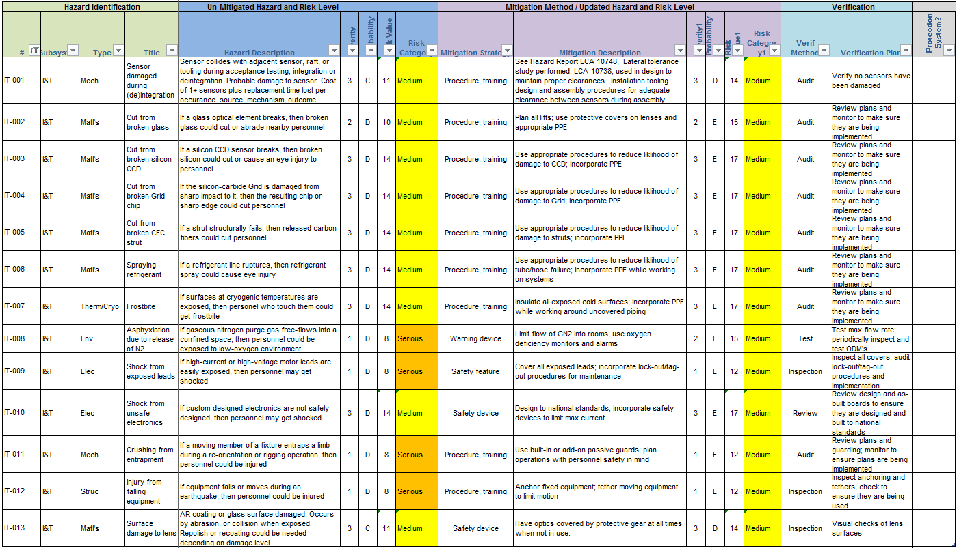
Hazard Analysis Report and Hazard List
LSST Camera Hazard Analysis Report (LCA-14) addresses Camera operating hazards
LSST Camera Hazard List (LCA-15) is a summary containing all hazards, their assessed risks, and mitigations
LSST Safety Council Camera Review • Bremerton, WA • 2015
Notes:
Verifications are VERY IMPORTANT, since one can design and build a solid interlock system that does not one bit of good if it’s not connected.
HAZARD REPORTS: When an hazard or mitigation is very complex of presents a special threat

Slide 7
Hazard Analysis Report (LCA-14)
Describes Camera subsystems in prose and diagrams
Describes analysis process (use of system-safety principles)
Outlines Camera operating hazards
Outlines hazards seen during integration, testing, and commissioning
Outlines mitigations for above hazards
LSST Safety Council Camera Review • Bremerton, WA • 2015

Slide 8
Hazard List (LCA-15)
149 hazards identified and analyzed for probability and consequence
Ten of these hazards warranted the development of Hazard Reports (further documentation of causes, mitigations, and verification methods)
29 hazards identified mitigation strategies involving active monitoring and control. This established the requirement for the Camera Protection System (CPS)
The CPS is a safety net that ensures no unsafe operations are executed and that systems are put in a safe state if a fault or a failure occurs
LCA-139 “Hardware Protection Plan” sets the methodology, architecture, and requirements that define the CPS
LCA-140 “Hazard Protocol List” identifies these hazards and delineates the protection protocols for each
LSST Safety Council Camera Review • Bremerton, WA • 2015
Notes:
The CPS maintains the safe state of the Camera involved with active monitoring and control.
CPS is INDEPENDENT of the CCS and complementary to it. Its sole purpose is to control energy application to protect hardware.

Slide 9
Hazard List (LCA-15)
Has a very-detailed log for tracking of all changes since inception
LSST Safety Council Camera Review • Bremerton, WA • 2015

Slide 10
Hazard List
Camera human- and system-hazards:
Thermal/cryogenic: 13
Pressure/vacuum: 9
Mechanical: 32
Structural: 32
Electrical: 31
Control: 4
Environmental 8
Fire: 1
Materials: 19
LSST Safety Council Camera Review • Bremerton, WA • 2015

Slide 11
Hazard List
LSST Safety Council Camera Review • Bremerton, WA • 2015

Slide 12
Hazard Lists
There are 6 ways to mitigate a hazard
Eliminate hazard: Remove the hazard altogether
Control hazard: Change design/manufacturing plans to reduce risk of mishap
Safety feature: Incorporate passive or static interveners to prevent a mishap
Safety device: Add active device or monitor to interrupt mishap sequence
Warning device: Incorporate monitors and warning of incipient mishap
Procedure, training: Invoke special procedures, PPE, dedicated equipment
And 5 ways to verify those mitigations:
Test: Functional test of installed system verifies mitigation functions correctly
Inspection: Visual inspection or measurement verifies mitigation is applied as-req'd
Process control: Control parts/mat'l selection; qual/proof test; fab/ass'y process controls
Audit: Check of in situ mitigations verifies that they are being used
Review: Review or analysis of mitigation plans indicates that they will reduce hazard level
Cryostat Mitigation Strategy
4 | Eliminate hazard
9 | Control hazard
0 | Safety feature
5 | Safety device
1 | Warning device
4 | Procedure, training
23 | Total
Cryostat Verification Method
11 | Test
1 | Inspection
5 | Process control
3 | Audit
3 | Review
23 | Total
LSST Safety Council Camera Review • Bremerton, WA • 2015
Notes:
Mitigations are listed in preferred order.

Slide 13
Hazard Reports
LCA-10740 Physical Damage to Sensors during Acceptance Testing
LCA-10741 Contamination of Sensors
LCA-10742 Overpressure/Failure of Cryostat
LCA-10743 Physical Collision of Exchange System Parts
LCA-10744 Oxygen Deficiency Hazard (ODH)
LCA-10745 Damage/Failure of L3
LCA-10746 Damage/Failure of L1 – L2
LCA-10747 Power up or Power down Damage to Sensors
LCA-10794 ESD Damage Sensors
LCA-10795 Temperature Excursion for Sensors
LSST Safety Council Camera Review • Bremerton, WA • 2015

Slide 14
Summary
The SSPP helps integrate safety into the LSST Camera Project
The HAR, Hazard List, and Hazard Reports detail hazards, mitigations, and verifications
Team has provided extensive and detailed documentation of hazard causes and mitigations
LSST Safety Council Camera Review • Bremerton, WA • 2015

Slide 15
End of Presentation

