Slide 1
Camera Protection System Martin Nordby Chief Mechanical Engineer LSST Camera Safety Review August 18, 2015
R1

Slide 2
Camera protection approach
The Camera Protection System (CPS):
Includes components that detect hazardous conditions and prevent mishaps from occurring—deemed an active monitoring/control mitigation in LCA-15 Hazard List
Is fully independent of CCS software control (but is monitored by CCS)
Operates regardless of the state of the CCS
Provides the last and strongest line of a tiered defense against occurrence of a mishap
1st line: design, analysis, and testing of Camera components
Developing clear understanding of functional requirements
Review of design and manufacturing plans
Verification test plans to ensure that the as-built hardware meets expectations
2nd line: monitoring, communication, command, and control system (a.k.a.: CCS)
Orchestrates all Camera actions
Actively monitors the condition of all systems within the Camera
Compares operating parameters with preset allowable limits
Provides early warning of trends in hardware operation that could result in a mishap
Takes immediate action to prevent a mishap if thresholds are exceeded
3rd line: Camera Protection System
Includes hardware interlocks and switches
PLCs enable/disable active devices to ensure systems are in a safe state

Slide 3
Camera Protection System functionality
Active protection functions detect a hazard and put the camera into a safe state
The safe state is attained by removing power from the device which might cause a mishap due to the fault.
These active functions are implemented in a fail safe manner. In most instances the designs satisfy the requirements for Safety Integrity Level 2 as defined in IEC 61508, Safety Instrumented Functions.
Active functions are implemented as locally as practical, in most cases within the subsystem concerned
Active protection functions fall into two classes
Conditions not fulfilled for a particular action: these are not latched
Includes most Exchange System and Shutter protection functions
Faults: these are latched and need to be reset by the operator
Mostly involve sensor values out of range

Slide 4
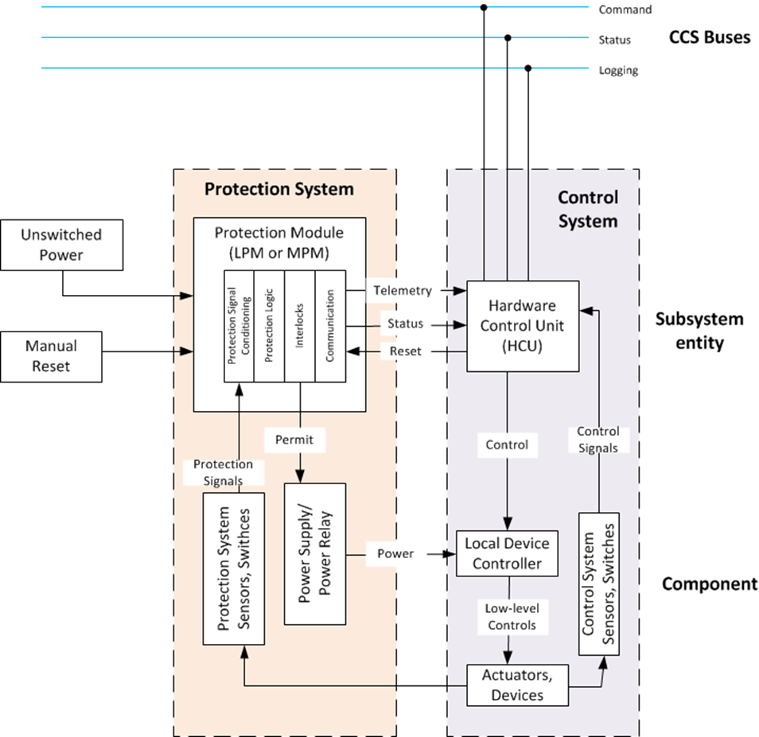
CPS architecture
CPS hardware and protection logic operate in parallel with the CCS and local Hardware Control Units
CPS components are always on and are not controlled by the HCU
Sensors and switches rely on positive signals only
Protection logic often is binary—checking switch status or out-of-range conditions
Elements of the CPS are not mixed with control system components or cross-strapped

Slide 5
Auto Changer protection system architecture

Slide 6
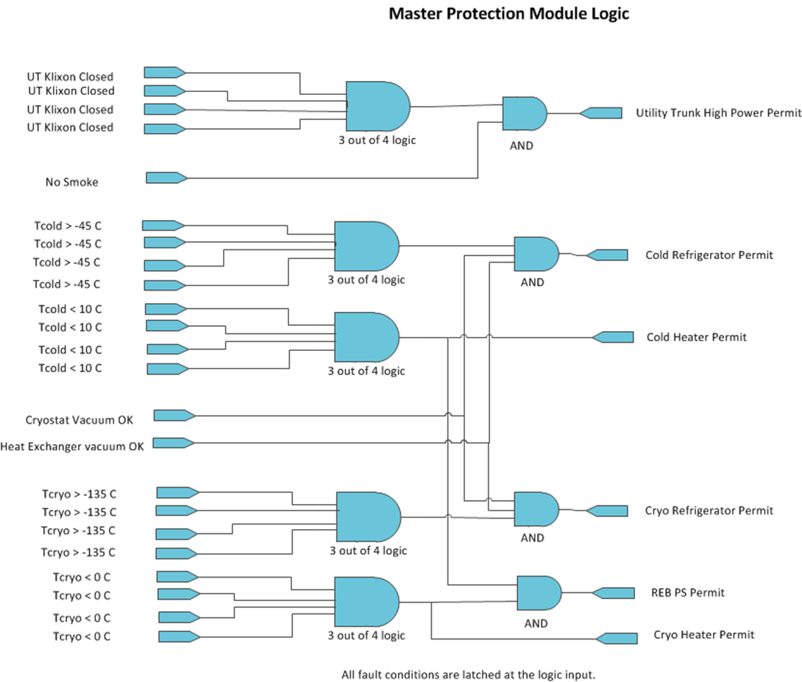
Master protection example: cryo plate temperature
Some protection functions cross subsystems
These functions are handled by the Master Protection Module
Sensors for these are connected directly to the MPM and the MPM is connected directly to the controlled device
Sensor and fault condition
Protection logic
Device being controlled

Slide 7
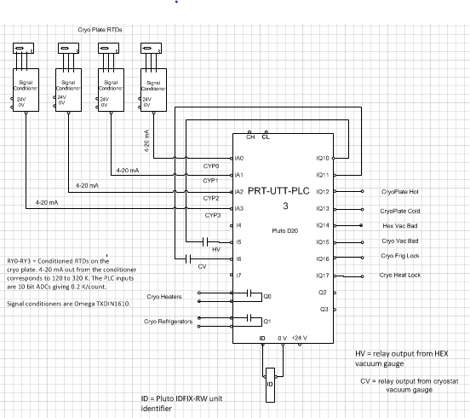
Master protection example: MPM PLC for cryo plate
Patterned outputs
Alarms (non-safe outputs)
Permits (safe outputs)

Slide 8
CPS summary
Hazards to the camera have been collected and analyzed, and those requiring active systems for their mitigation have been identified
Workable and costed designs for implementing the active protection functions are in hand
Further and on-going work
Select components
Complete logic for all subsystem protection modules
Develop fault recovery protocols—this ties into CCS mode transitions and definition of engineering mode levels
Detail the certification process for local and master protection modules

