Slide 1
Introduction and Camera Overview
Martin Nordby
Chief Mechanical Engineer
LSST Camera Safety Review
August 18, 2015
R1

Slide 2
Camera Safety Review Agenda
Introduction (25 minutes, Nordby)
LSSTCam PSAP and safety overview (20 minutes, Kenny)
  System safety, SLAC ES&H during I&T, review process, subject-matter safety
Hazard analysis process (20 minutes, Kenny)
  HAR and SSPP process details and outcome
  Hazard List—details of camera hazards and mitigation (identify operating hazards)
Camera protection system (15 minutes, Nordby)
  General plans for protection system functionality
Camera design and hazard mitigations (60 minutes, O’Neill)
  Walk through subsystems and hazard mitigations/controls built into the design
I&T hazards (30 minutes, Nordby/Bond)
  Plans for capturing and addressing hazards; training-auth-release of work
  WP&C; seismic; high-value lifts and handling; brittle materials
  I&T process flow
  Maintenance planning
Camera hazards on the summit (30 minutes, Kenny)
  Clean rooms; on-telescope
  Further work: LOTO, access control, ODH and clean- and utility- room monitoring, hazards associated with maintenance, hoisting and rigging, fall protection, confined space

Slide 3
Camera Safety Review Agenda
Introduction (25 minutes, Nordby)
LSSTCam PSAP and safety overview (20 minutes, Kenny)
Hazard analysis process (20 minutes, Kenny)
Camera protection system (15 minutes, Nordby)
Camera design and hazard mitigations (60 minutes, O’Neill)
I&T and Operating and Support Hazards (30 minutes, Nordby/Bond)
Camera hazards on the summit (30 minutes, Kenny)

Slide 4
Charge
Has the Camera System Safety Program established the appropriate systems and processes to ensure the delivery of the Camera in a safe and environmentally sound manner?
Is safety adequately integrated into the camera system and subsystems?
Is the LSST Camera team effectively
  Identifying hazards
  Characterizing the hazards
  Assessing the associated risk
  Establishing appropriate controls to reduce the risk to acceptable levels
  Identifying means to verify that the controls are implemented

Slide 5
Camera Final Design Overview

Slide 6
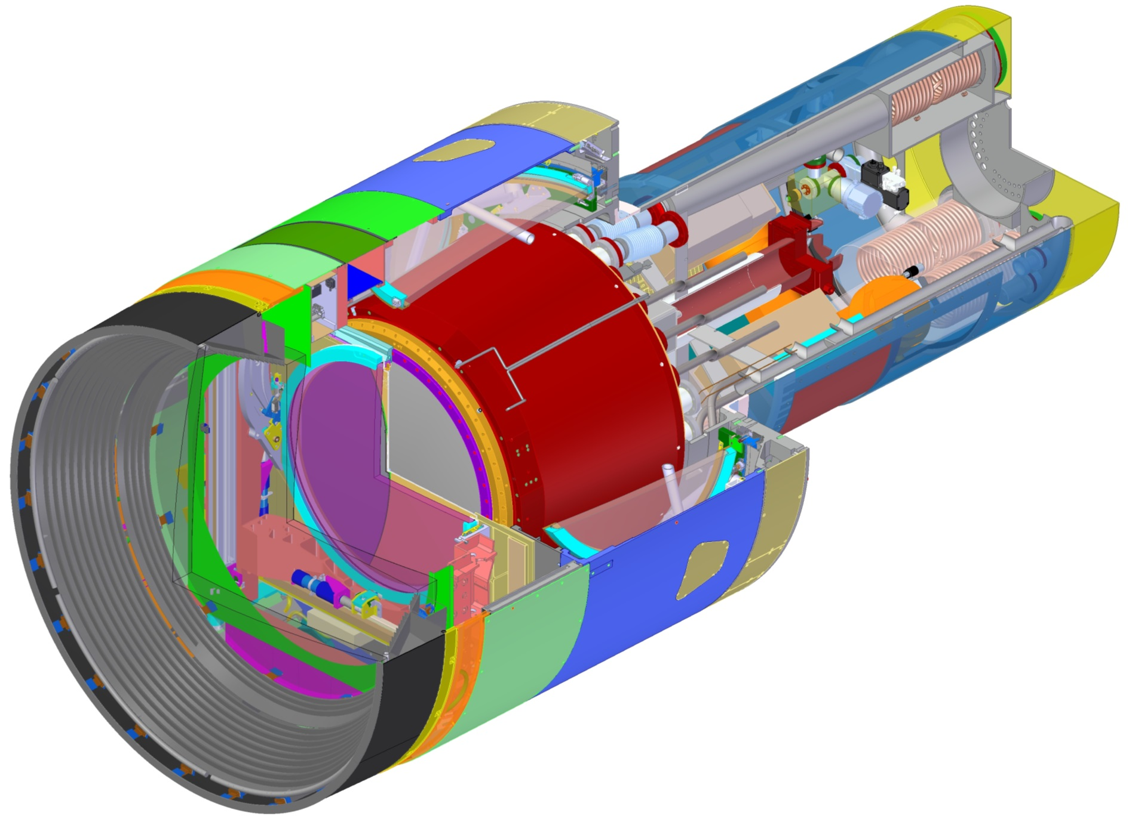
Camera assembly
Camera Parameters
Depth-of-focus | f 1.2
Focal plane diameter | 634 mm
Maximum mass | 3000 kg
Maximum diameter | 1650 mm
Total length | 3732 mm
Auxiliary electronics
L3 lens
Detector plane
Filter
L2 lens
L1 lens
Refrigeration system heat exchangers
Utility Trunk
Carousel holding off-line Filters
Cryostat
Camera Body
Shutter
Light baffles
Shroud
Scale
Auto Changer
1000 mm

Slide 7
Camera focal plane with 201 sensors
Wavefront Sensors
(2 half-WFS at 4 locations)
Guide Sensors
(8 locations)
3.5 degree Field of View
(634 mm diameter)
Science Sensors (189 locations)
Science Raft Sensor Assembly (RSA)
(21 locations)
4 mm
Focal plane
Sci CCD
40 mm
Wavefront - Curvature Sensor Side View Configuration
Corner Raft Sensor Assembly (RSA)
(4 locations)

Slide 8
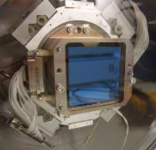
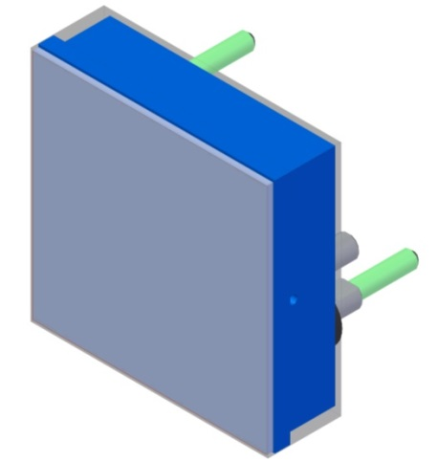
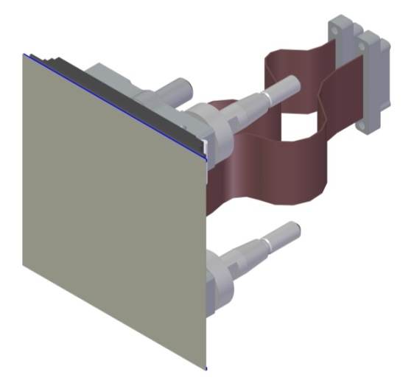
Science and guide sensors
CCD Sensors
3.2 Gigapixels
10 micron (0.2 arcsec) pixels
2 second read-out
Spectral coverage: 350–1040nm
Silicon CCD bonded to ceramic circuit board and ceramic/invar structure
Prototype sensors
ITL sensor
Vulnerabilities
Thin, brittle sensors
ESD-sensitive circuits
Sensor performance affected by contamination
5 voltages require sequenced power-up
Profile measurement of a sensor
e2V sensor

Slide 9
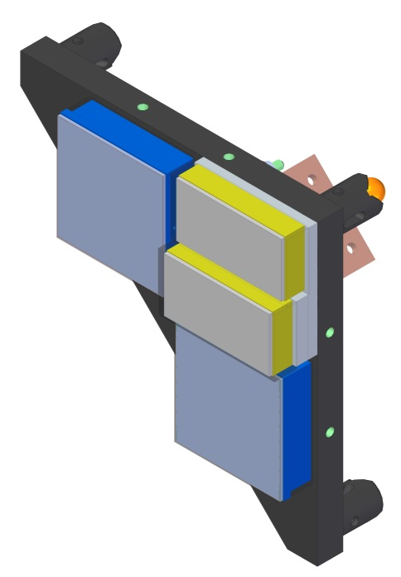
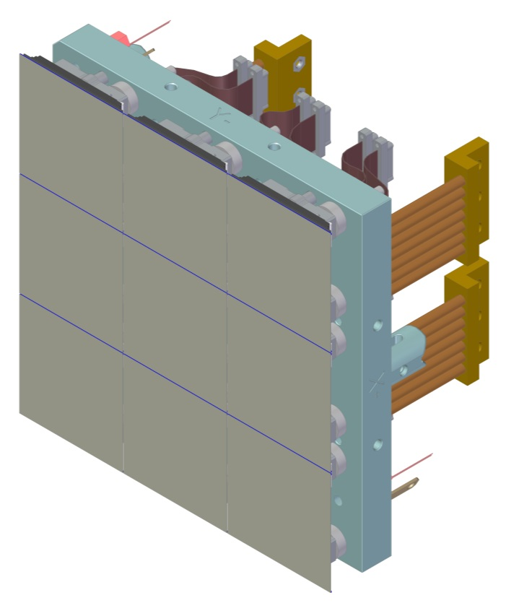

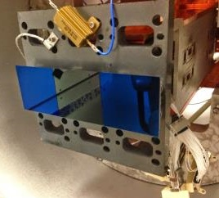

Sensors mounted to raft sensor assemblies
Raft Sensor Assembly
Silicon-carbide baseplate to maximize stiffness and thermal behavior
Sensors registered to baseplate with precision posts and screwed in place
Nominal gap between sensors: .25 mm
Heaters on baseplate stabilize CCD temperatures
Corner Raft Sensor Assembly
Science Raft Sensor Assembly
Thermal Strap
Wavefront sensor
Guide sensor
Science sensor
Vulnerabilities
Brittle SiC baseplate material
Tapped holes in SiC may produce dust
Small gaps between sensors
V-groove mounts see high contact stresses
Raft Baseplate
Prototype sensors on a raft plate

Slide 10
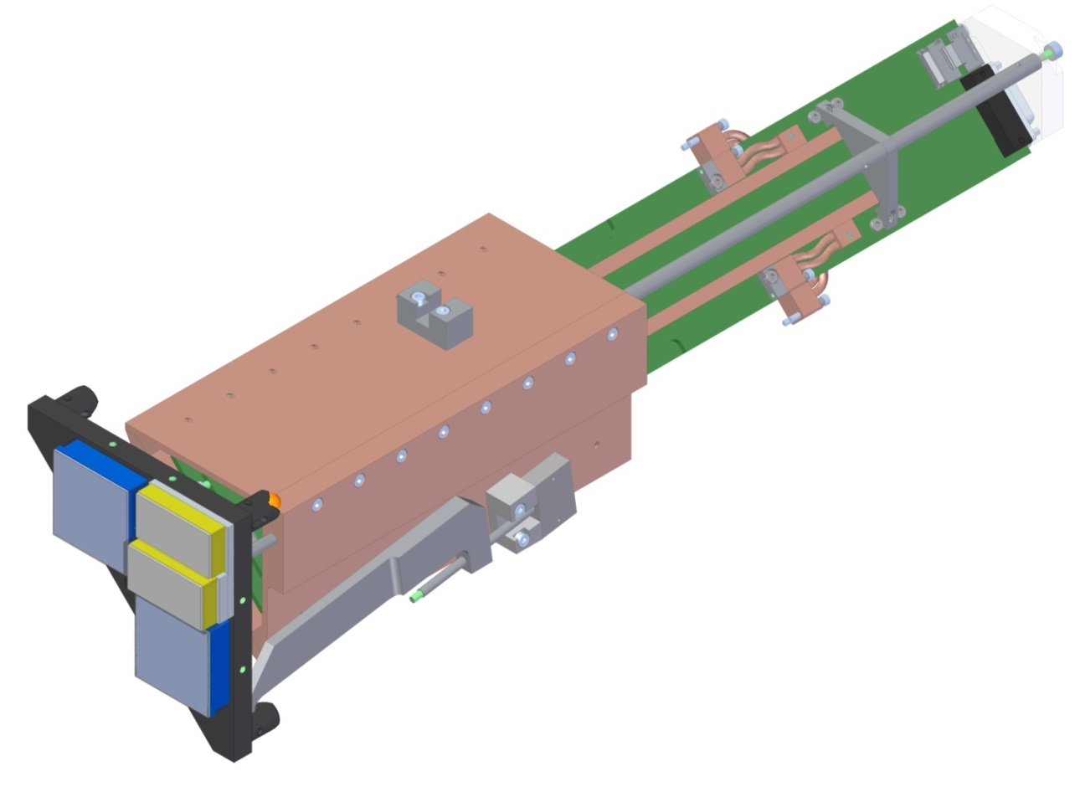
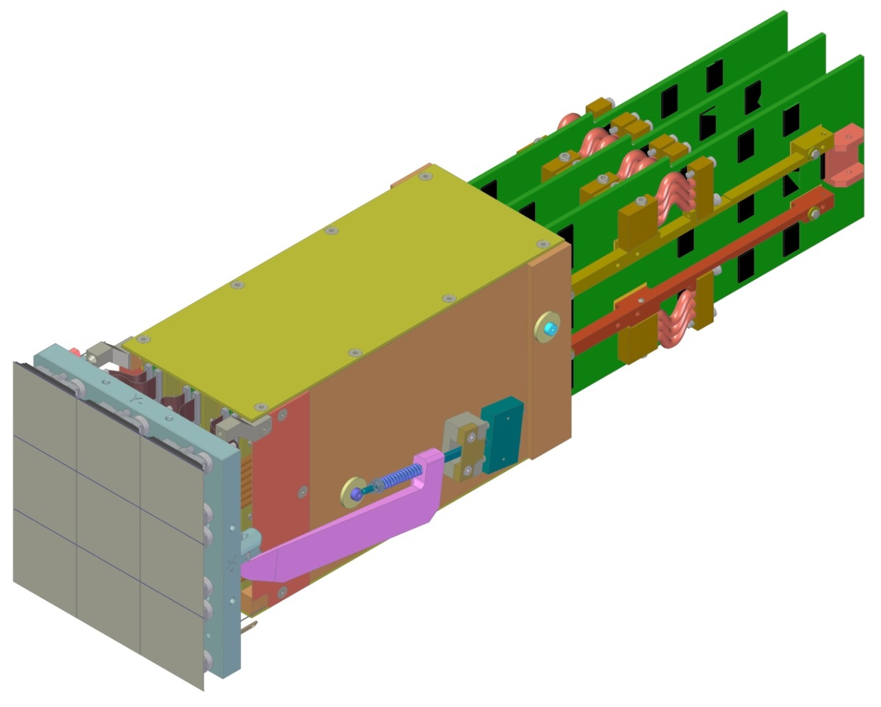


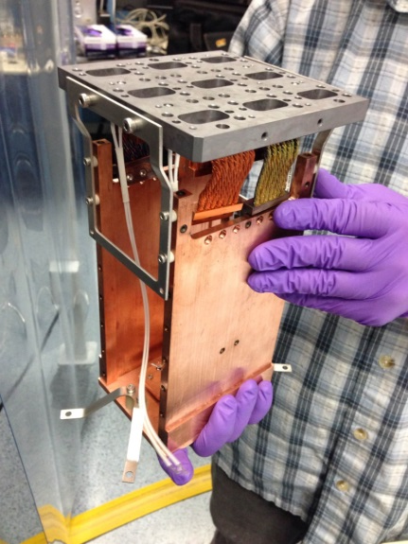
Raft sensor assemblies and raft tower modules
Raft Tower Module
1 REB provides voltages, read-out control, and image digitizing for 3 CCDs
Stack of 3 REBs mount to REC
RSA is held to Grid with spring-loaded hold-downs
Gap between CCDs on neighboring rafts: .5 mm
Raft Electronics Board (REB)
Corner Raft Tower Module
Science Raft Tower Module
Vulnerabilities
REB components can outgas in vacuum
RTMs integrate with very small clearances
Long thermal path with contact resistances
Prototype RTM structure and Base Plate

Slide 11
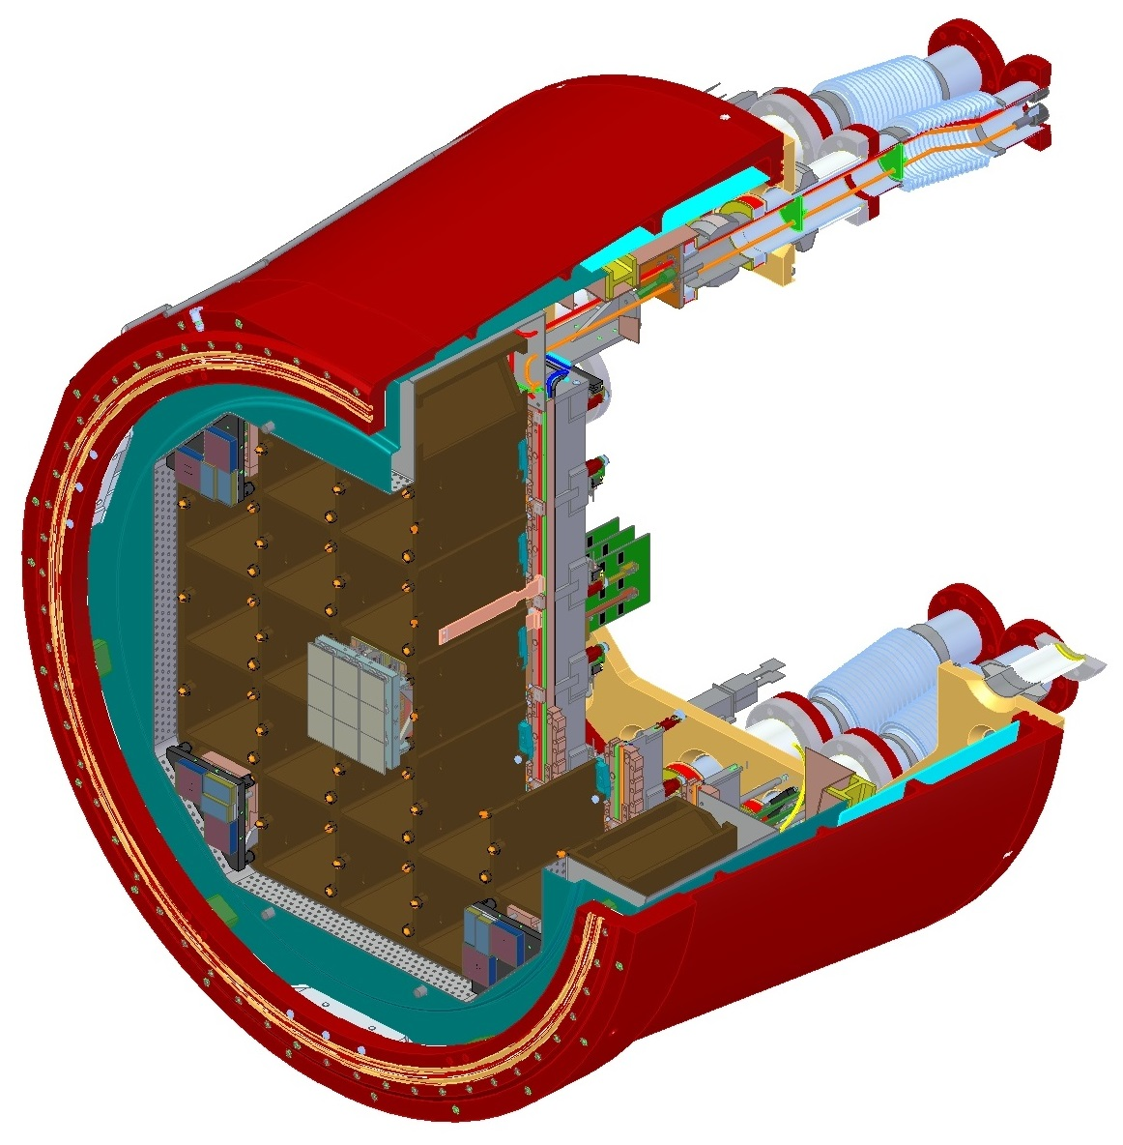
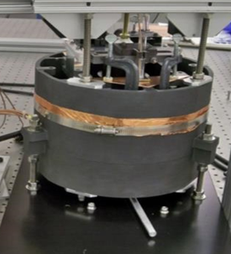
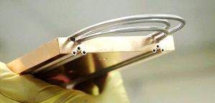
Cryostat assembly with raft towers integrated
Cryostat Integrating Structure
SiC Grid provides stable support for CCD detectors on focal plane
Cryo plate provides thermal control of cold CCDs
Cold plate removes REB process heat
Provides pumping and monitoring for clean high-vacuum environment
Cryostat Housing
Vacuum-insulated refrigerant lines (-135 C)
Cryo Plate (-135 C)
Cold Plate (-40 C)
Instrumentation flange
Sensors
(-100 C)
Grid K-C ball test
Vulnerabilities
Refrigerant leak in cryostat would contaminate CCDs and clean components
SiC Grid structure is brittle
Vacuum sealing and pumping is vital to reduce risk of contamination
Cryo Plate braze test
Grid support structure (-130 C)

Slide 12
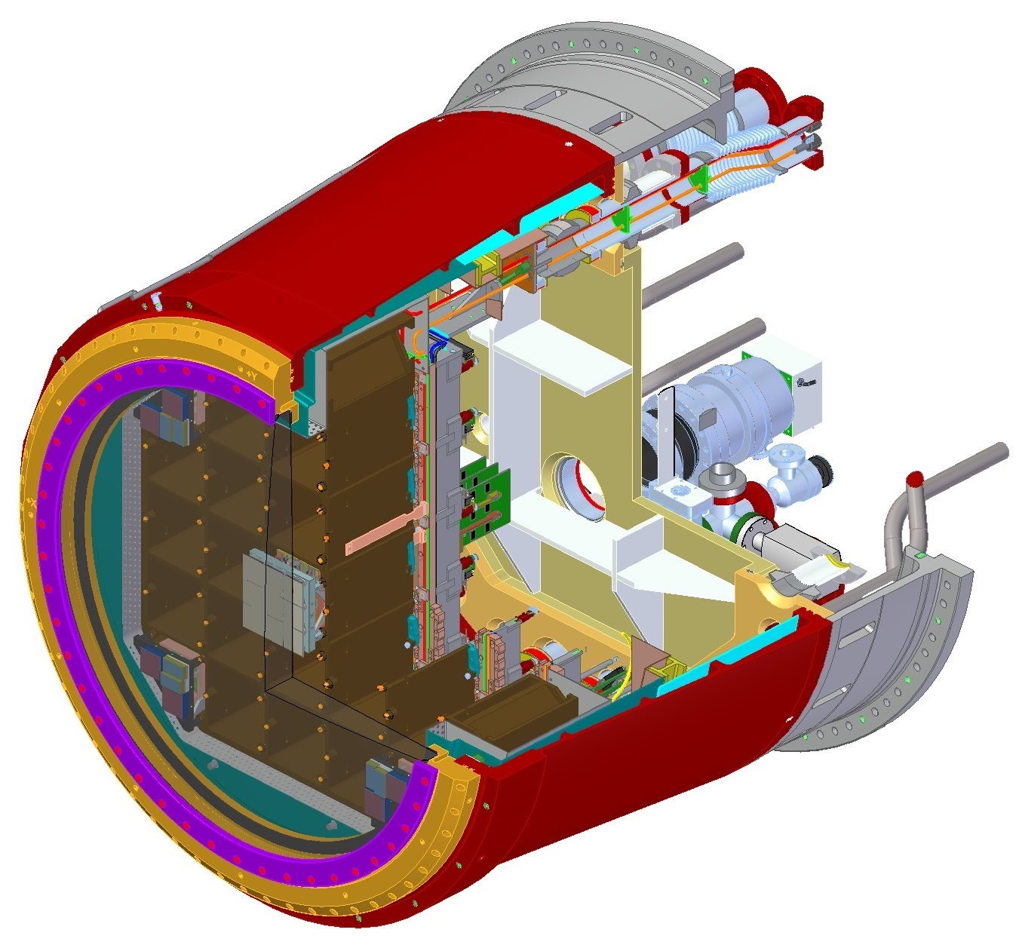
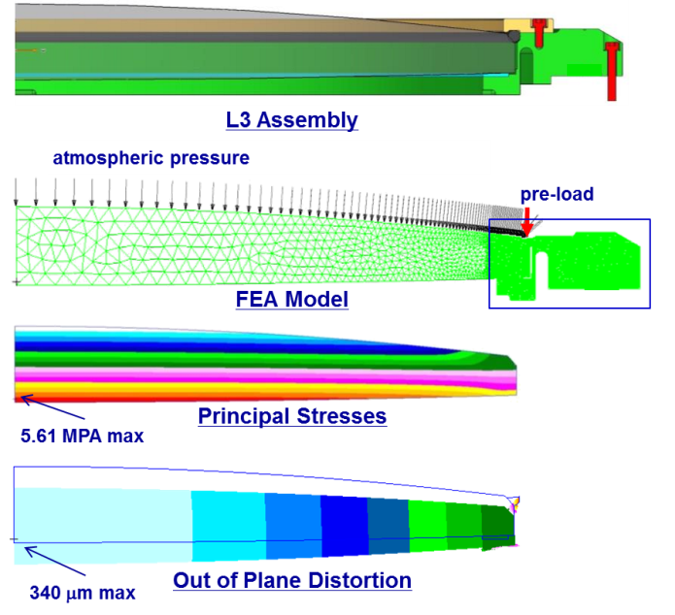
Cryostat with L3 lens and vacuum pumping hardware
L3 Lens Assembly
Entrance window into cryostat
Holds off atmospheric pressure load
Includes double vacuum seal
Titanium flange allows for thermal and structural isolation of lens from cryostat
Cryostat support cylinder
Vacuum system components
Vulnerabilities
Brittle material under stress
Lens/flange/cryostat CTE mismatches
L3 Lens stress analysis
L3 Lens Assembly

Slide 13
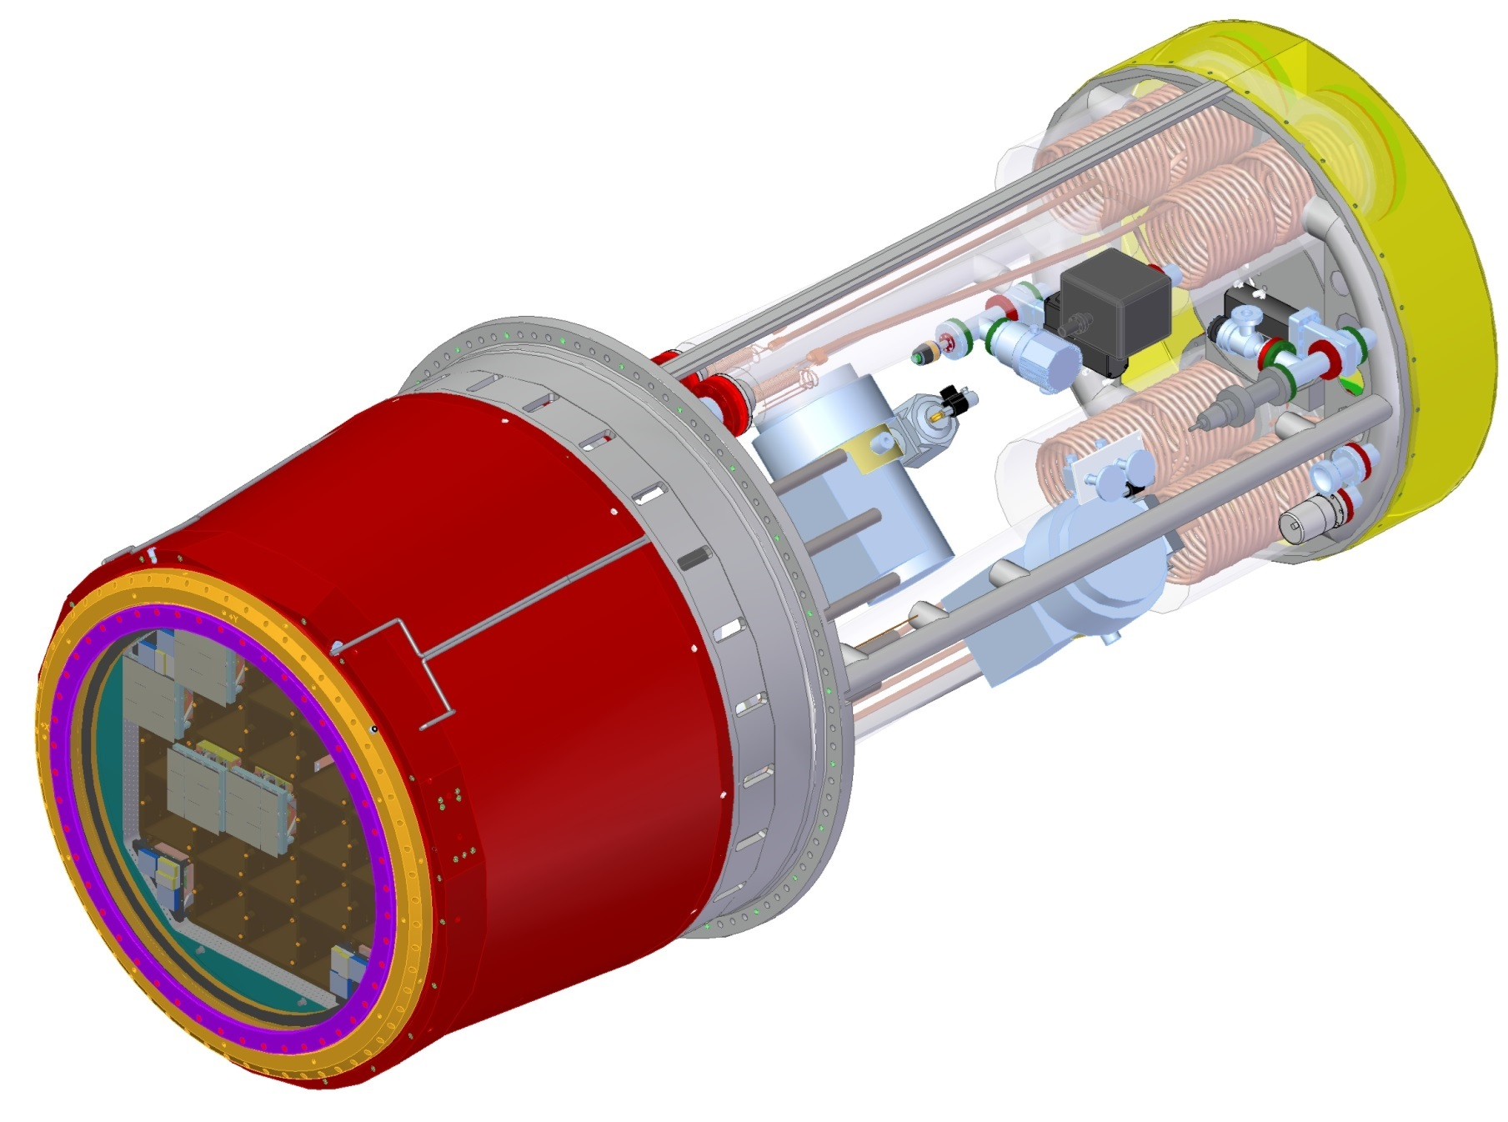
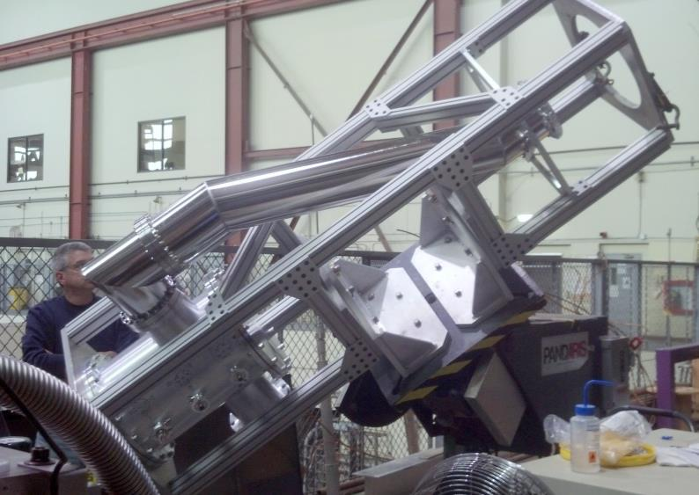
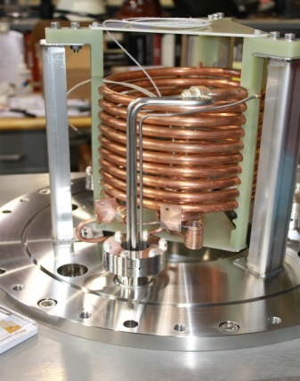
Cryostat and refrigeration system heat exchangers
Refrigeration Systems
Cryo system removes 540 W at -130 C from CCD heating, L3 radiation, conduction
Cold system removes 1500 W at -40 C from REB boards
8 parallel systems use commercial hermetically sealed compressors units
Compressors on telescope keel beam
Heat exchanger units
Vacuum-insulated transfer lines
Heat exchanger prototype
Fully articulating sub-scale prototype

Slide 14
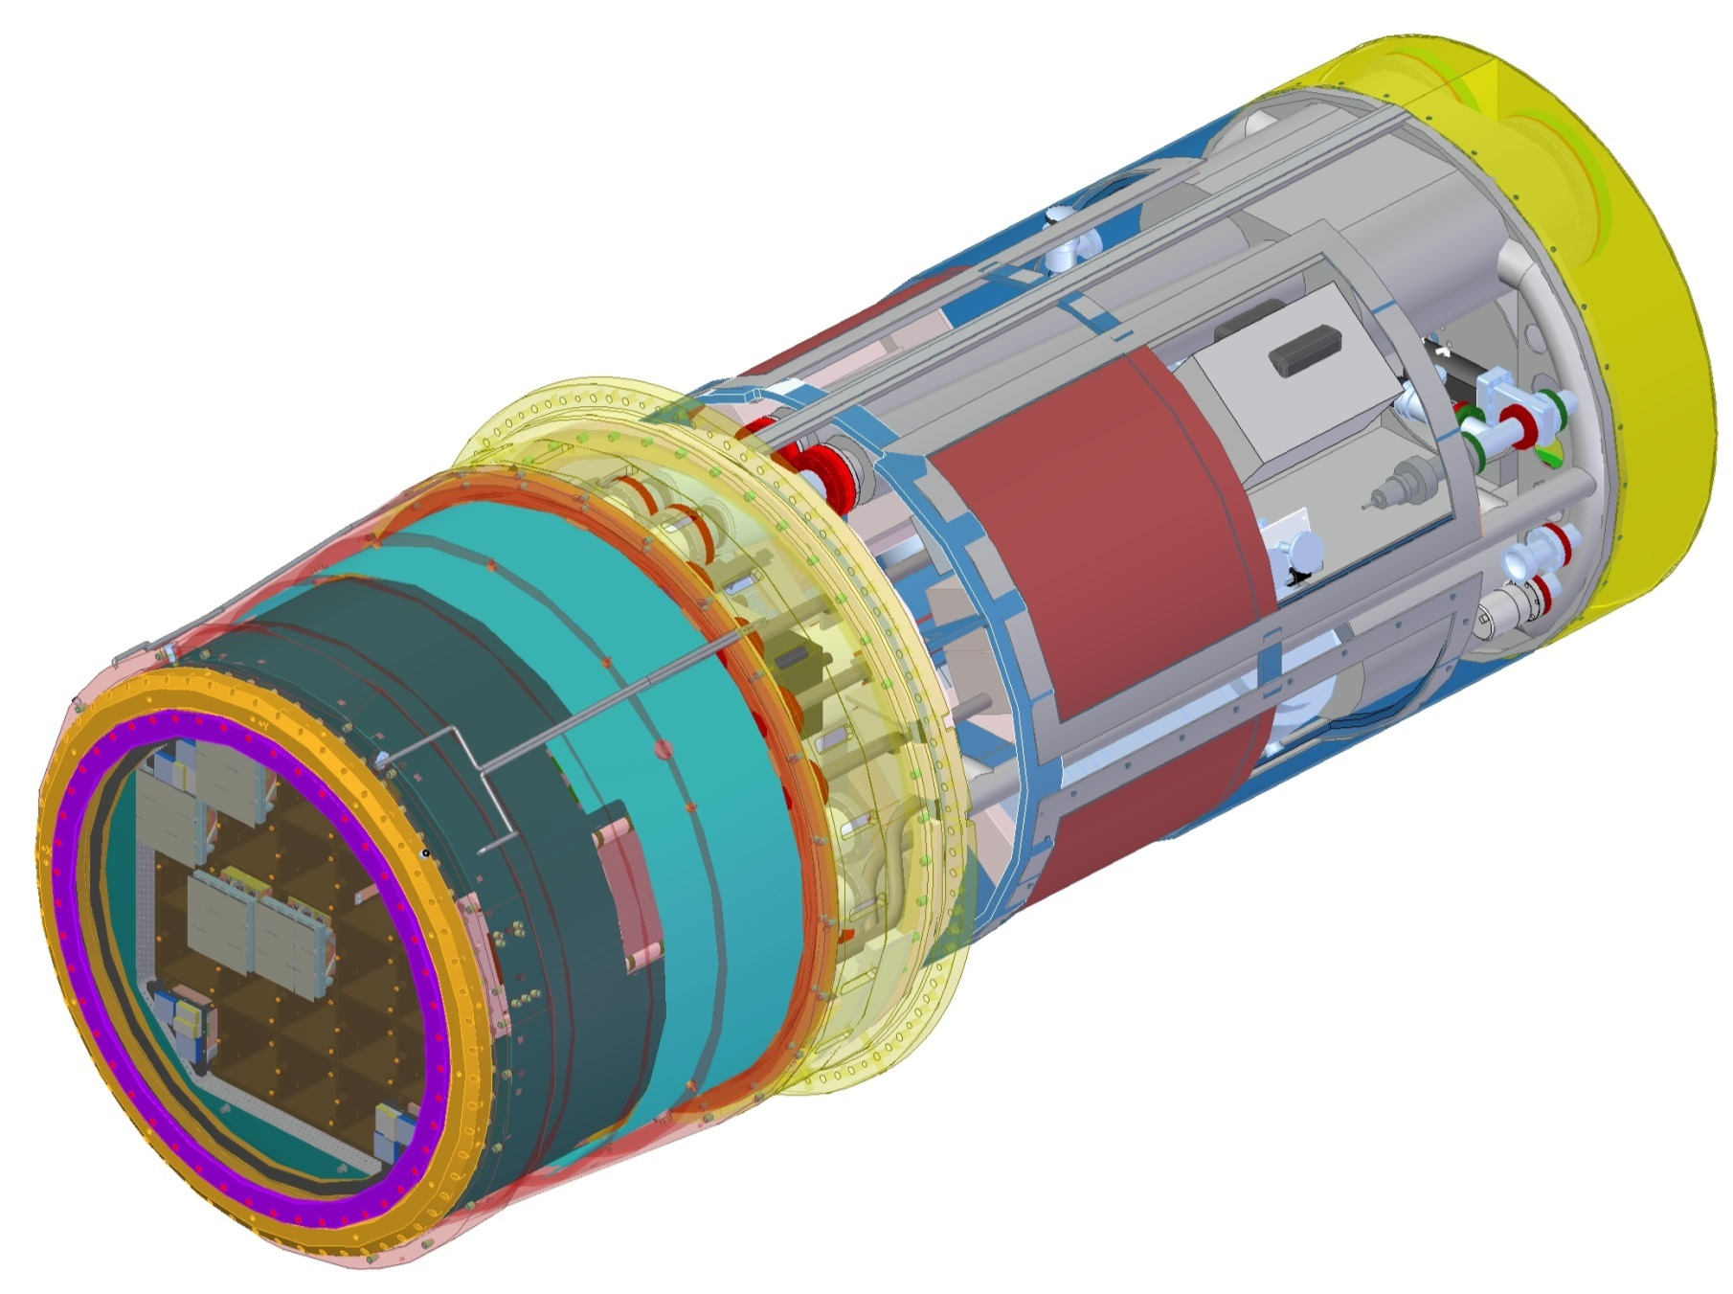
Cryostat and fully loaded utility trunk
Utility Trunk Integrating Structure
Houses utilities and electronics
Provides a single location for disconnect of all lines to the Camera
Cools all support utilities using glycol
Allows for access to electronics crates during camera servicing
Maintains clean, sealed environment
Vacuum components
Auxiliary electronics
Utility trunk
Region accessible while mounted to telescope
L3 Lens Assembly
Cryostat

Slide 15
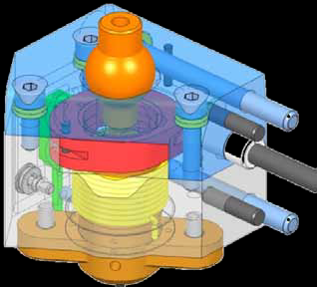
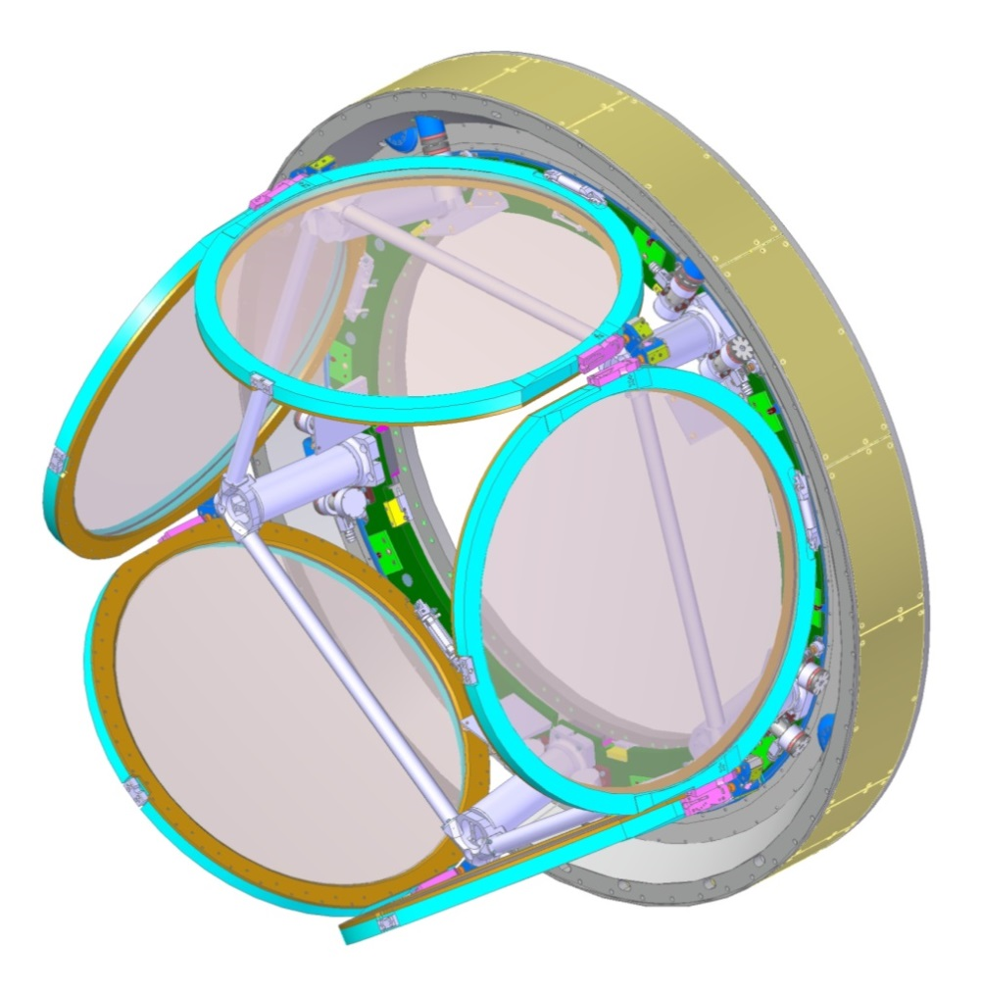
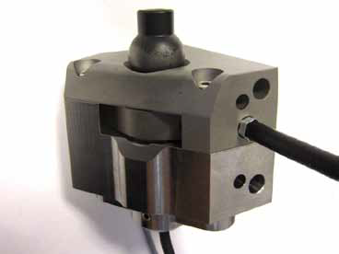
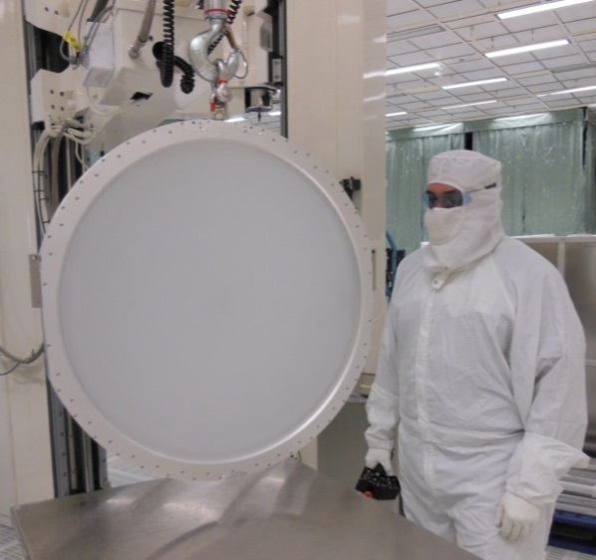
Carousel assembly holding 5 on-board filters
Carousel
Stores 5 filters in the clean environment of the Camera
Moves filter into the hand-off position for bringing on-line
Clears cryostat
Carousel X- filter clamp test unit
Carousel structure
Filter clamp
Filters
6 filters provide broad spectral range
Spherical radii and variable thickness of filters handled by standard frame design
Frame held kinematically
Vulnerabilities
Control of carousel clamp and rotation mechanisms
Kinematic supports result in many single failure point items
Stresses in thin filters
Back Flange
Filters
Filter demonstration unit

Slide 16
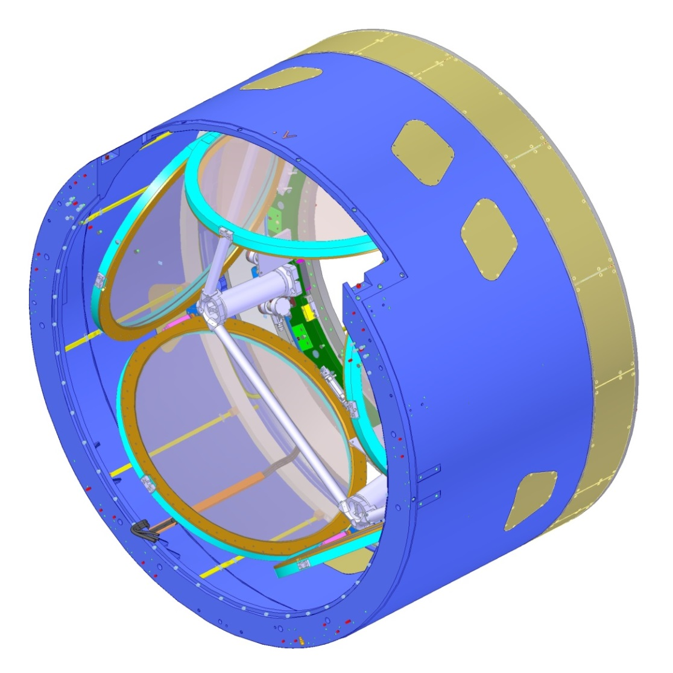
Camera body and back flange
Camera Body Integrating Structure
Provides primary support for L1-L2 Ass’y, Auto Changer, Shutter
Maintains clean, hermetically sealed environment for all optics
Presents primary structural interface to telescope at back flange
Presents primary thermal interface to telescope at outer housing
Vulnerabilities
High local loads and mount points
Must sustain 5.7 g seismic loads
Carries ~5 kPa internal pressure
Camera
back flange
Camera housing
Access ports

Slide 17
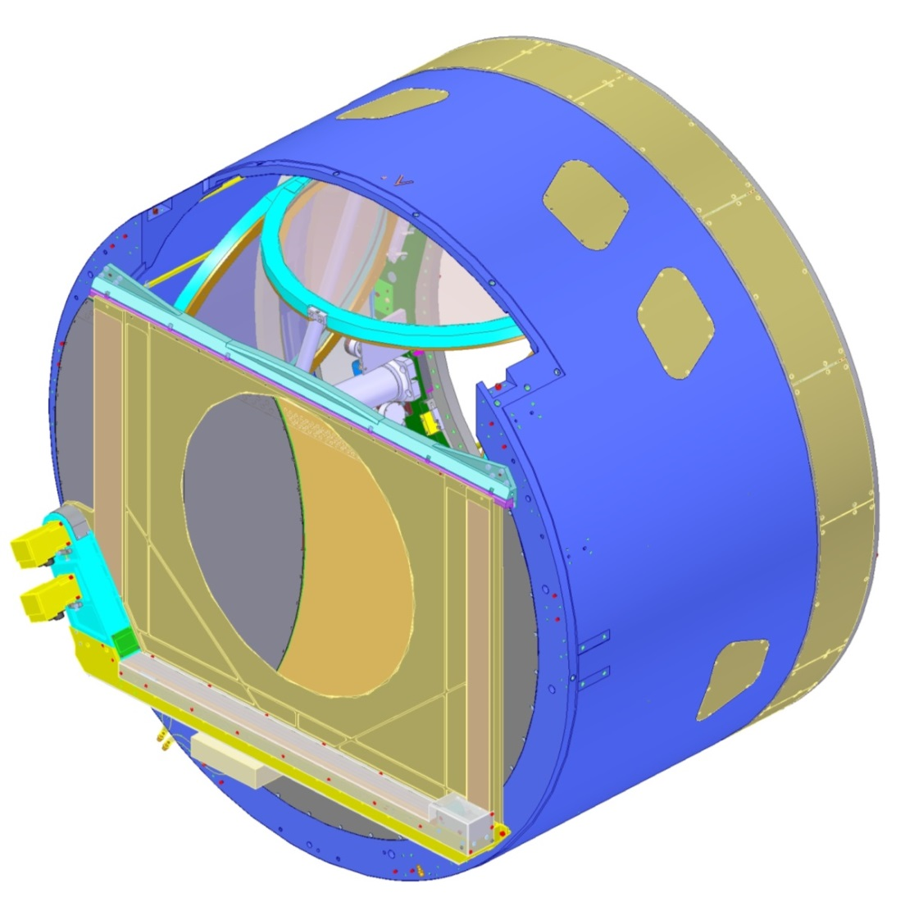
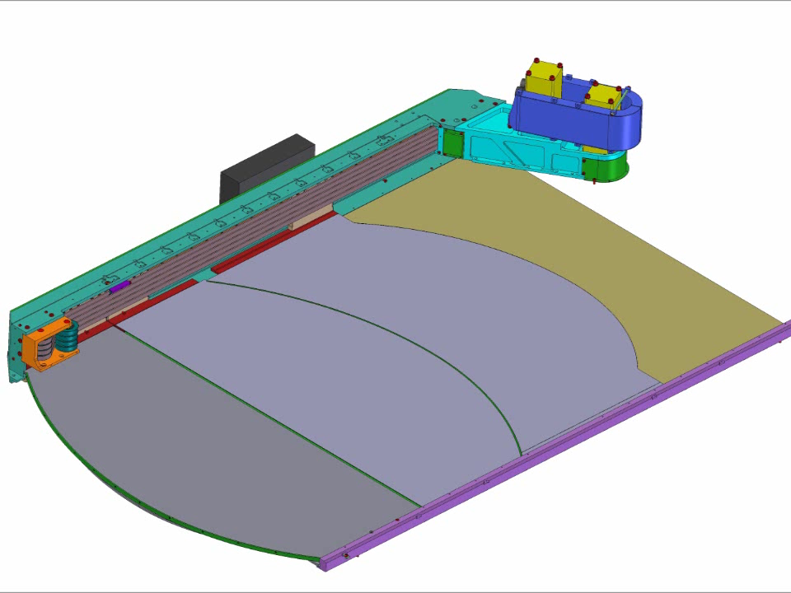
Shutter mounts to front flange of the camera body
Shutter
1 sec open/close time
734 mm opening aperture
1E6 cycles per year
Fits between filter and L3
Vulnerabilities
High blade speeds (~1.5 m/sec)
Close clearances to optics
Two blade stacks run on one rail
Shutter

Slide 18
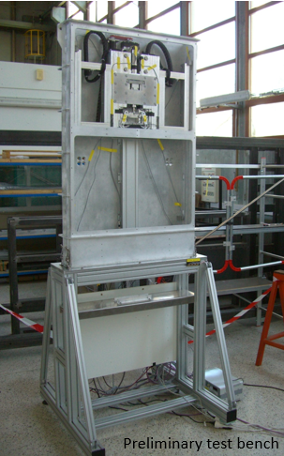
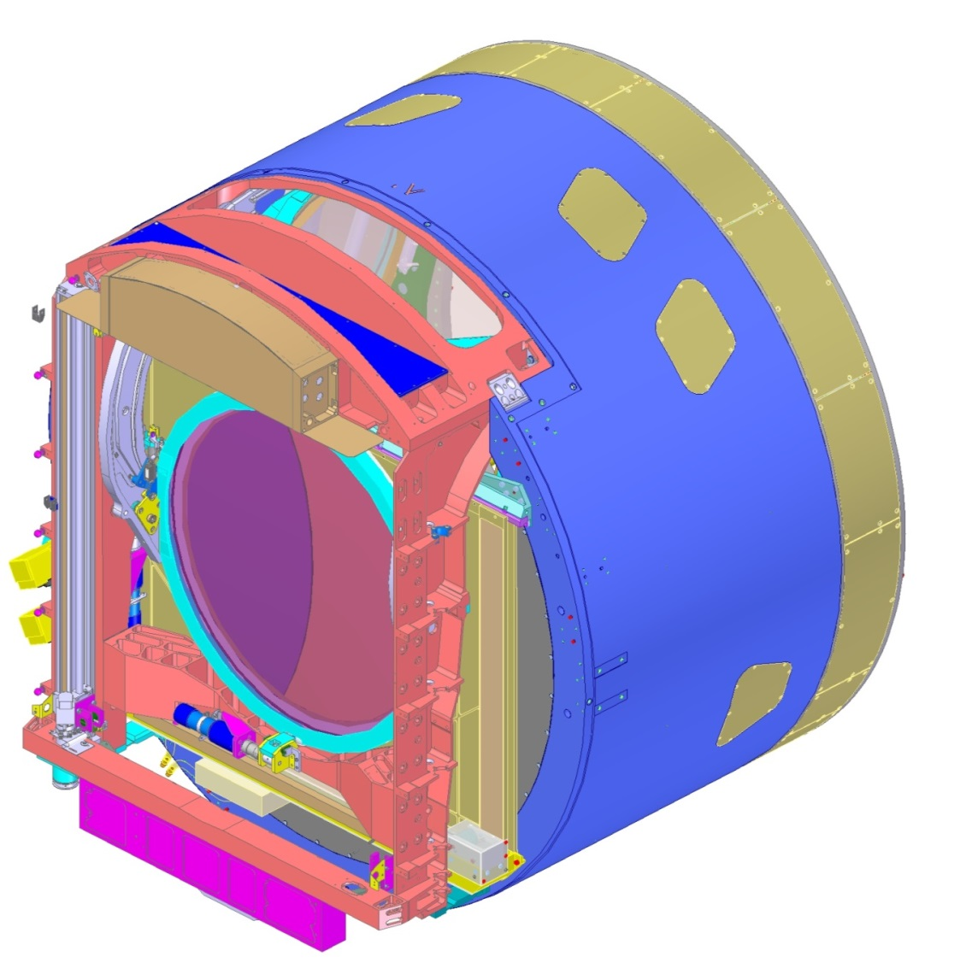
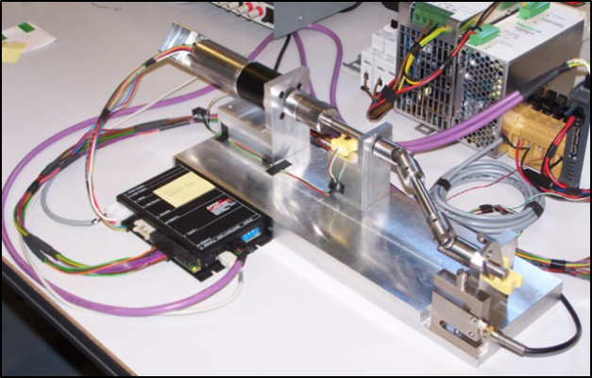
Auto changer moves filters from the Carousel into the on-line position
Exchange System
Supports a filter in the on-line position
Moves filter into the field of view by remote command
Change time < 90 sec
Filter diameter ~800 mm
Accommodates swap out of filter from camera
Filter Loader mount port
Filter Loader prototype
Vulnerabilities
Control of clamp and drive mechanisms
Kinematic supports result in single failure points
Drive train component failure or loss of function
On-Line Clamp test unit
Auto Changer
Filter

Slide 19
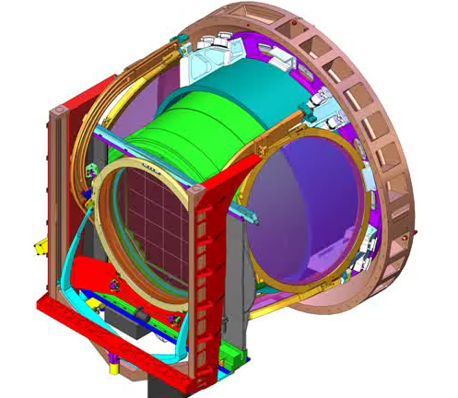

Exchange system motion and single-filter prototype test videos
Exchange system motions
Single filter test unit in Marseille, FR

Slide 20
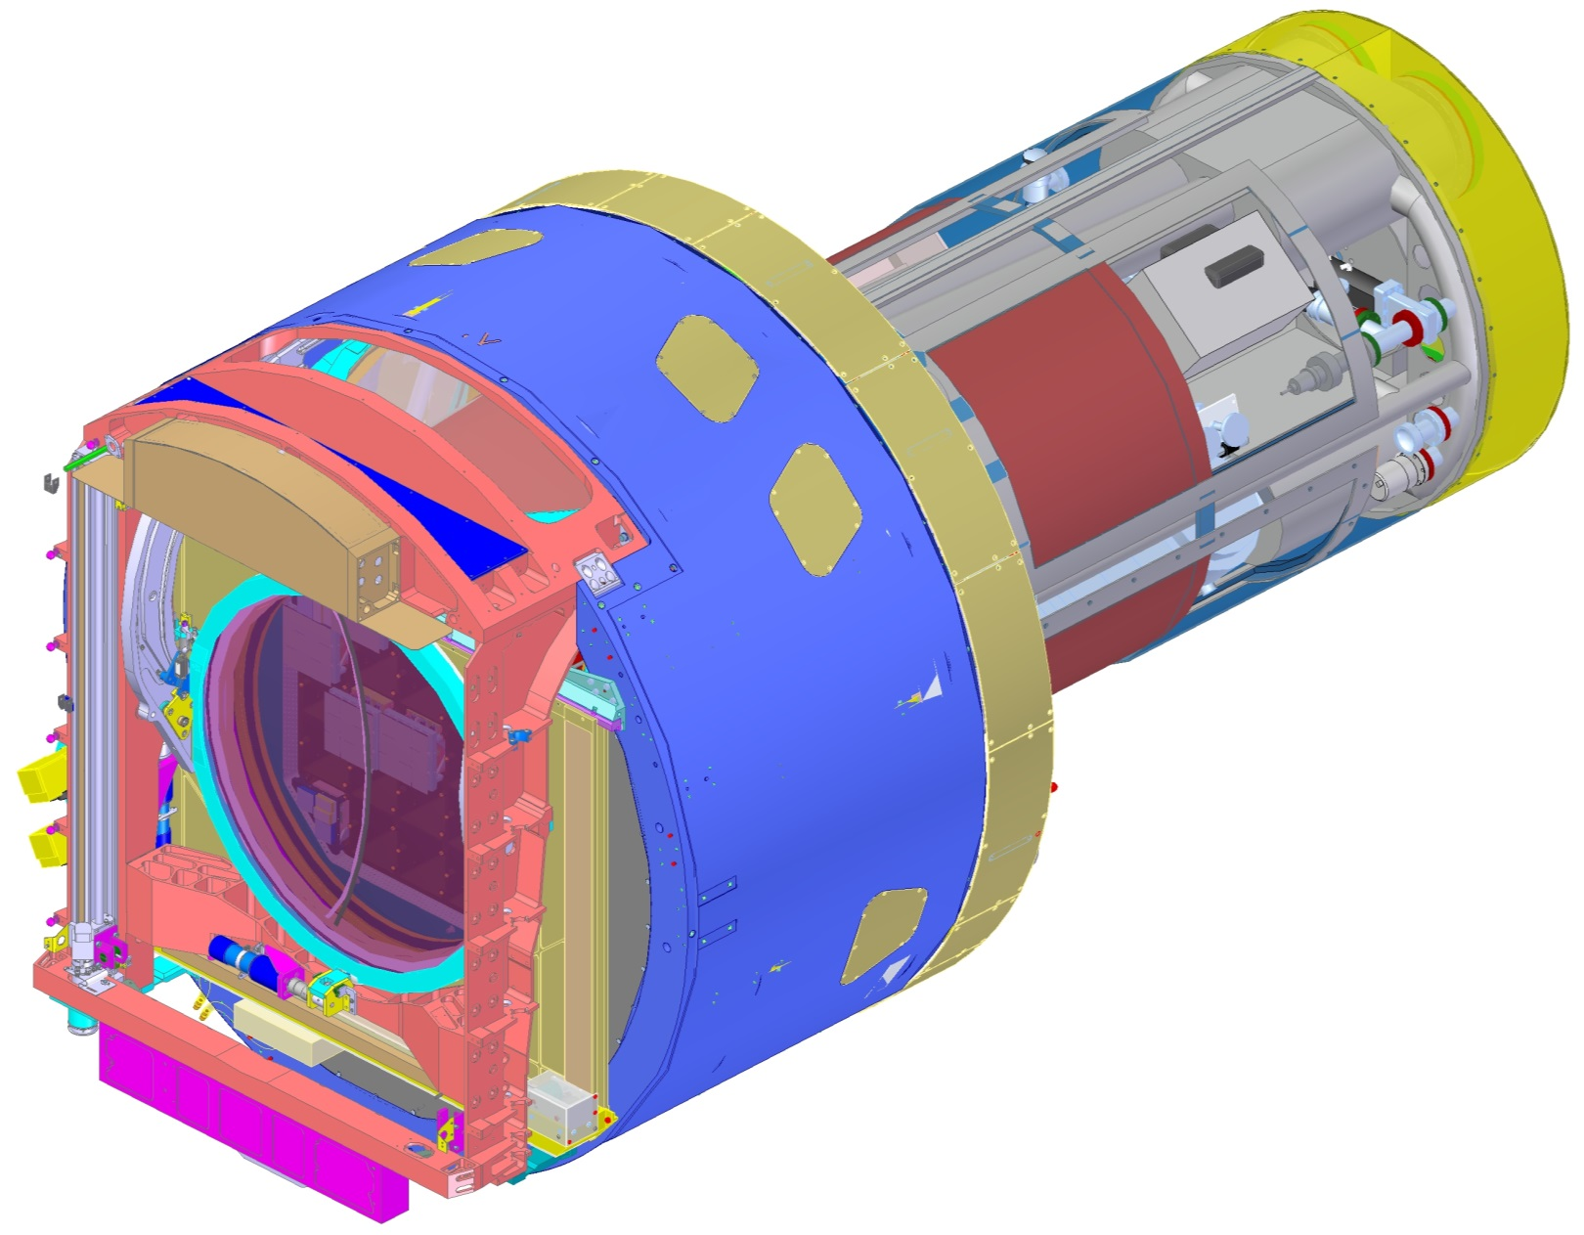
Fully loaded cryostat integrated into Camera assembly
Utility Trunk
Detector plane through Filter and L3

Slide 21
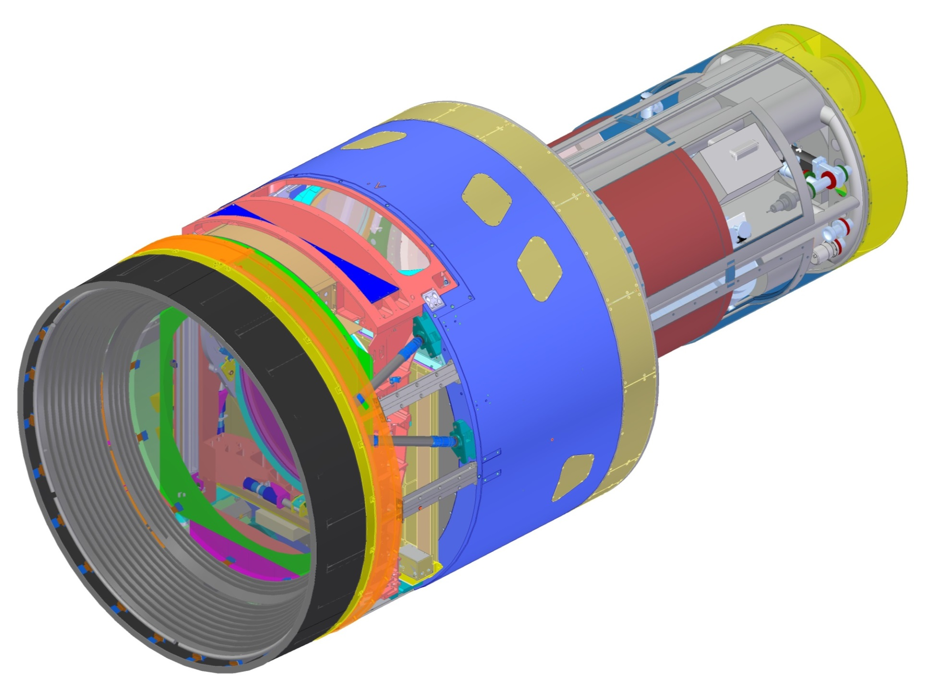
L1-L2 assembly mounted to the Camera front flange
L1-L2 Assembly
L1 lens is 1.6 m diameter
L1 and L2 lens aligned and tested as a unit
L1-L2 assembly supported kinematically
Struts allow for aligning the assembly
CFC structure provides rigidity
Vulnerabilities
Large, heavy lenses
Single failure point struts
Bonded joints and flexures under high stress
Bonded CFC structure
L1-L2 mounting struts
Camera shroud support frame
L1-L2 assembly

Slide 22
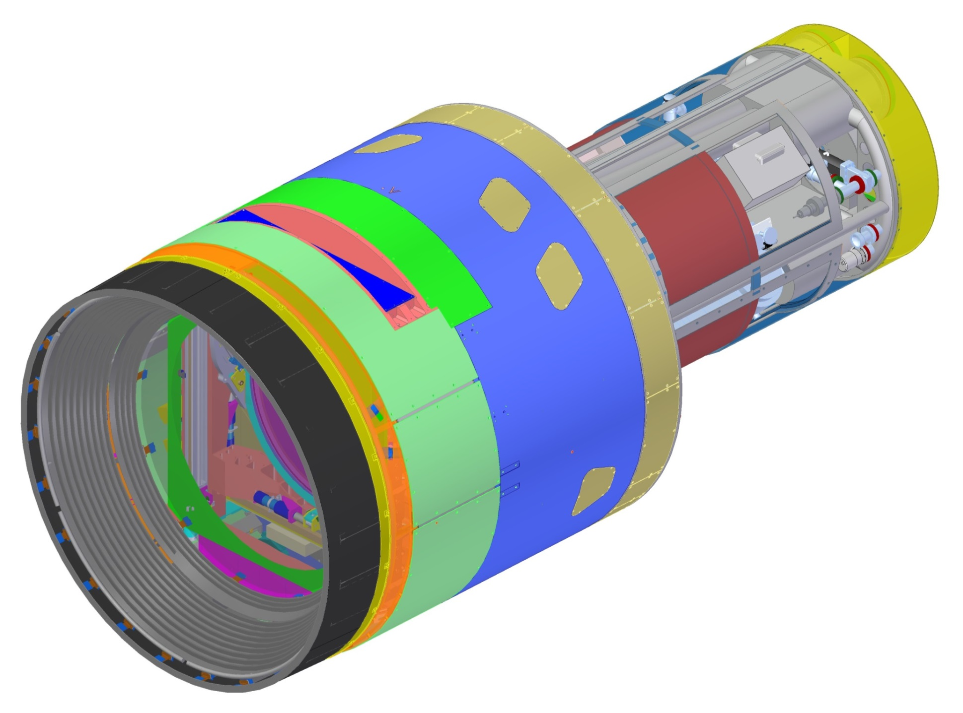
Camera with shroud—fully assembled
Utility Trunk
Camera Body
Camera Shroud
L1-L2 assembly

Slide 23
Camera assembly

Slide 24
Camera design summary
Nearly all subsystems of the camera have been subjected to a Final Design Review, including review of subsystem hazards and controls
  Remaining FDRs: refrigeration system, camera body, shutter, utility trunk, auxiliary electronics
Subsystem hazards have been identified and their definitions refined as subsystem designs have matured over the years
  Hazard design mitigations are included in the final design
  Hazard controls have been incorporated into the control and protection systems
  Administrative controls have been flagged as operating and support hazards and are scheduled to be further addressed at subsystem Manufacturing Readiness Reviews

