Slide 1
Observing Strategy
Highlighting key definitions, suggested SAC roles, and challenges

Slide 2
Key Components of the Observing Strategy and Key Avenues for Community Input
Suggested SAC Roles
Challenges

Slide 3
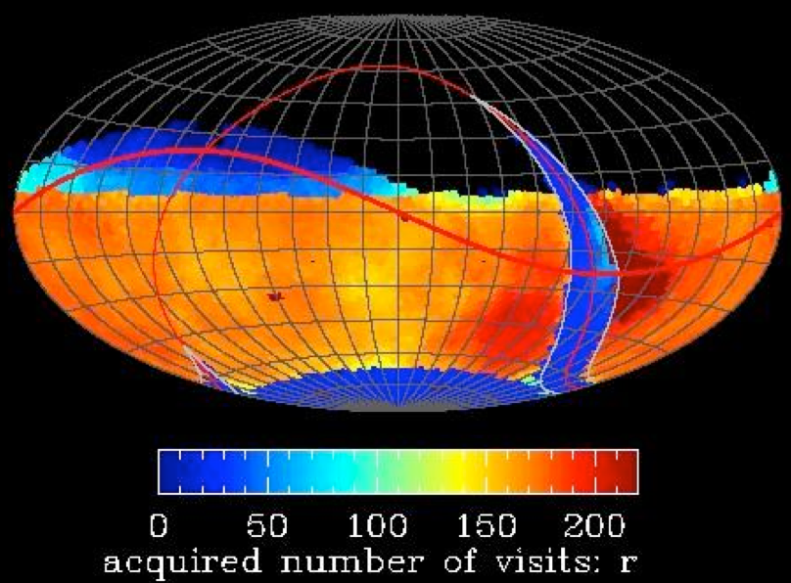
Key Components of the Observing Strategy
Wide-Fast-Deep
LSST’s core ~18,000 deg² survey
This is the most important aspect of LSST’s implementation to get right
We heard the community: Limited Project resources have focused on delivering simulated rolling cadences in the WFD footprint
The community white paper is the avenue for community input to the WFD cadence. This will remain the case through (at least) setting the baseline cadence for commissioning http://ls.st/o5k
Example LSST Observing Strategy

Slide 4
Key Components of the Observing Strategy
Mini-Surveys
Northern Ecliptic Spur
Galactic Plane
South Celestial Pole
The community white paper is the avenue for community input to mini-survey definition – via both metrics for assessing efficacy of cadences, and for suggested boundary conditions/survey strategies.
Resources permitting, should we continue to invite suggested mini-survey cadences through a separate process?
Example LSST Observing Strategy

Slide 5
Key Components of the Observing Strategy
Deep Drilling Fields
Limited area surveys, with unique cadences and/or specific depths and/or other unusual implementations – designed to accomplish unique science goals enabled by LSST’s wide FOV and aperture.
A request for proposals (target Fall 2017) will define DDFs in more quantitative detail. Evaluation of proposals will involve the SAC. Andy Connolly will discuss the proposed process.
Example LSST Observing Strategy

Slide 6
Key Components of the Observing Strategy
Director’s Discretionary Time
We want the operations project to be responsive and flexible to unique opportunities, such as LIGO follow-up.
It is too early to predict the most compelling opportunities in the mid-2020’s.
We propose a small amount of Director’s Discretionary time to protect this flexibility, and are currently considering 1% of time allocated for DD programs.
The process for requesting DD time will be defined shortly before operations begins.

Slide 7
Suggested SAC roles
Readers for Observing Strategy White Paper chapters
We would like to distribute community contributed white paper chapters among SAC members for basic review – end of March. Suggested return of comments – end of April/early May. Not a referee’ing process.
Would it help for this presentation to be summarized in a 1-2 page document for the community?
Appropriate representation of science cases in community contributed metrics
Any implementation of the LSST cadence must deliver on the science requirements. SAC involvement in White Paper reading will enable assessment of science representation among metrics, and ID’ing major gaps. The Project will look to the SAC to take a leading role in gathering additional science input.

