Slide 2
Safety Management - NOAO-AURA-LSST Base Facility Addition
HOW WE MANAGE SAFETY IN THE PROJECT OF REFURBISHING AND BUILDING BASE FACILITY

Slide 3
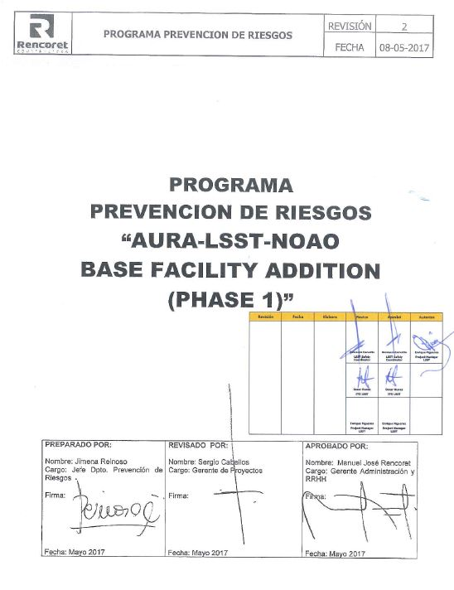
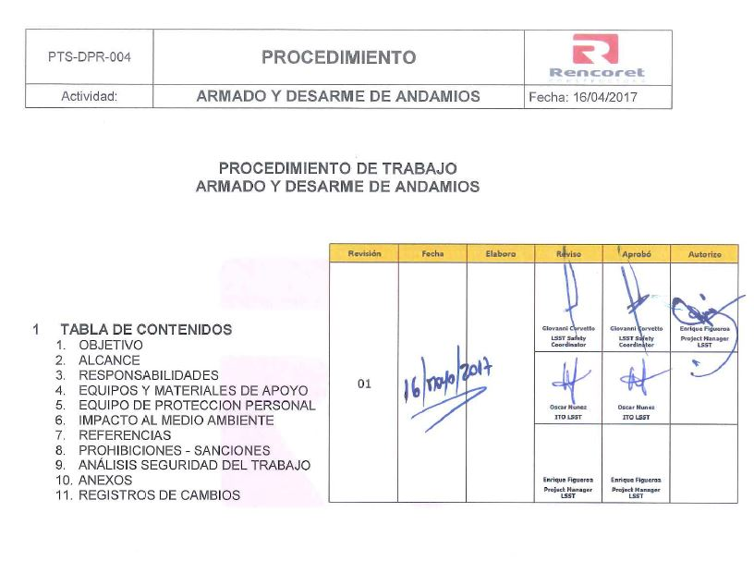
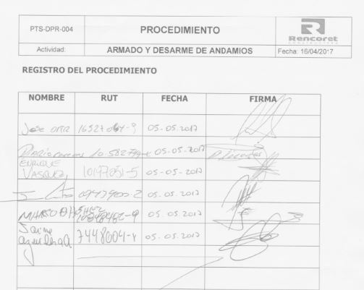
Safety Management - NOAO-AURA-LSST Base Facility Addition
Safety and Occupational Health and Environment Programs of each contractor
Safety Work Procedures for each specific area of the Project
Training of employees in safety work procedures

Slide 4
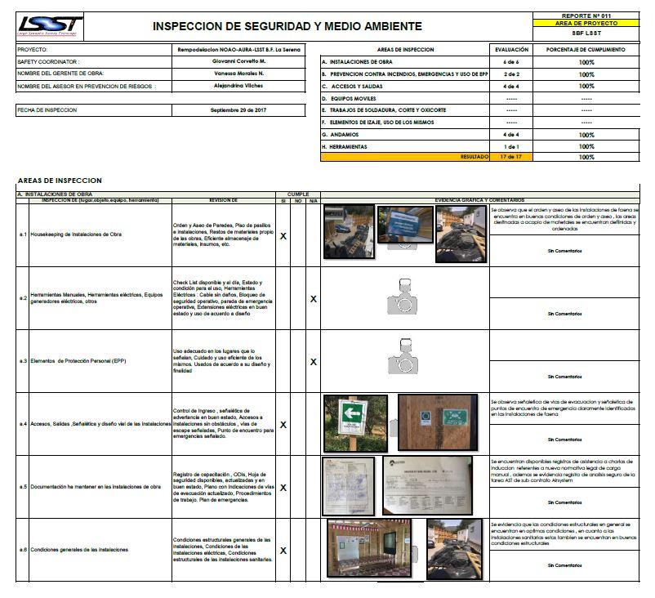
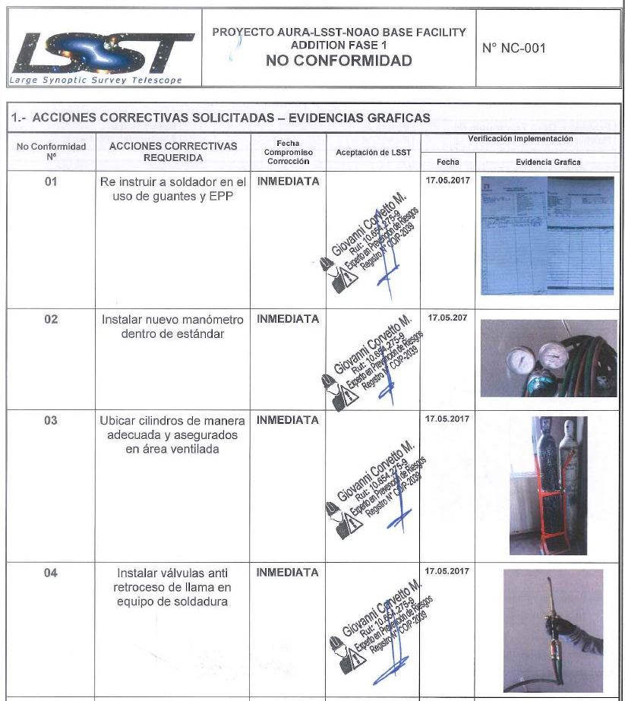
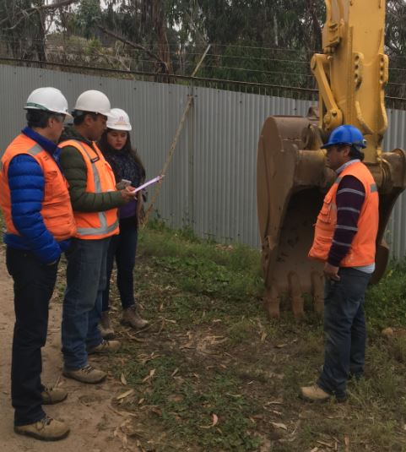
Safety Management - NOAO-AURA-LSST Base Facility Addition
Weekly Safety Inspections
Identifying Hazards and Documented via Non-Conformities Format
Coordination Meetings

Slide 5
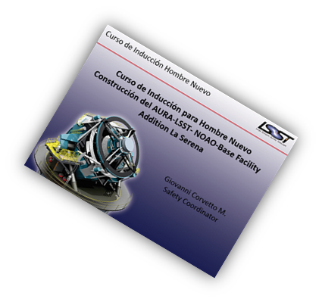
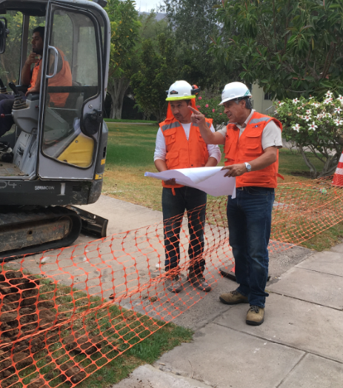
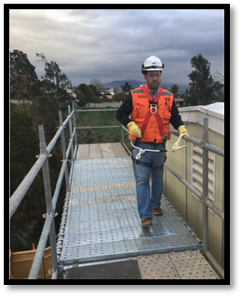
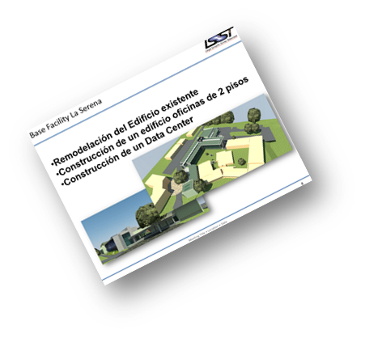
Safety Management - NOAO-AURA-LSST Base Facility Addition
Weekly Coordination Meetings between the LSST Team and Contractors
Design of a protocol that includes Safety Induction of all Contractor Staff
Permanent presence at construction site of the LSST Staff (Project Manager, ITO Technical, Safety Coordinator)

Slide 6
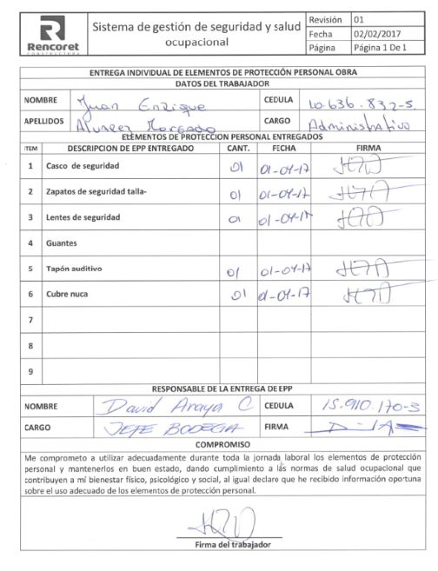
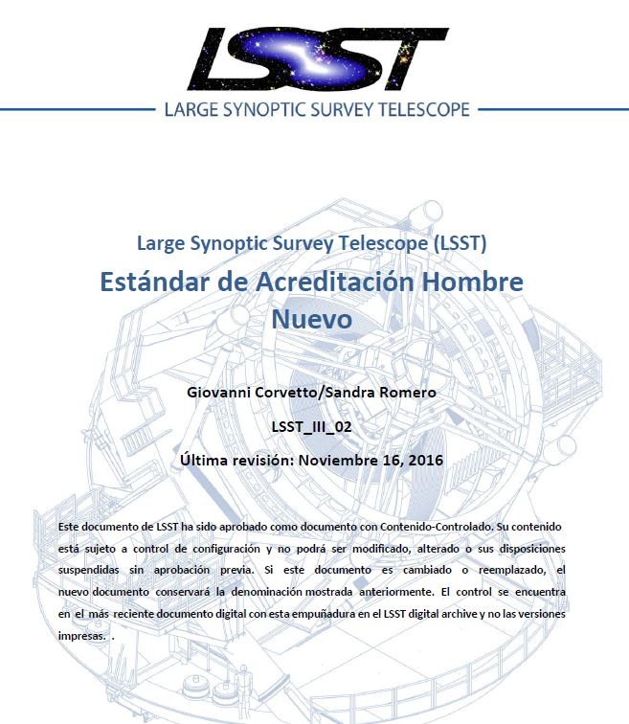
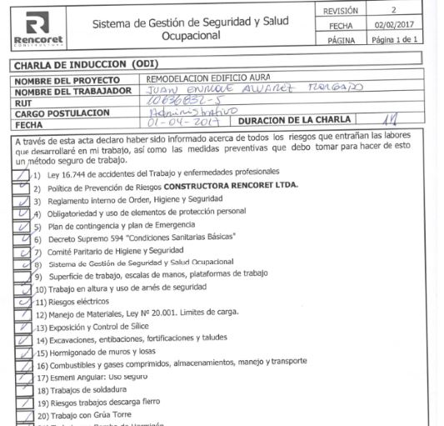
Safety Management - NOAO-AURA-LSST Base Facility Addition
Design of an accreditation standard to ensure compliance with legal regulations
Review of relevant documentation (ODI, PPE Registry) and submission to the Procurement Department

Slide 7
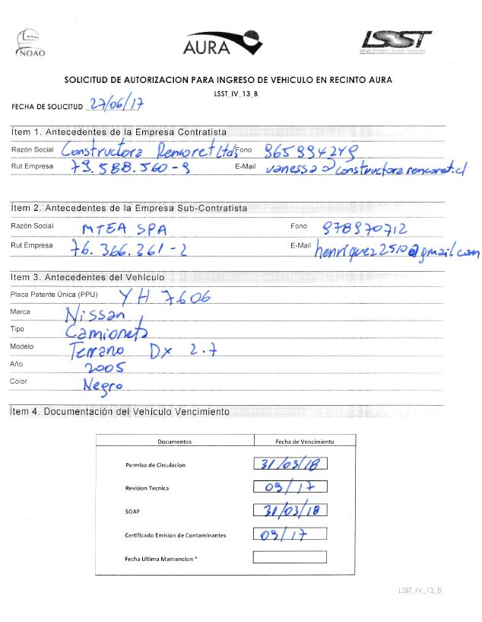
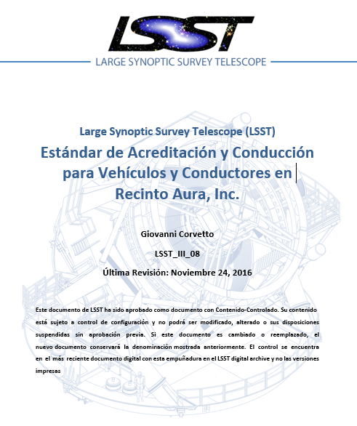
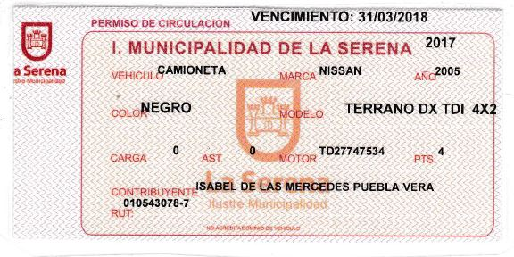
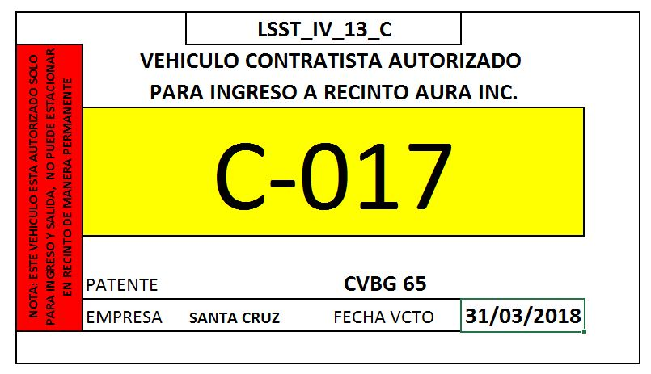
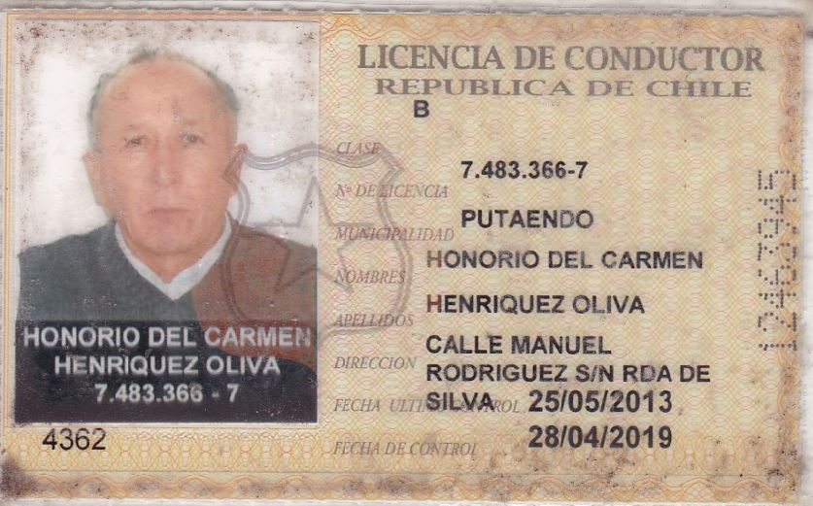
Safety Management - NOAO-AURA-LSST Base Facility Addition
Other Areas of Safety Management
Design of Vehicle Accreditation System
Previous Vehicle Documentation Review
Previous Review of Drivers and Operators Documentation

Slide 8
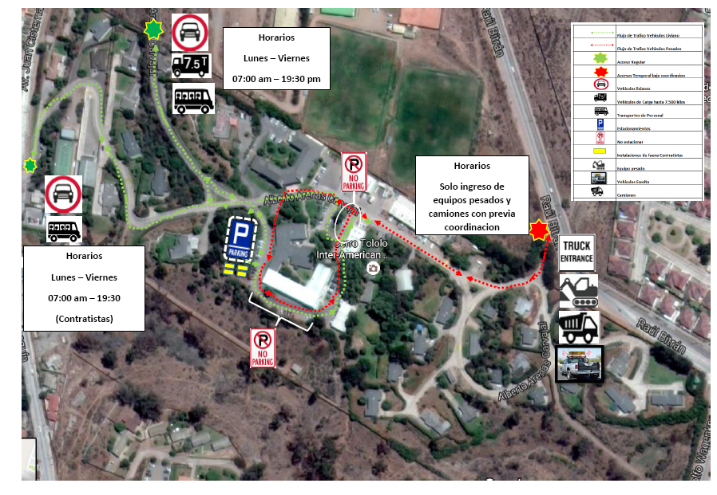
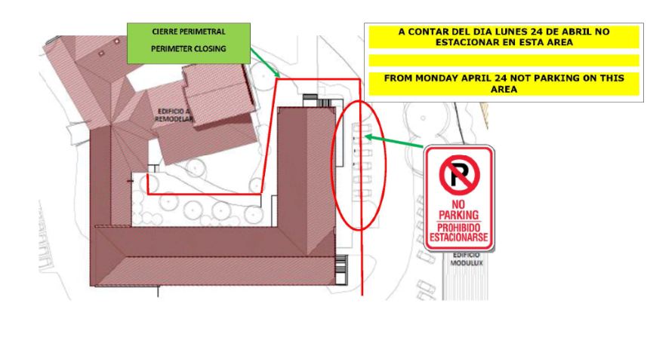
Safety Management - NOAO-AURA-LSST Base Facility Addition
Safety traffic flow design during construction

Slide 9
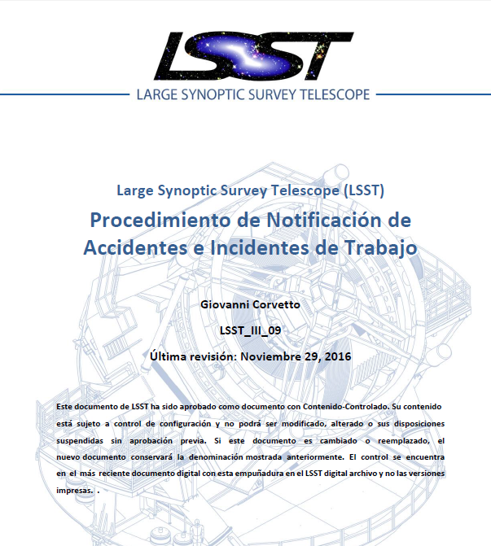
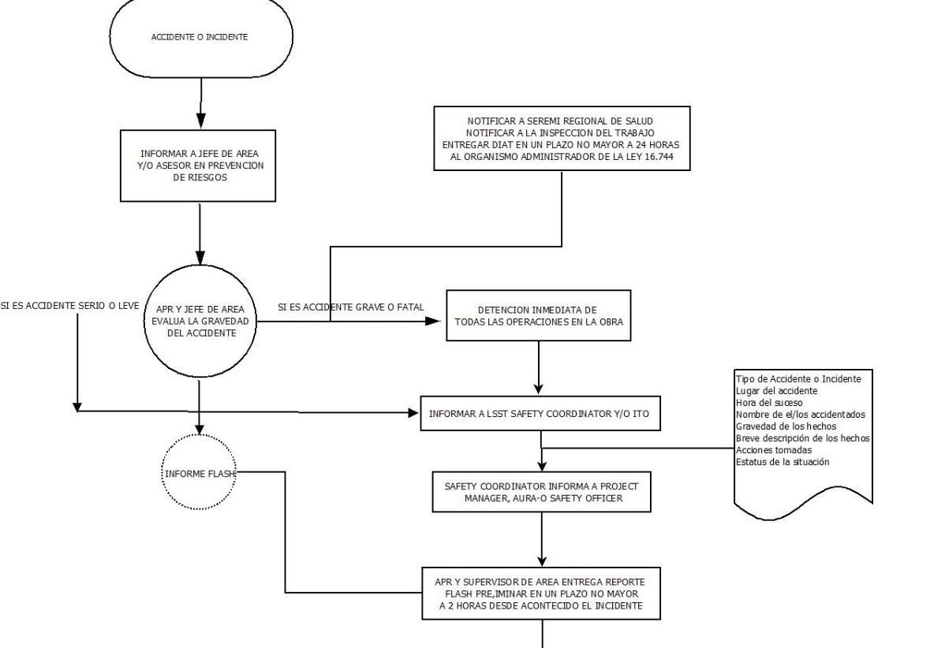
Safety Management - NOAO-AURA-LSST Base Facility Addition
Communication Standards for Contractors
Accident Notification and Investigation

Slide 10
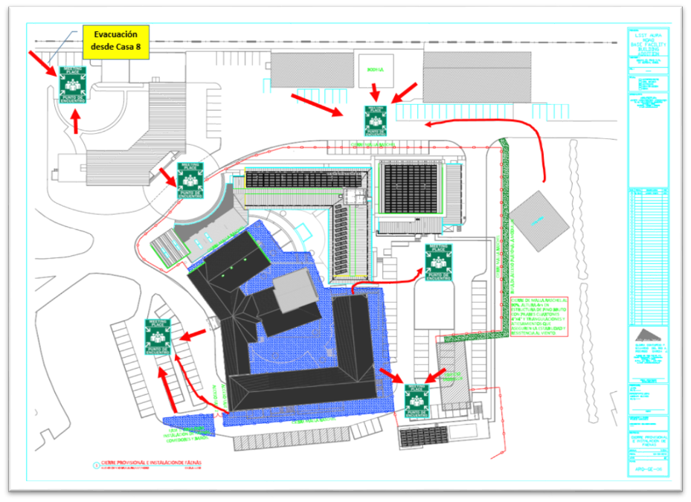
Safety Management - NOAO-AURA-LSST Base Facility Addition
Design of Emergency Meeting Points in conjunction with Aura Safety Pro's

