Slide 1
LSST PROJECT PHASE #2 BASE FACILITY AND DATA CENTER CONSTRUCTION

Slide 2
AS PREPARATION OF THE SITE FOR THE LOCATION OF THE BASE FACILITY AND DATA CENTER HAS BEEN NECESSARY TO PERFORM A SERIE OF PREVIOUS WORKS TO THE CONSTRUCTION OF THE BUILDINGS, AS INDICATED: .- RELOCATION OF ELECTRICAL LINES .- RELOCATION OF COMMUNICATION LINES .- SECTOR WATER MATRIX TO INTERVENE .- GAS LINES .- SEWAGE SYSTEM .- RELOCATION OF SMALL FIRE STATION .- DEMOLITION OF NORTH SIDE OF THE MOTEL .- PARTIAL WAREHOUSE RELOCATION .- INTALLATION OF HALF VOLTAGE LINES AND LOW CURRENTS. .- REMOVE OF ARBORIC SPECIES AND TRANSPLANT OF PALMERAS SOUTH SECTOR MODULUX BUILDING.

Slide 3
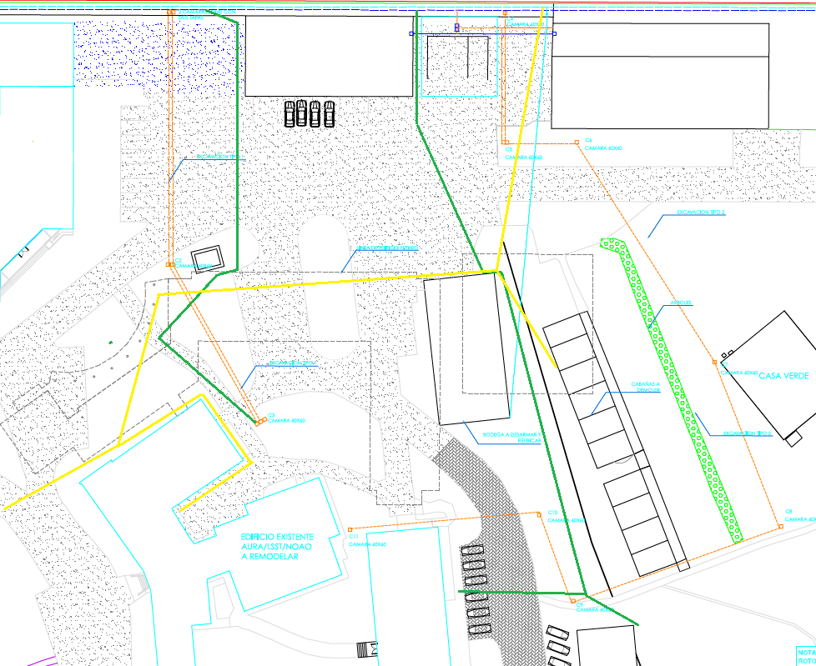
RELOCATION OF UTILITIES
.- ELECTRICAL LINES
.- COMMUNICATION LINES
.- WATER MATRIX
.- GAS LINES
.- RED FIRE
.- SEWAGE SYSTEM

Slide 4
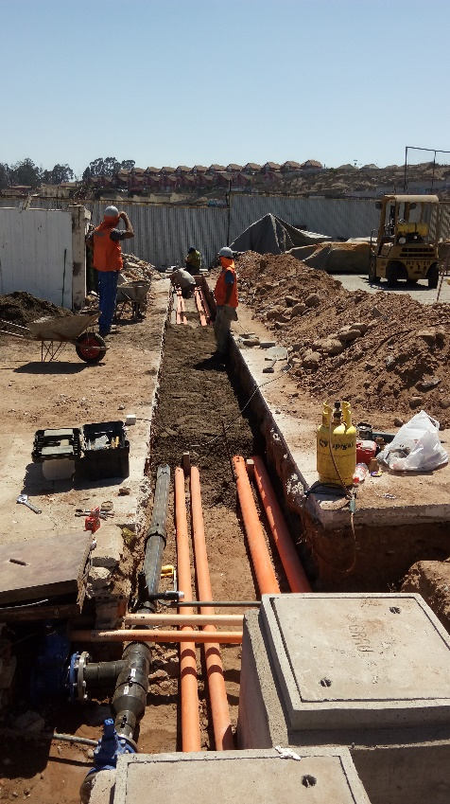
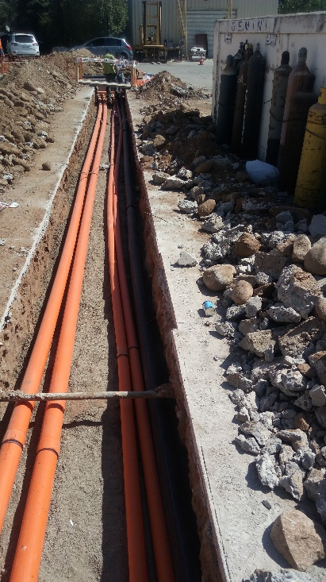
DUCT EXCAVATION AND INSTALLATION
Excavation and installation of electrical and communication ducts.
Electrical ducts 2 of diameters. 75 mm.
Communication ducts 2 of diameters. 110 mm.
Depth of excavation: 500 mm. and 800 mm. in the street.

Slide 5
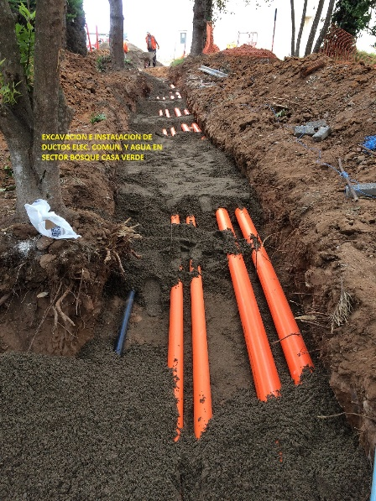
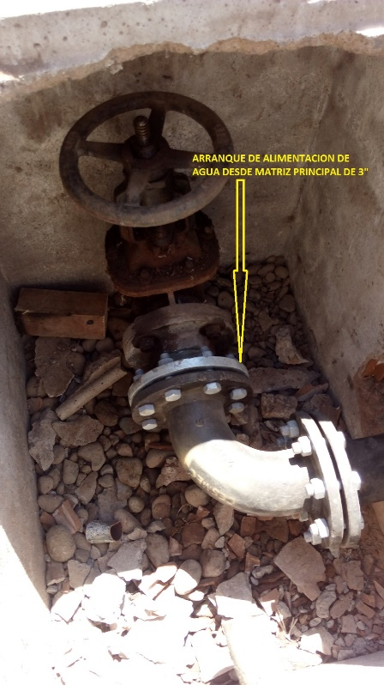

Slide 6
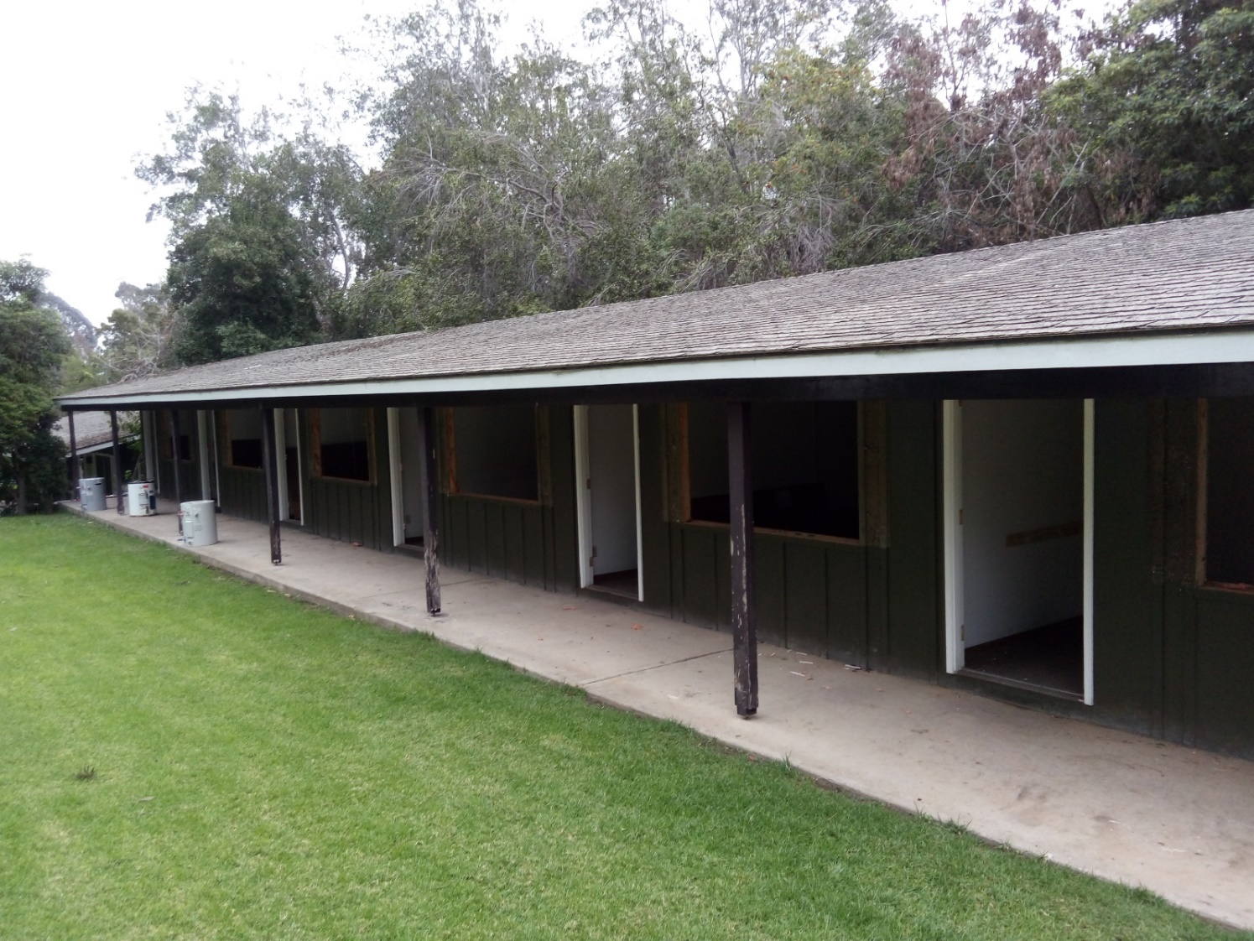
MOTEL SECTION TO DEMOLISH
The Motel section that was necessary demolishing corresponds to the north side section with a total of 5 rooms and a kitchenette.

Slide 7
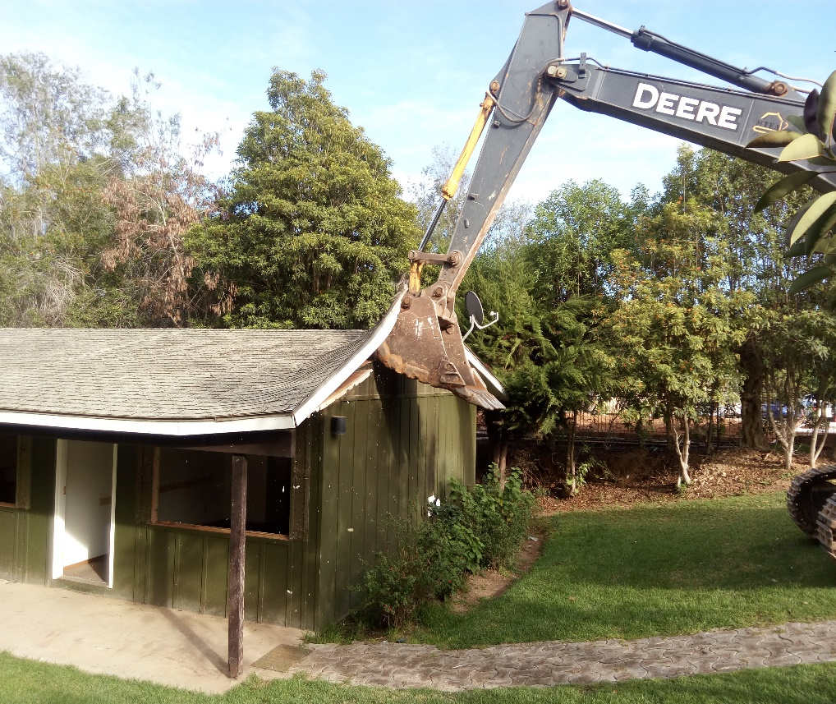
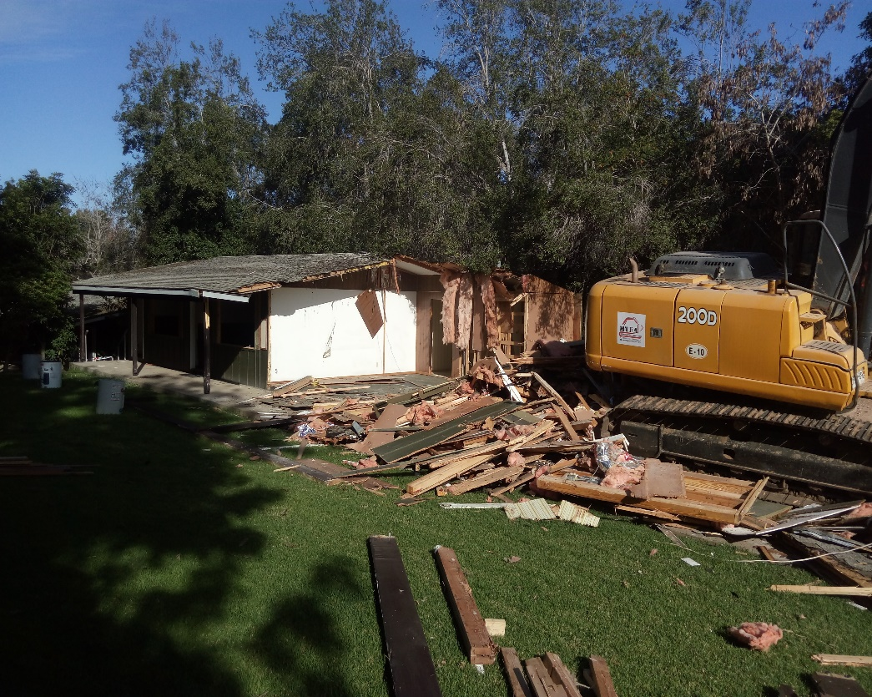
MOTEL DEMOLISHING PROCESS
.- July 4th: Start demolition of the Motel, work lasted 3 days.

Slide 8
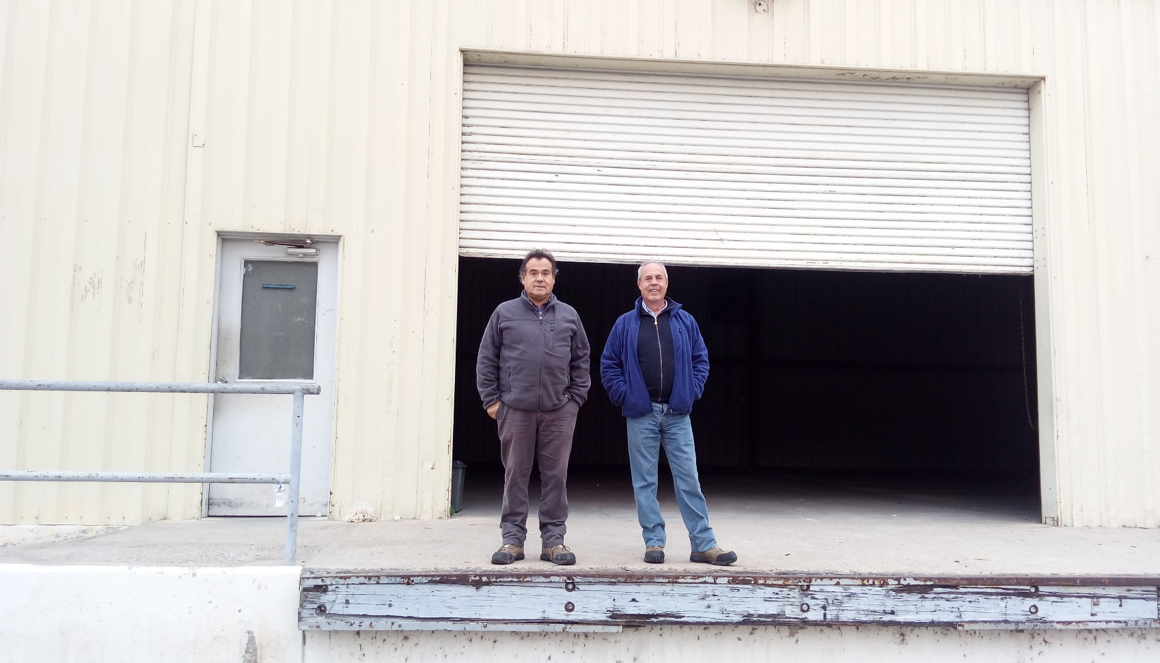
DEMOLITION AND REMOVAL OF WAREHOUSE
The partial removal was a necessary work to create space for the Base Facility and Data Center construction.

Slide 9
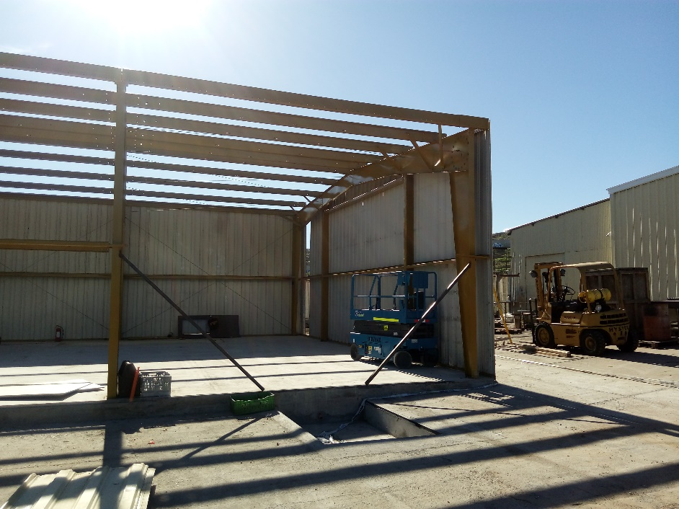
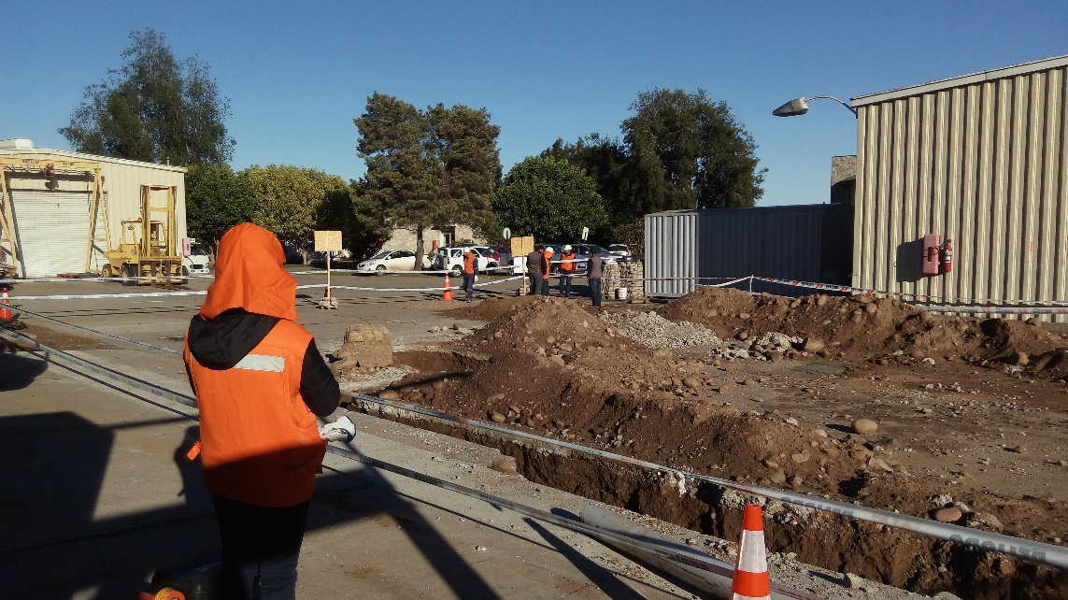
LOCATION FOR THE NEW WAREHOUSE SITE
Foundations and slab work to rearm the warehouse

Slide 10
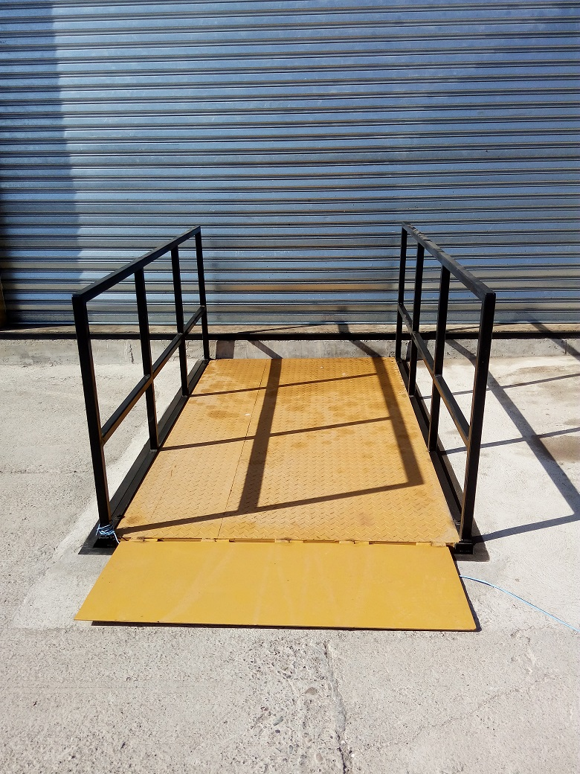
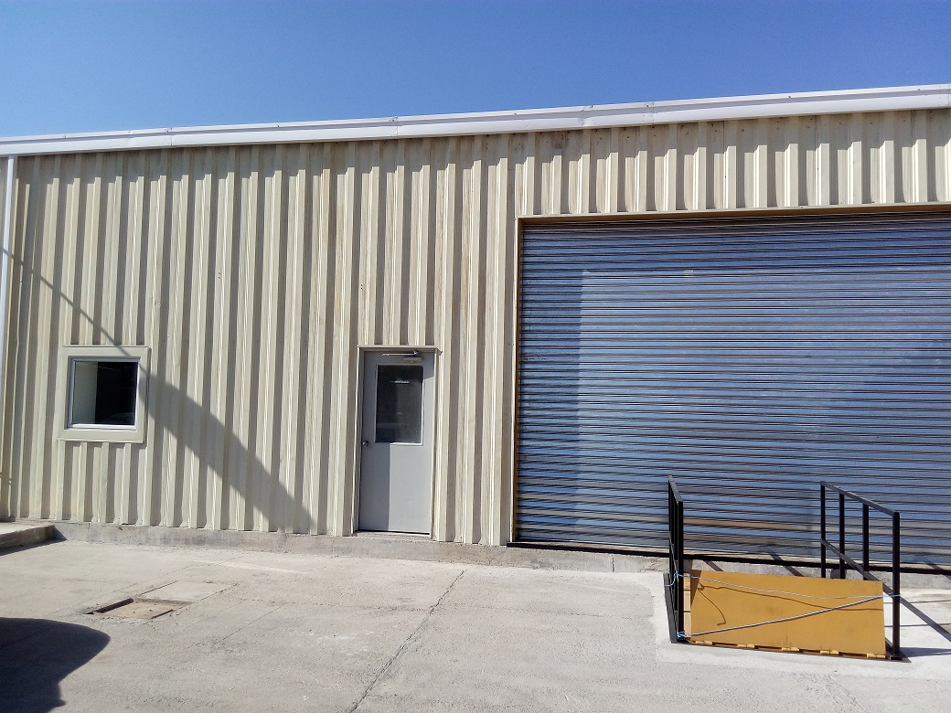
`
FRONT FACE Y DOCK LEVELER
Dock leveler :
.- 6000 lbs Capacity
.-Maximum height lift 1600 mm.
.-Measurements: 1500 x 2000 mm.

Slide 11
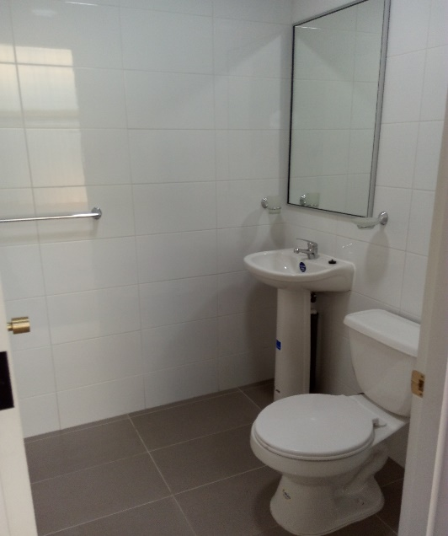
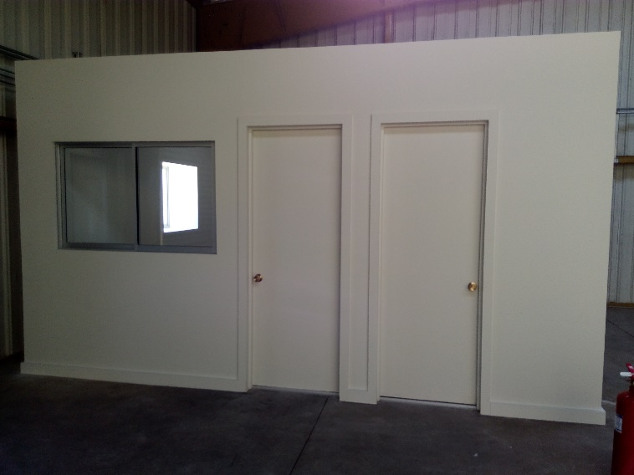
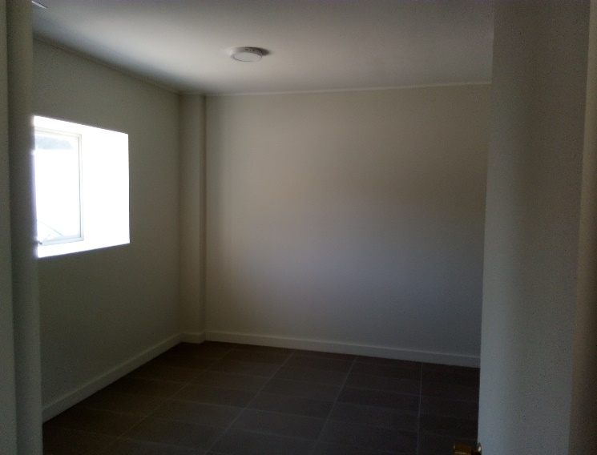
INSIDE NEW OFFICE AND WAREHOUSE RESTROOM
Along with the move to the Warehouse new location, office and restroom were remodeled.

Slide 12
EXCAVATION ROUTES FOR HALF VOLTAGE LINES AND LOW CURRENTS
The new Facility and Data Center installations require a new electrical connection that must be channeling with Half Voltage Lines and Low Currents until the new technical room.

Slide 13
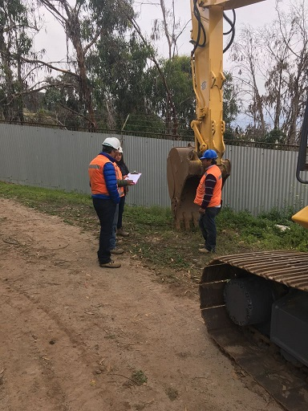
ROUTE AND EXCAVATIONS FOR HALF VOLTAGE LINES AND LOW CURRENTS OF NEW CONNECTION
Start of works:
September 1st, 2017 and still in progress.

Slide 14
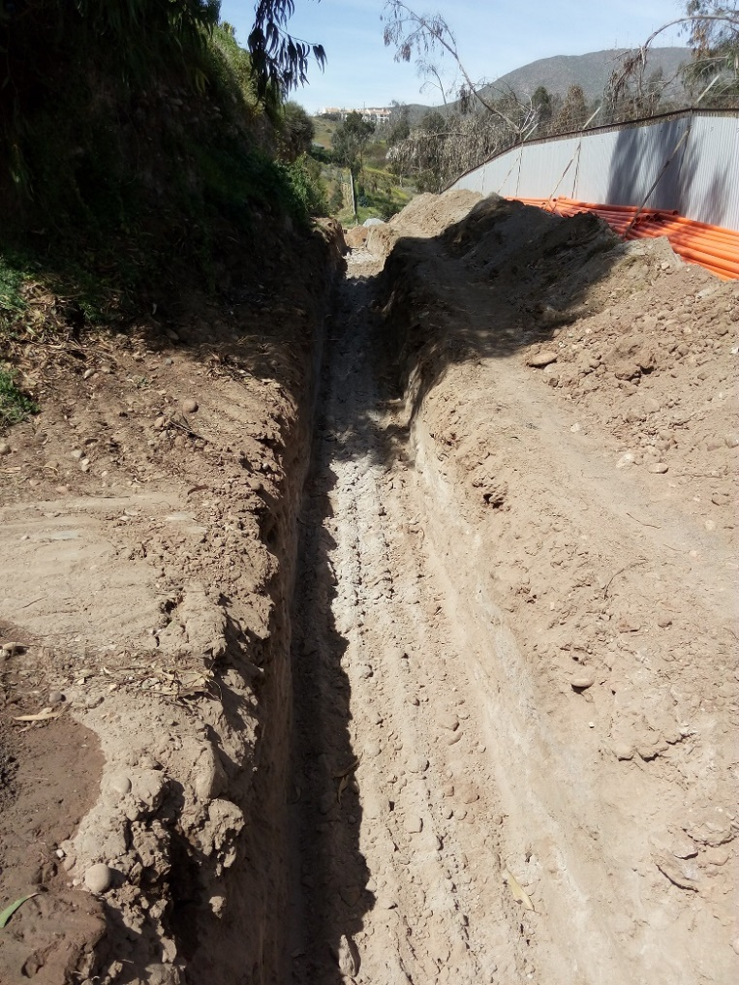
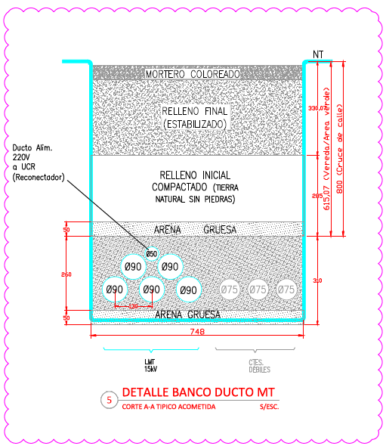
EXCAVATION ROUTE AND DUCT CONFIGURATIONS
Excavation routes for the channeling of Half Voltage ducts and Low Currents according to EE.TT.
Depth of Excavation:
650 mm in Green areas
800 mm. in cross streets.
Half Voltage Ducts
05 ducts of PVC
Schedule 80 Diameters .90 mm.
01 Duct of PVC schedule 40 Diameters. 50mm.
03 Ducts of PVC schedule 80 Diameters. 75 mm.

Slide 15
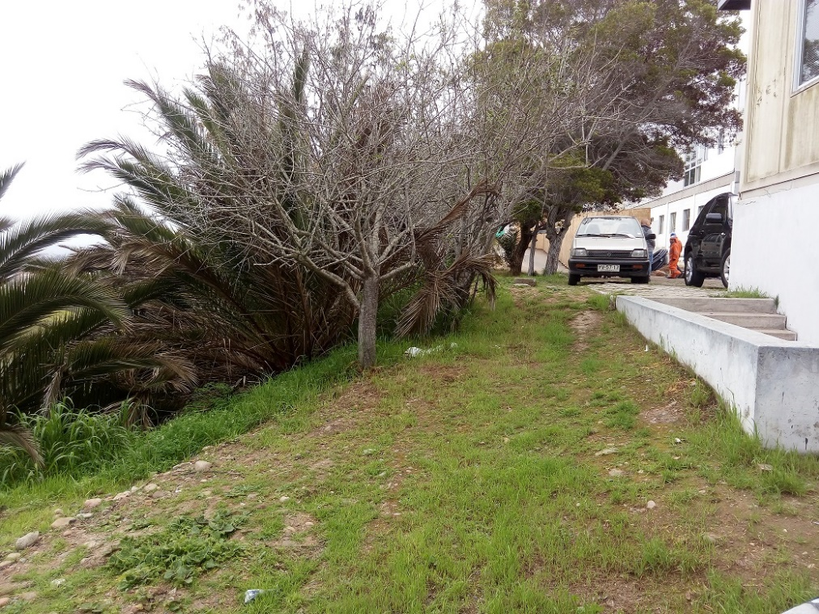
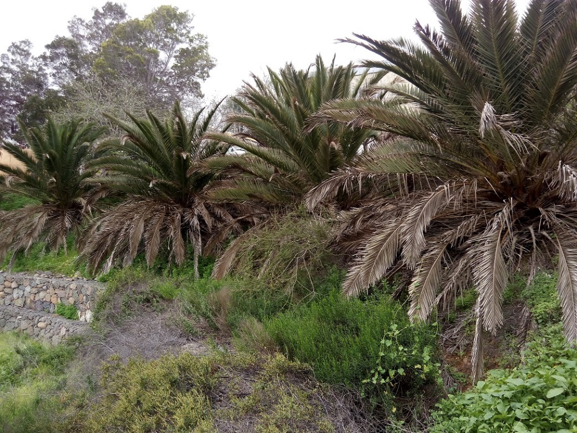
PREPARATION FOR TECHNICAL PLATFORM
It’s necessary to eradicate some Tree species and to relocate Palmeras.
.- 03 Aromos Tree
.- 04 Almend Tree
.- Remove and transplant 09 Palmeras in the hill

Slide 16
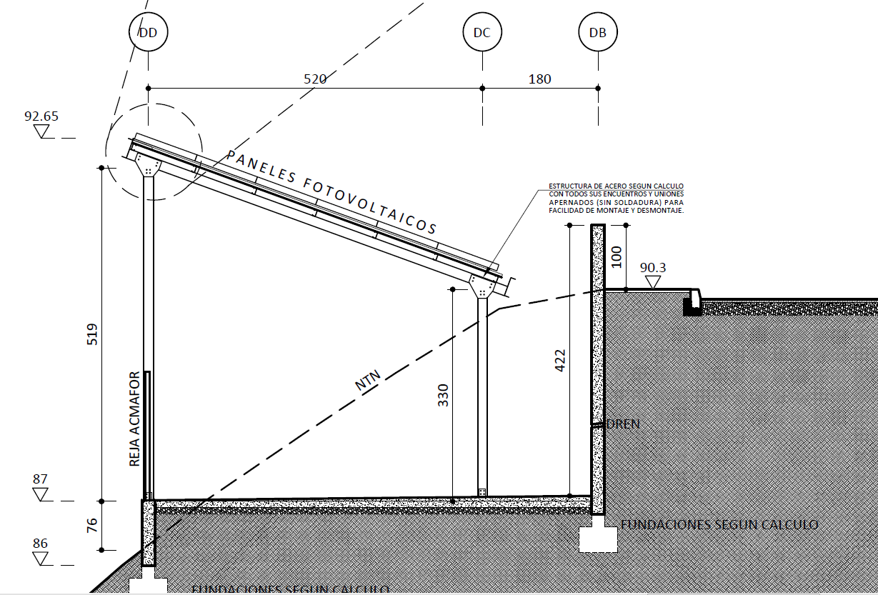
CUT AND DIMENTIONS OF TECHNICAL PLATFORM

Slide 17
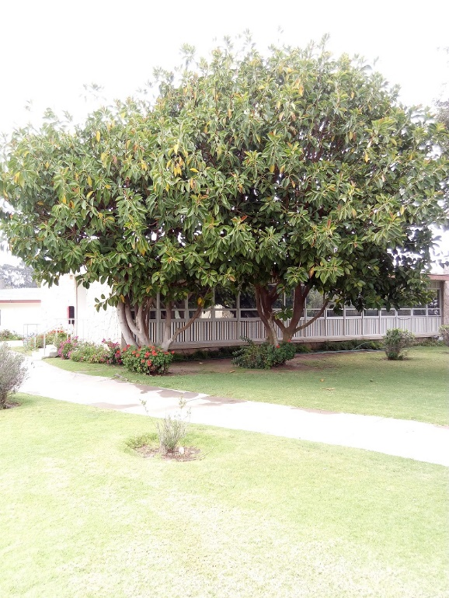
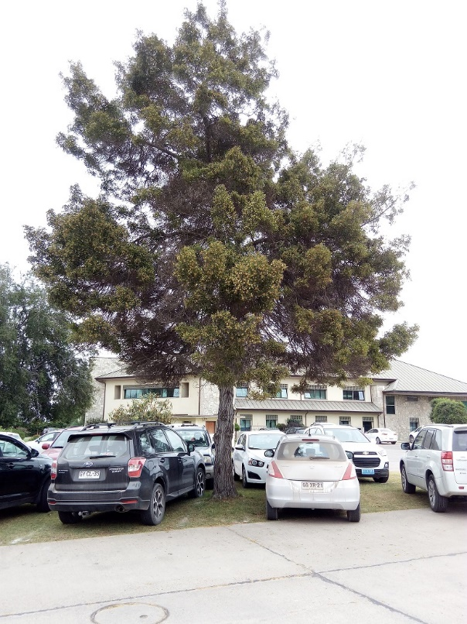
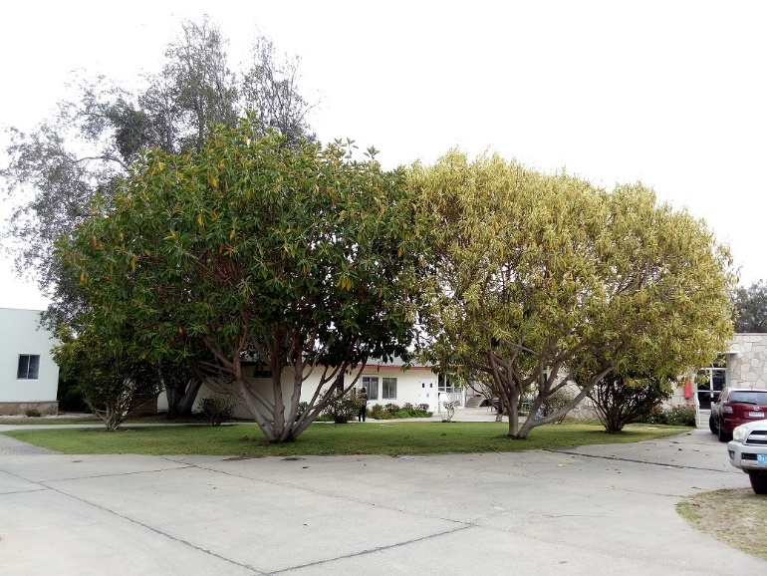
TREES MUST BE REMOVE

Slide 18
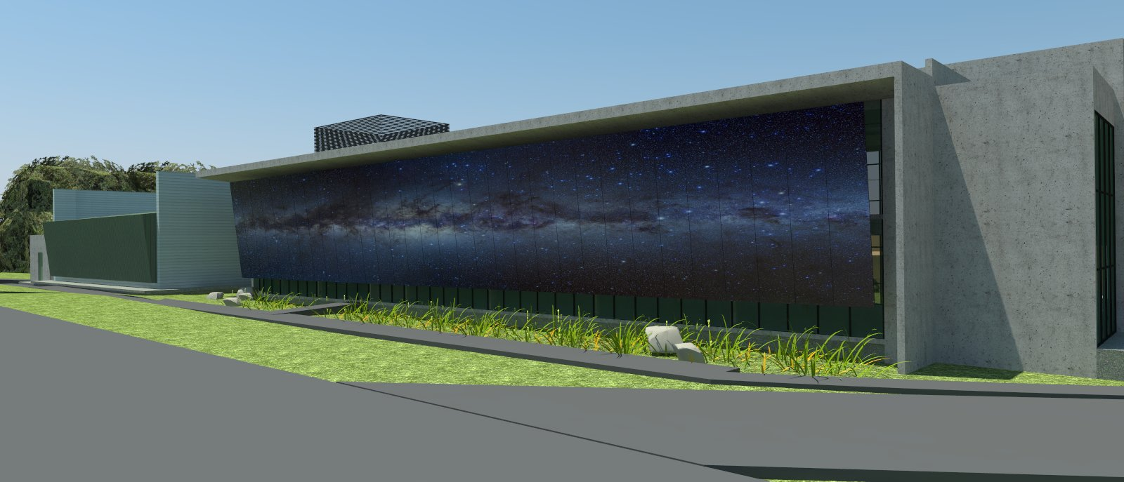
ALL THE INTERVENTION AND BOTHERS THAT WILL CAUSE CONSTRUCTION PROCESS WILL BE IN BENEFIT OF OBTAINING THIS RESULT.

